Slide 1

Report of the President 8:30-8:40 a.m.
CANS National Advisory Council
CANS National Advisory Committee (NAC) (Nov 13th 10-11:30 PST)
SAVE Campaign
Regional Presidents’ Meetings
November 12th 8-9 am PST
President’s Message to members
Leadership Academy
Board Orientation & Board Member Duties
NINR and other HHS problems: Advocacy vs. 501c(3) status
Governance for the Future*
Future orientation
Best practices of highly effective boards
More than a conference
Membership engagement (SIGs)
DEI
Policy and advocacy
Nominating Committee → Governance Committee
*Vernetta Walker consultation

Slide 2

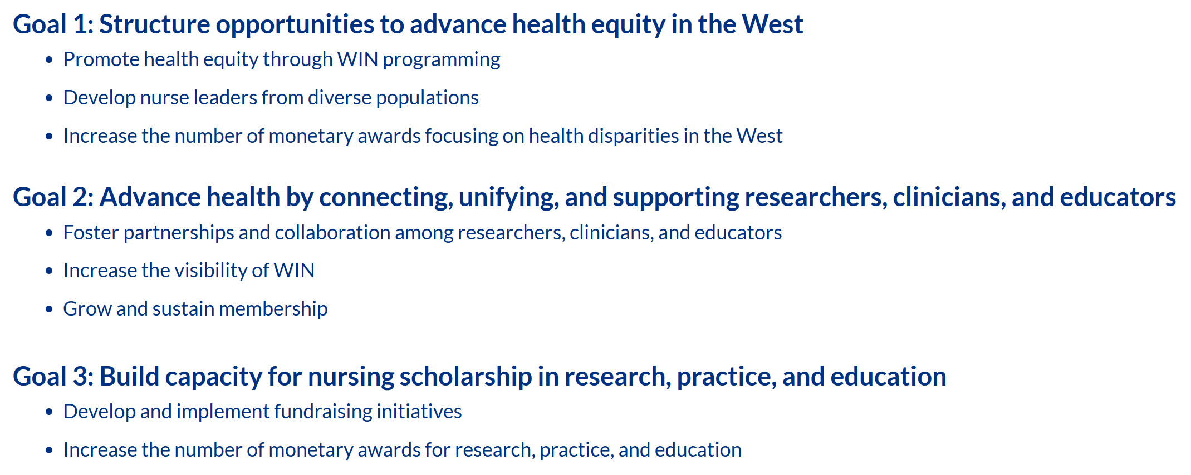
Accomplished
Conference
Pre-conference sessions that advance health equity
Abstracts of Distinction
Sustainability and Accessibility
Structure
Governance and Highly Effective Practices (Vernetta Walker)
Membership Assembly
Communication
Quarterly President’s Message
Growth
Mid-year WIN meeting
Leadership Academy
Practice Award
Policy
https://www.winursing.org/mission-vision-and-goals

Slide 3
Accomplished
Stabilizing: membership, conference attendance, finances
Thriving: governance for the future, Listening and Learning Together
Partnering: ENRS, SNRS, MNRS and CANS NAC participation
Growth
Strategic plan
Policy
National Collaboration
DEI framing
VISION that “all people [will] have the opportunity to achieve their best health and wellbeing.”
https://www.winursing.org/mission-vision-and-goals

Slide 4
Accomplished
Capital campaign
WAN fellowship
Growth
Practice Award
Leadership Academy
https://www.winursing.org/mission-vision-and-goals

Slide 5
Direction
Mid-year meeting
Quarterly President’s Message
Leadership Academy
Practice Award
Bylaws
Strategic Plan

Slide 6
