Slide 1
📌 Patient History:
A 51-year-old woman underwent contrast-enhanced chest CT for surveillance of small cell lung cancer.
🔍 Findings:
➡️ Axial CT: Left breast mass
➡️ Mammogram (CC & MLO views): Irregular mass confirmed
➡️ Targeted Ultrasound: Corresponding hypoechoic, irregular mass
➡️ Biopsy: Grade 1 invasive ductal carcinoma
🧠 Question for You:
What would you assign as the MOD (Method of Detection) in this case?
📸 Swipe to see images ➡️
💬 Drop your answer and rationale in the comments!
Let’s test your breast imaging knowledge. 🧠
#SocietyofBreastImaging #SBIWebinar #Radiology #MedicalEducation #BreastCancerAwareness #CaseChallenge

Slide 2
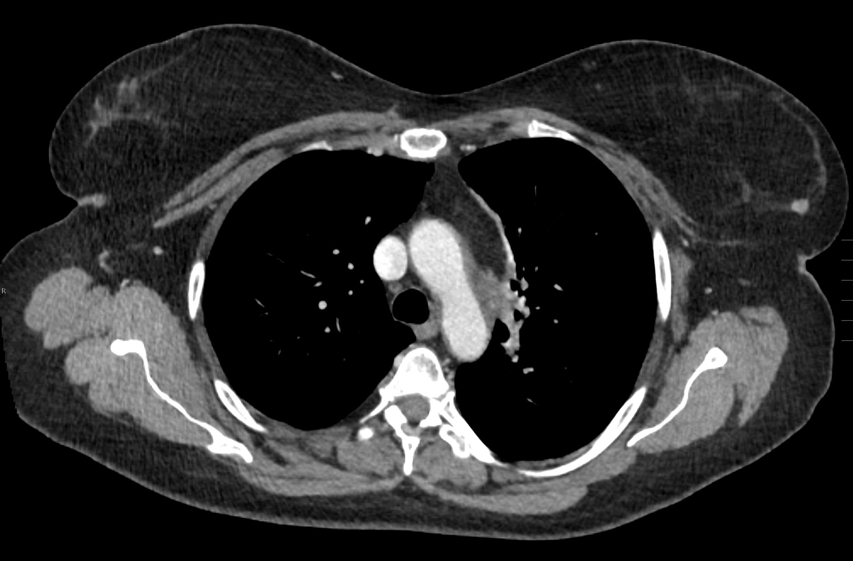
Courtesy of Dr. Manisha Bahl
Harvard Medical School
Massachusetts General Hospital

Slide 3
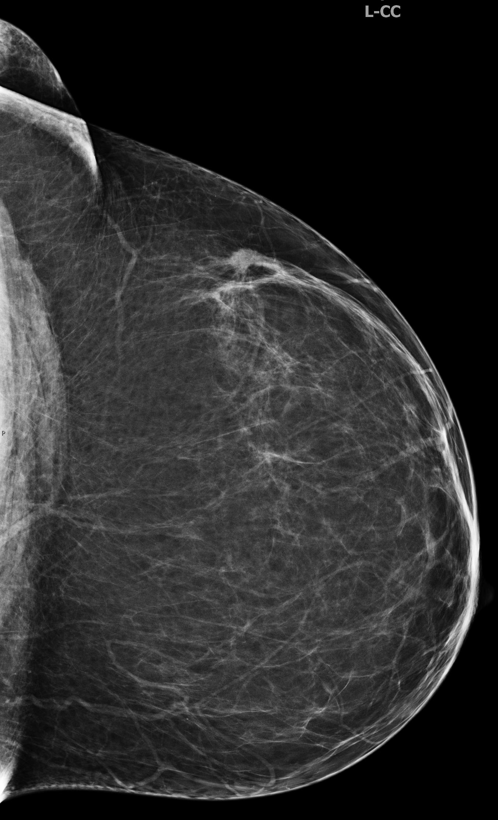
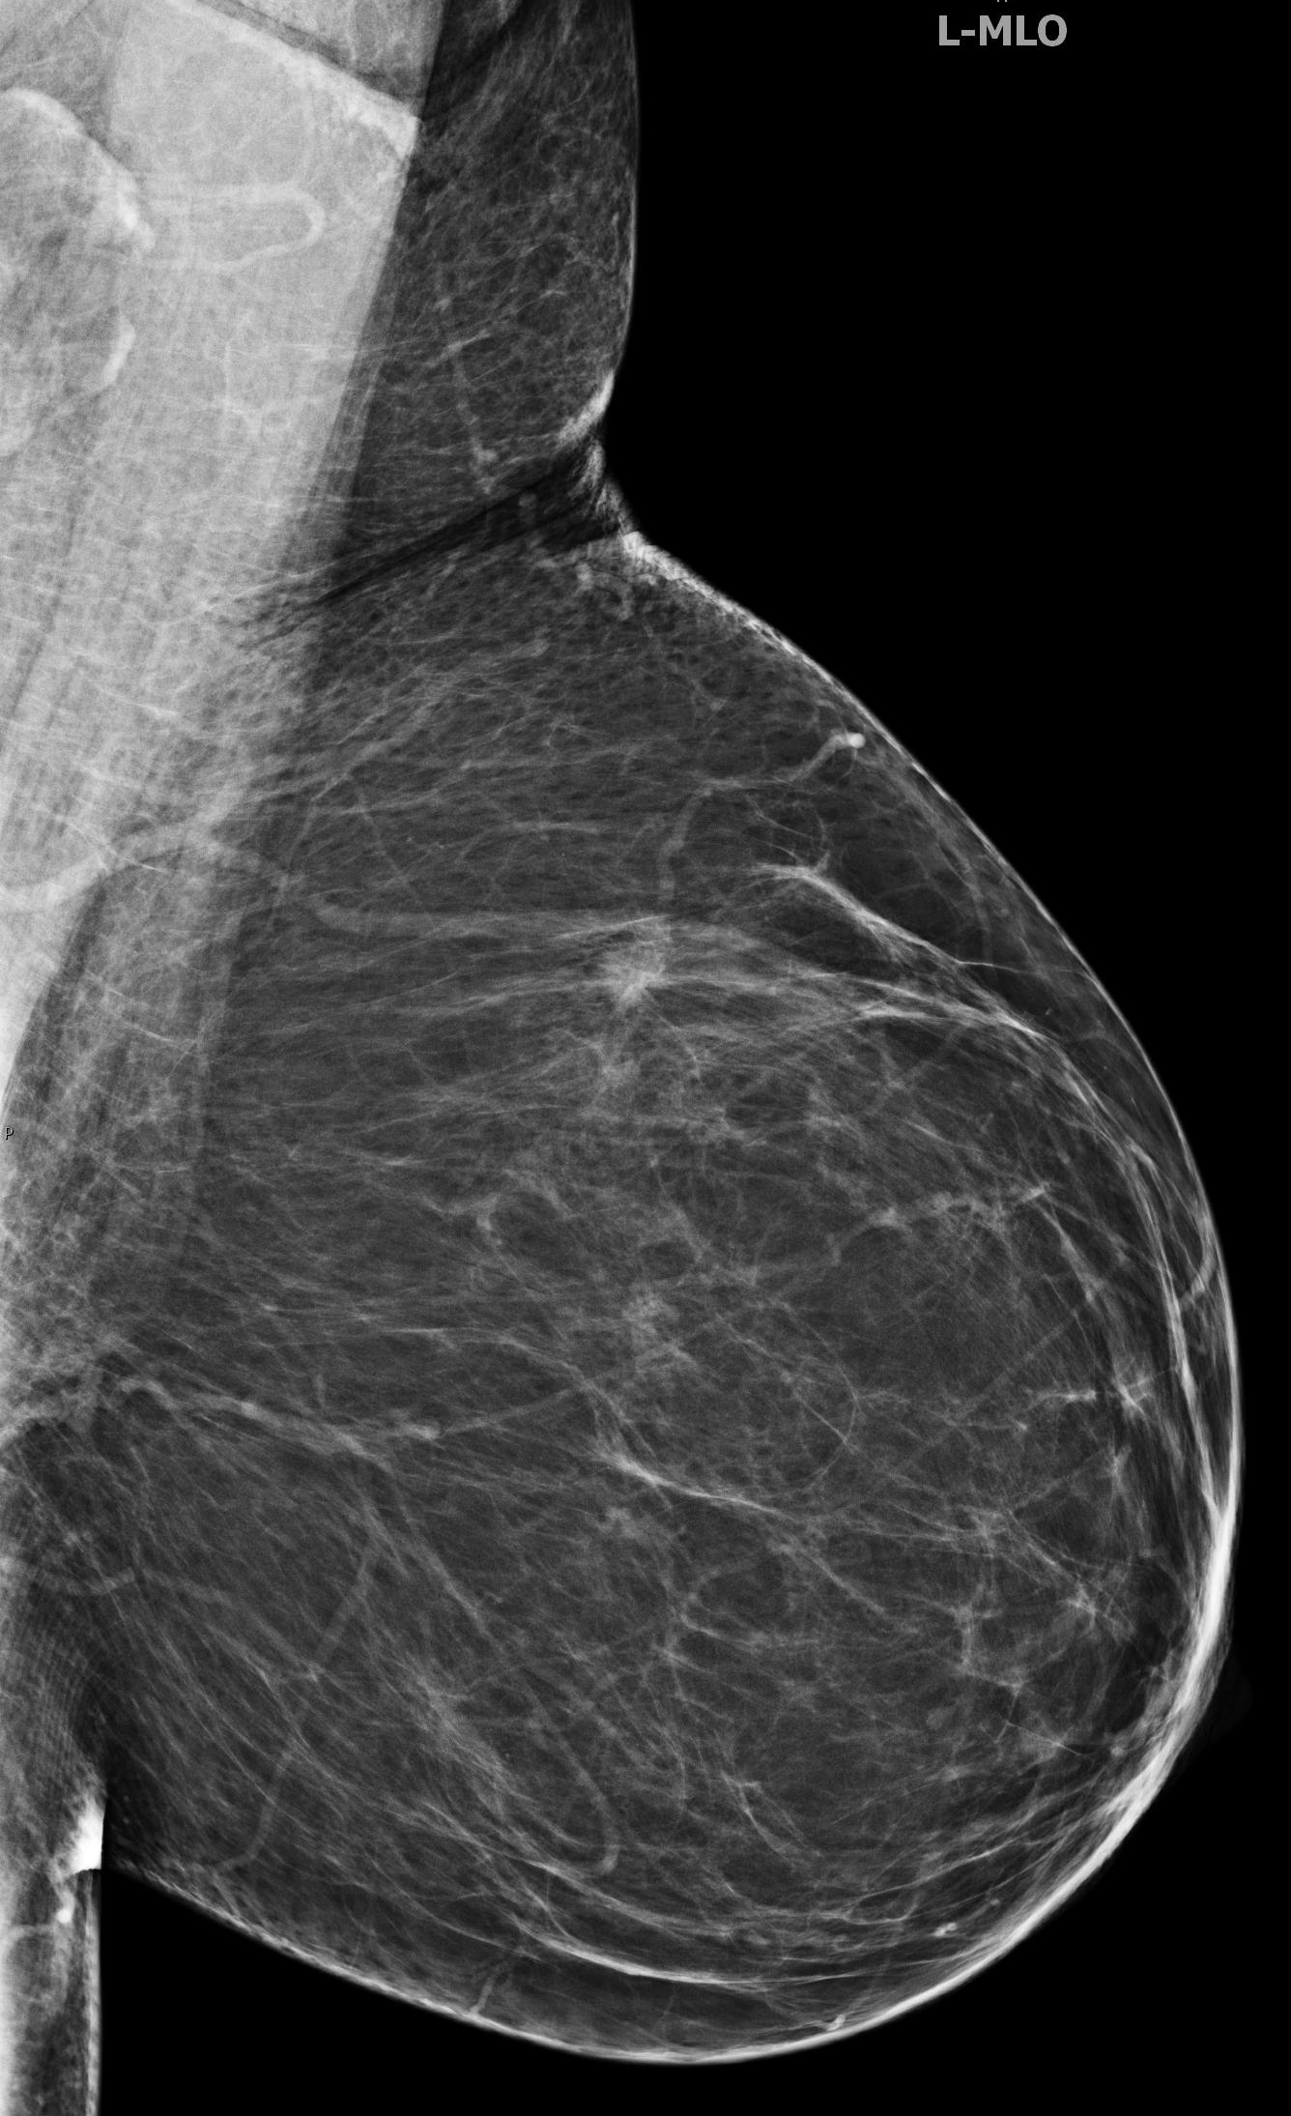
Courtesy of Dr. Manisha Bahl
Harvard Medical School
Massachusetts General Hospital

Slide 4
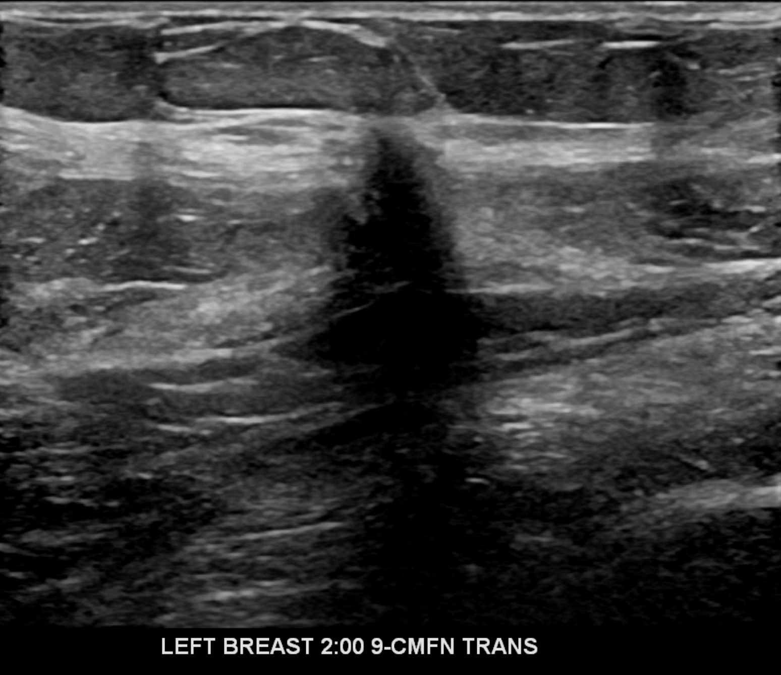
Courtesy of Dr. Manisha Bahl
Harvard Medical School
Massachusetts General Hospital

Slide 5
✅ Case Answer: Method of Detection (MOD)
N – Not Breast Imaging-Based Detection, Not Patient- or Provider-Detected
Thanks for participating in our breast imaging challenge! Here's the breakdown 👇
🧠 Correct MOD: 📍 Why?
The initial study that triggered further evaluation was a contrast-enhanced chest CT, not a screening breast imaging exam, and the mass was not detected by the patient or provider.
That makes this an incidentally detected mass on non-breast imaging, which falls under MOD category N.
💡 Key Learning Point:
Even if a breast abnormality is confirmed on follow up imaging, we classify the MOD based on the first imaging examination or clinical sign that triggered the workup leading to the breast cancer diagnosis.
#SocietyofBreastImaging #SBIWebinar #RadiologyEducation ##MOD #DiagnosticRadiology #ImagingCaseChallenge

