Slide 1
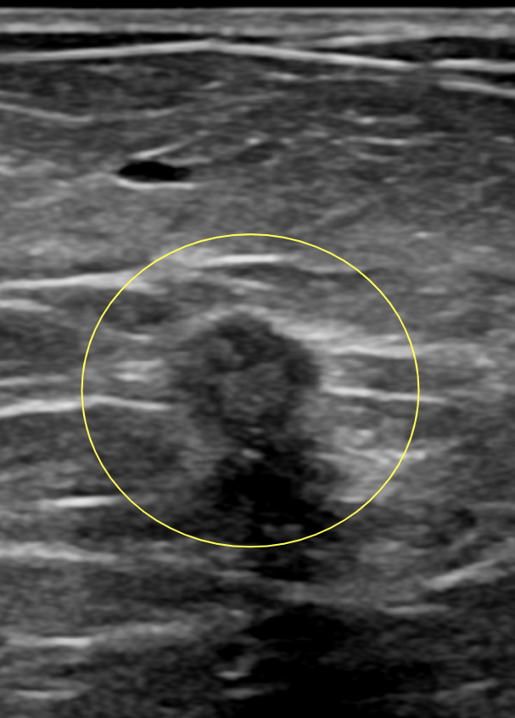


Freeze Frame: Would You Cryo This Breast Lesion?
64 year old woman presents with this ultrasound finding during diagnostic workup for palpable lump. Core needle biopsy reveals invasive ductal carcinoma, ER+/PR+/HER2-, Grade 1.
She is medically frail and wants to avoid surgery.
Based on this image and clinical scenario, is this patient a good candidate for cryoablation? Why or why not?
Comment your thoughts ⬇️ and we’ll post the expert rationale tomorrow.
#BreastImaging #Cryoablation #RadiologyEducation #SBI #SBIWebinarSeries
Courtesy of Dr. Robert C. Ward
Brown University
Rhode Island Medical Imaging

Slide 2
✅ You Got It! This patient is an ideal candidate for breast cancer cryoablation.
Here’s why:
📌 Key Features:
Unifocal IDC, <25% intraductal (no EIC)
ER/PR+, HER2–
Well visualized on ultrasound
Size <1.5 cm on MG, US, and MRI
0.5 cm from skin
0.3 cm from pectoralis
Clinically node-negative
❌ Not a surgical candidate due to comorbidities
📣 Stay tuned for more case challenges! #BreastImaging #Cryoablation #RadTwitter #SBIWebinars #FreezeFrame #CaseChallenge

