Slide 1
ChooseRestaurants.org

Slide 2
COA Training
Notes:
The online COA application streamlines the COA process, increases NRAEF’s capacity to award COAs and allows students to take responsibility for earning their COA.

Slide 3
Three Users of the COA system
Students
Teachers
Coordinators

Slide 4
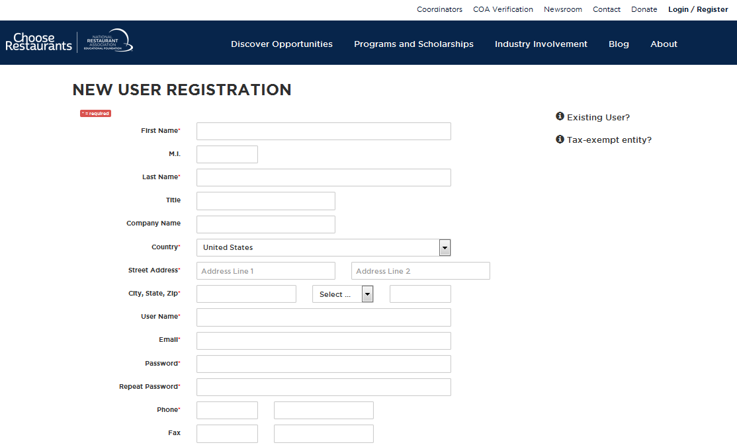
Students, Teachers and Coordinators all must register on the website.
Please stress importance of accurate information.
*Legal Name
Notes:
The COA Tracking and Approval website is broken into 3 sections: Coordinators, Educators, and Students. Coordinators, Educators and Students MUST register on the website. To begin, we will look at what a student must do to start their COA application.
The completed COA will be mailed to the address the students input during registration.
Register: Fill out the New User Registration Form by clicking “Register” in the top left corner of Nraef.org
Best Practice: Advise students to use their legal name and not a nickname (“driver’s license name”)

Slide 5
Students

Slide 6
Student Responsibilities
1. Register on the website
2. Track and enter hours and competencies
3. Give supporting documentation to teacher for review

Slide 7
Notes:
After students have passed an exam, they can go to “Track COA Progress” in the drop-down menu in the “Students” tab, where they can log in the “existing user” box.

Slide 8
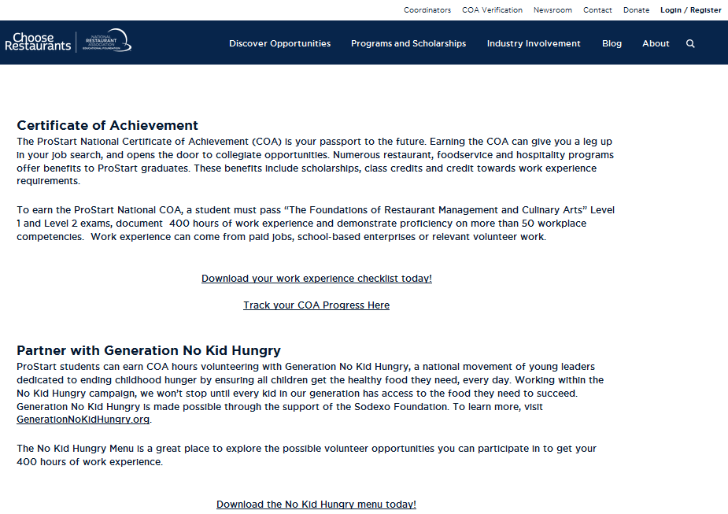
Notes:
Students will then log in using the login and password they created during registration.
Best Practice – Advise Educators to keep a copy of students’ user names and passwords in case a student forgets. Give each student an index card when registering. Instruct them to print their usernames and passwords –LEGIBLY- on the card and collect them.

Slide 9
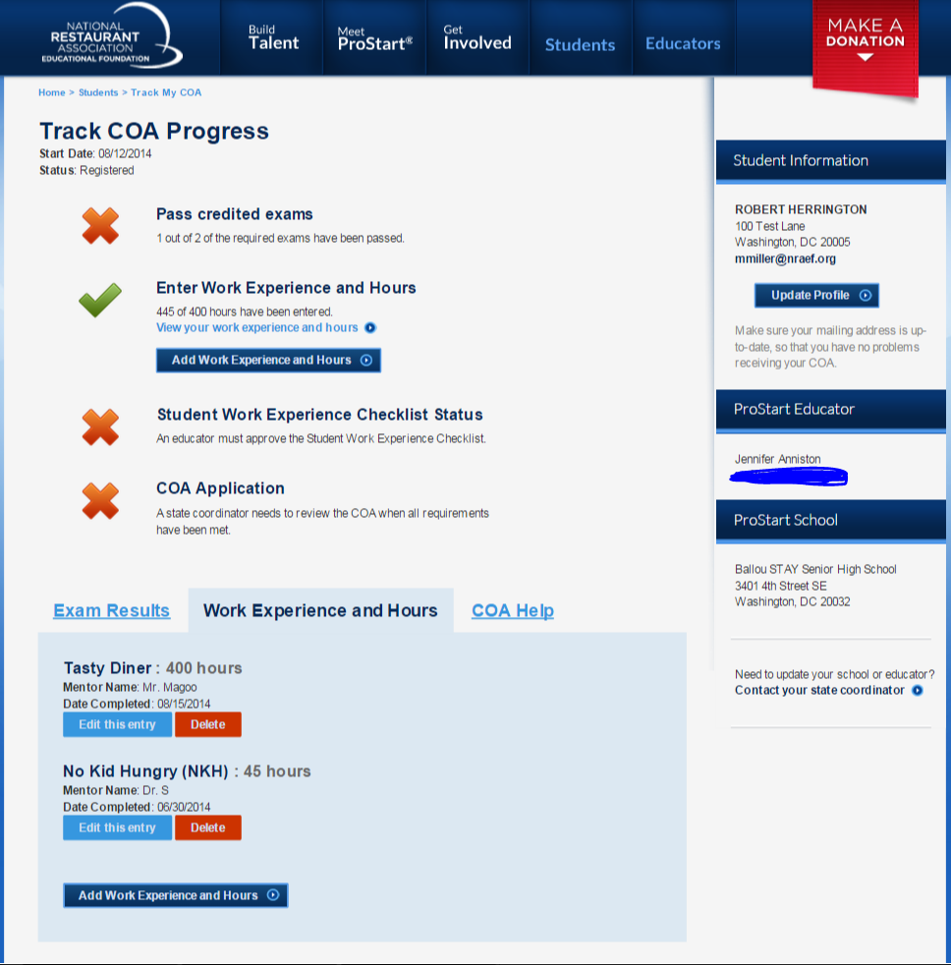
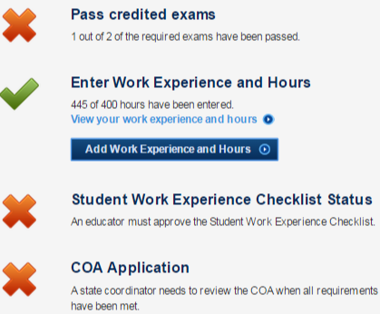
Notes:
Once logged in students will gain access to their personal “Track COA Progress” page. We can see a few key things above.
First: This student has passed 1/2 Exams. This is what starts the application and makes it possible for the student to begin logging hours.
Second: This student has logged and fulfilled the requirement for hours (400). Students may begin entering hours after passing their initial FRMCA Exam. At that time they may enter hours worked up to a year prior to the date the initial exam was processed
Third: This Student’s “Work Experience Checklist” has not been approved

Slide 10
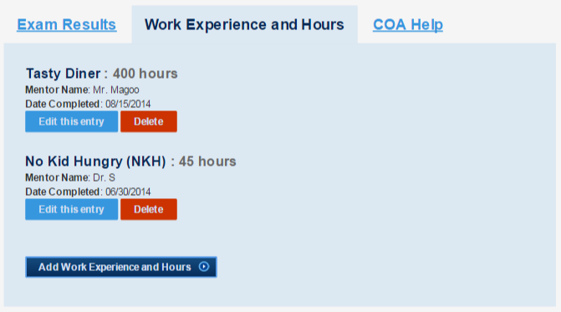
Work Experience Hours
Notes:
The way a student enters hours can be seen here.
Simply by pressing Add Work Experience and Hours and filling out the form the student can keep track of hours worked (Paid/Unpaid/Volunteer)
Students MUST still present documentation of hours worked to the educator. Documentation can be pay stubs, a letter (on letterhead) signed by the student’s supervisor or a signed volunteer form. Documents that do not show hours worked are not acceptable.

Slide 11
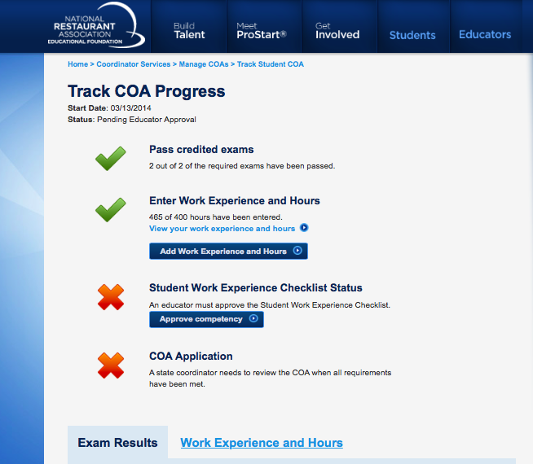
Notes:
At this point this student has completed all he/she can on the COA Application. The next step is to give the educator documentation of work hours and completed/signed “Student Work Experience Checklist(s)” that document proficiency in at least 52/75 competencies.
NOTE: This screenshot was taken from inside the Coordinator’s view. The “Approve Competency” button is NOT available to students, but only to Educators and Coordinators.

Slide 12
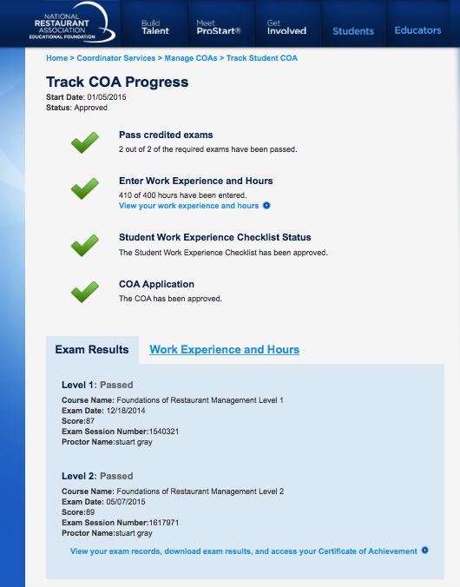
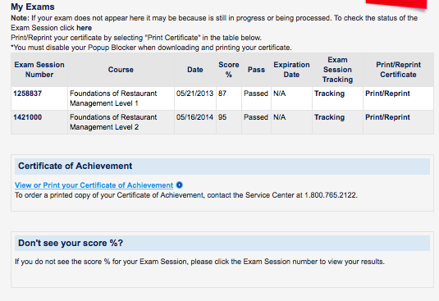
Accessing E-Certificate
Notes:
After the COA process has been completed, and the COA has been issued, the student may access an E-Certificate from within the student log in. A hard copy of the COA is also mailed to the address on file.
Note- E-Certificates are not viewable for COAs earned prior to the online system.

Slide 13
Most Common Problems: Student
Exam Record Merging / Multiple Profiles
This can happen when a student forgets their login credentials and creates another account. It can also happen if any information is different between Exam 1 and Exam 2 (i.e. Address)
To merge the records:
Email servicecenter@restaurant.org with student name and exam session numbers
Allow adequate time for the merge to occur
COA has been approved and issued, but E-Certificate won’t load
This is a technical error and the Service Center should be contacted.

Slide 14
Educators

Slide 15
Educator Responsibilities
1. Register on the website
2. Review student documentation of work hours and competencies
3. Send supporting documentation to Coordinator within agreed upon time frame
Note: Entering student hours not included!

Slide 16
Notes:
Educators
Please log in

Slide 17
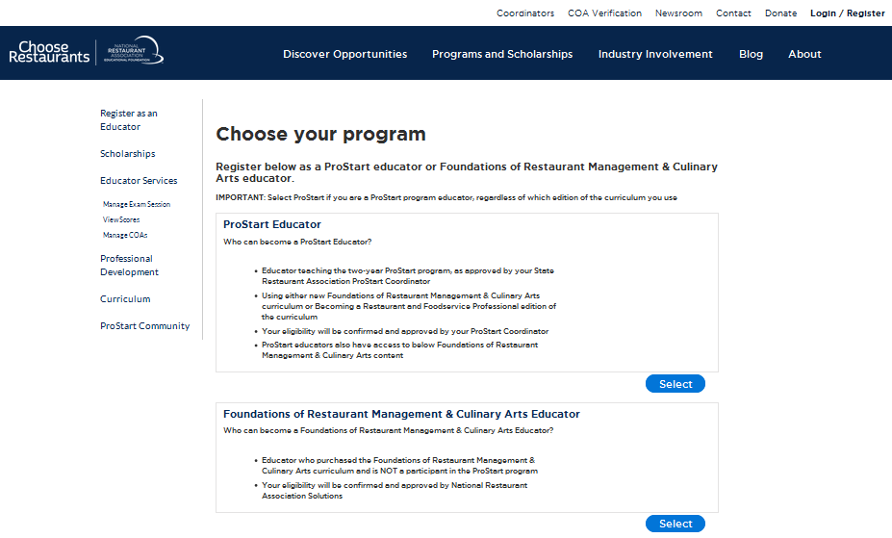

Slide 18
Notes:
Mouse over the educators tab then click educator services
Once in educator services click “Manage COAs”

Slide 19
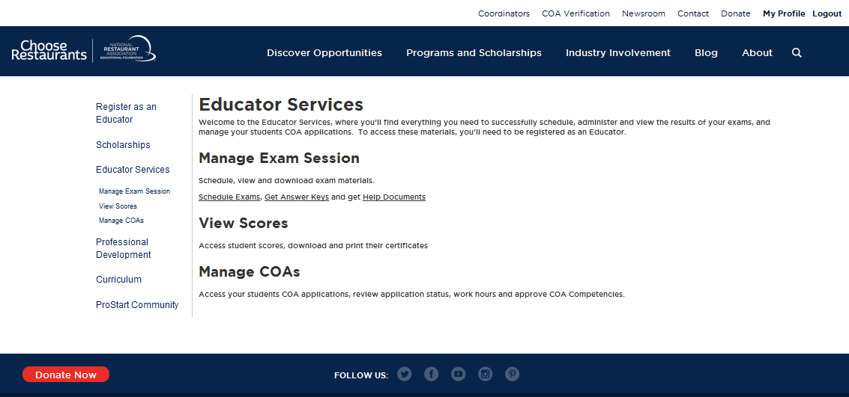

Slide 20
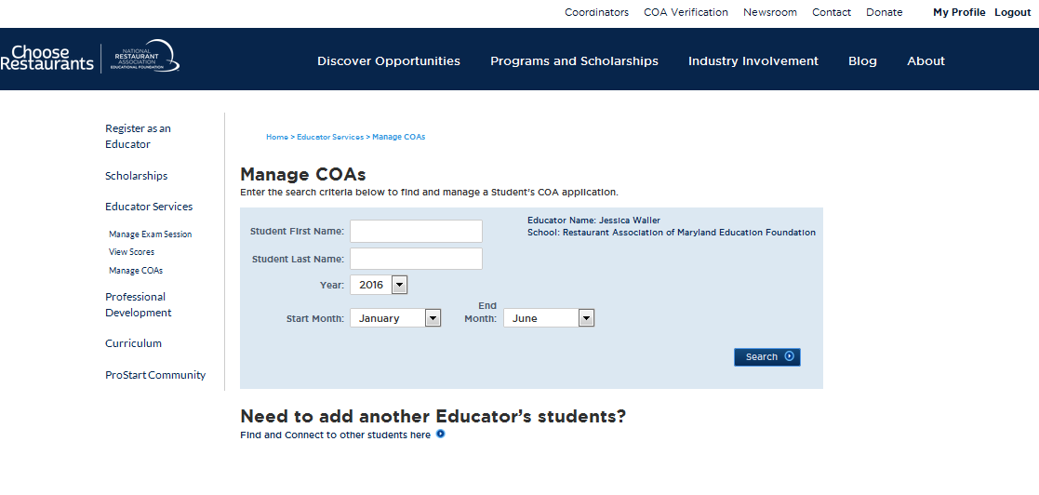
Notes:
This is what the “Manage COAs” page looks like. Please keep in mind the year and months are very important! Each of the search criteria can be used independently or used together to search for classes or specific students. For example if you entered Year: 2015 between January and June you would get all the students that have taken an exam in your class during that time.

Slide 21
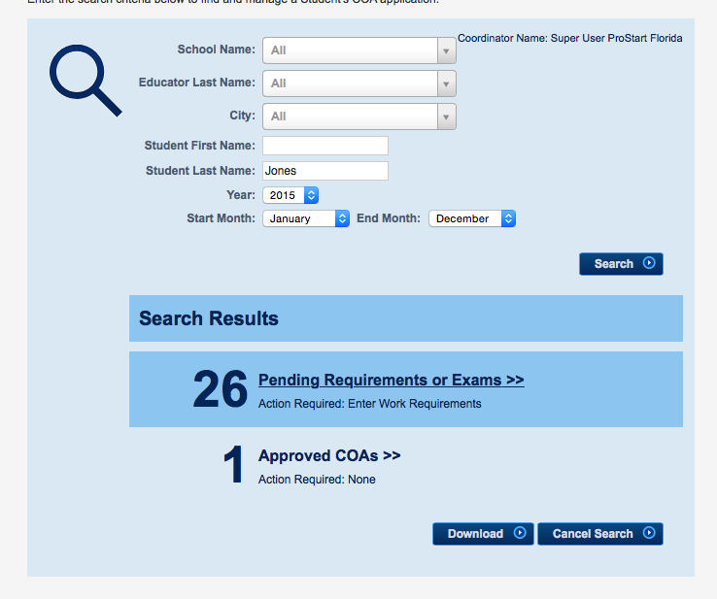
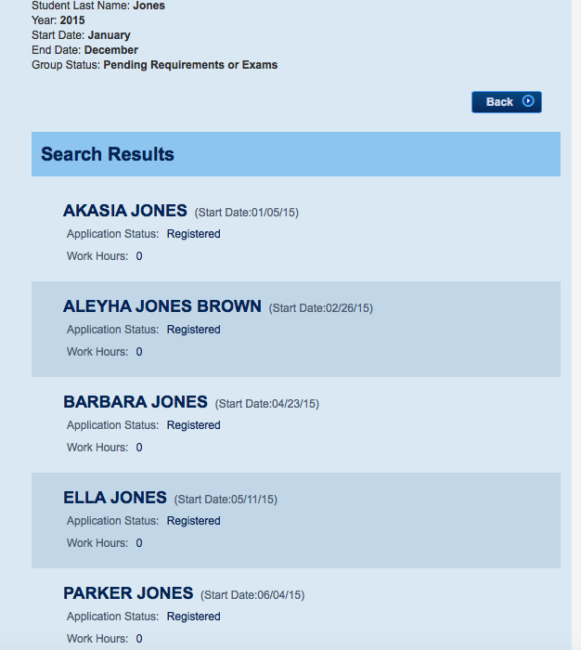
Notes:
To search for a student enter as much information as is known. Hovering over each section will create a link to click for additional results. Similarly, simply hover over the students name to create a link to view the individual page.

Slide 22
Notes:
The next step for an educator, once having found a student is to review their application. Once both tests are completed and 400 hours have been entered the educator has to review the application and review the competencies thus “approving” the “Student Work Experience Checklist” is approving the COA Application.

Slide 23
Student Work Experience Checklist
Notes:
Press Approve Competency….once you’ve reviewed the Student Work Experience Checklist and pressed “Approve Competency” the popup will appear verifying whether you want to approve “Ok” or not “Cancel”
Note: If the popup does not appear please make sure you do not have your popups blocked.

Slide 24
Notes:
Once there are 3 green checks on the student’s “Track COA Progress” page the educator portion of the application is complete.

Slide 25
Educator Sends Student Documents to State Coordinator for Final Approval
Notes:
How this happens varies by state.

Slide 26
Most Common Problems: Educators
1. Teacher receives an “Access Denied” message when trying to access COA applications
This likely means the teacher is registered as a Foundations instructor and not ProStart. The teacher should go to the “Register” page and request ProStart access. This will go to the Coordinator for approval. Further IT assistance will be necessary, so contact NRAEF for assistance.
2. The “Approve Competency” button does not appear even though the exams and hours are complete.
This is a technical error. The teacher should email Megan, who will contact NRAEF for assistance.

Slide 27
Questions?
Please send questions to Olivia Aberdeen oaberdeen@marylandrestaurants.com

