Slide 1


Understanding the Limits of Your CECL Calculation Through Sensitivity Analysis

Slide 2

Today’s Presenter
Justin Crawley
Senior Consultant at Abrigo: CECL Subject Matter Expert

Slide 3
Agenda
1
Sensitivity Analysis
Why? Who’s Asking?
2
Relevant Inputs
What am I testing?
3
The Mechanics
How do I perform a Sensitivity Analysis?
4
Documentation
What do my results mean?
5
Q&A
Thanks for coming!

Slide 4
Sensitivity Analysis
Why?
It’s important to understand the limits of what the CECL model is capable of.
How will changes in observations/expectations impact my reserve?
Is this different than Capital/Economic Stress Testing?
Why?

Slide 5


















Who’s Asking?
Examiners
Model Validators
Big 4 Accounting
Regional Accounting Firms

Slide 6
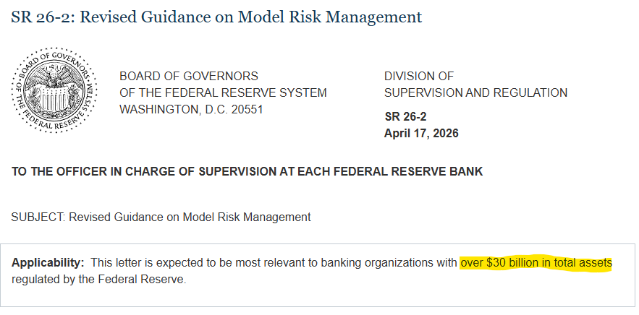
Current Events

Slide 7
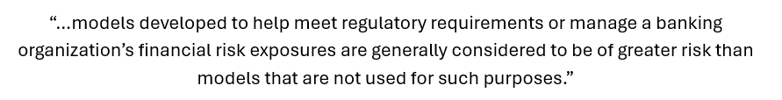

Current Events

Slide 8
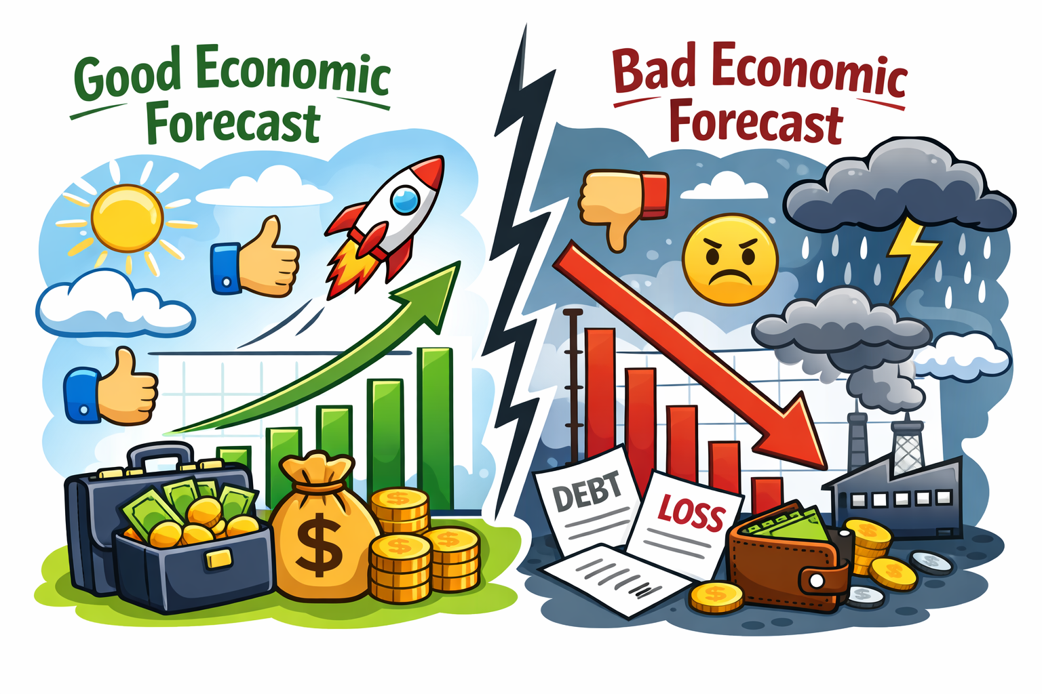
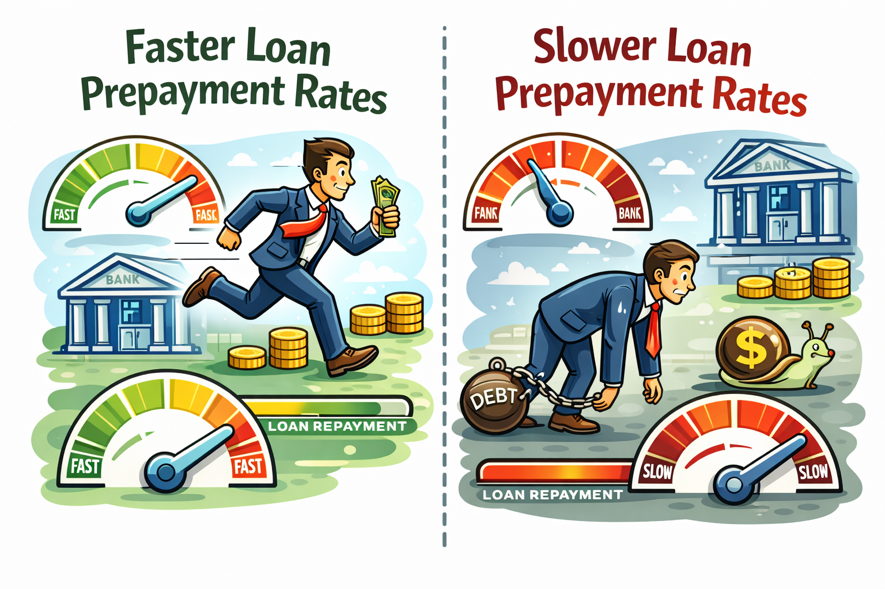
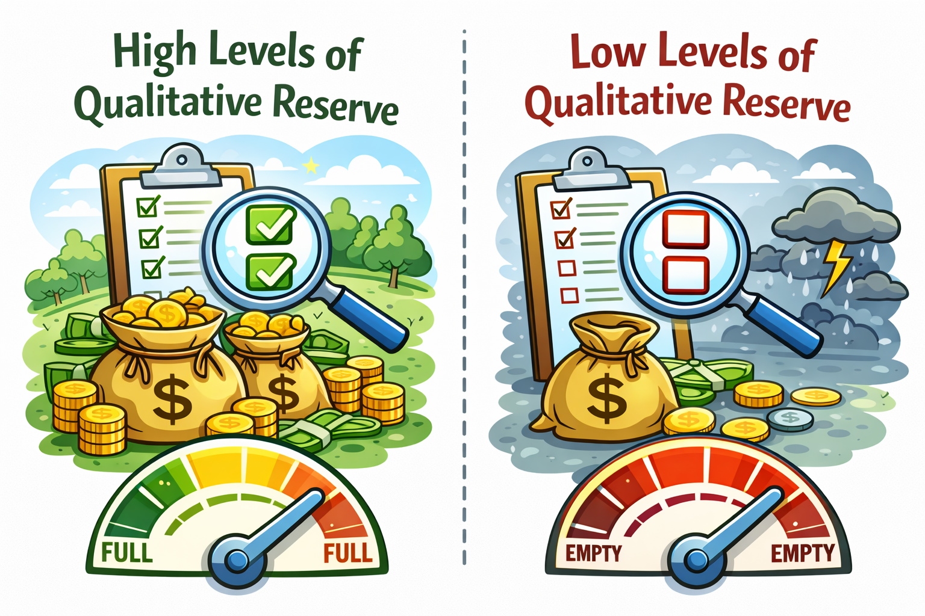
What Are We Testing?
Forecast Environment
Prepayment Rates
Qualitative Elections

Slide 9
Model Limits and Capabilities
What could I expect in my reserve during good economic conditions?
What about during bad?
How do changes in payment behaviors affect my calculation?
Add a footer title

Slide 10
What are Examiners Asking us?
Common Examiner and Audit findings:
No documented sensitivity analysis being performed
Testing is performed, but not interpreted
No management action tied to the results
No support for assumption ranges
Is this part of a broader risk management policy

Slide 11
Other Questions to Consider
How precise does CECL really NEED to be?
Putting the “E” in CECL
Sensitivity Analysis helps demonstrate “reasonable and supportable” outcomes
Small assumption changes should not create irrational reserve swings
Identifying whether volatility is operational noise or model instability

Slide 12
Other Questions to Consider
When does a result change matter?
Sensitivity Analysis helps us establish internal thresholds for “material” reserve changes
  5 bps enough to worry over?
  What about 25 bps?
Important to connect the answers to this question to our documentation language

Slide 13
Other Questions to Consider
What happens when multiple assumptions move together?
Real world conditions rarely move independently
Compounding effects often expose hidden model sensitivities
Another bridge between Sensitivity analysis and broader enterprise Stress Testing

Slide 14
Other Questions to Consider
Why do some portfolios react more aggressively than others?
Consumer vs Commercial Sensitivity
Longer duration portfolios react more strongly to forecast changes
Are the results consistent with our expectation for the pools?

Slide 15
Other Questions to Consider
Are Q-factors masking model weaknesses?
Are we over reliant on q-factors?
If so, then what is driving that?
  Segmentation problems
  Data quality issues
  Model Calibration concerns
  Methodology elections
Sensitivity analysis can reveal whether Q-factors dominate the reserve
Examiner focus on unsupported qualitative adjustments increasing

Slide 16
Other Questions to Consider
How do we explain reserve volatility to leadership?
Sensitivity Analysis gives us the framework to explain:
  Expected or unexpected volatility
  Acceptable ranges
  Worst-case assumptions
It allows us to visualize the drivers of reserves

Slide 17
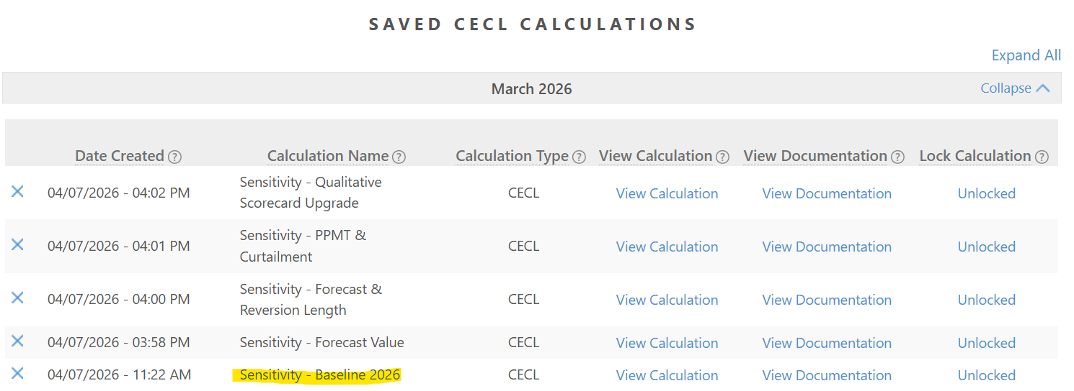
How Do We Do It?
The mechanics of a sensitivity analysis.
Identify a Baseline Calculation and make copies:

Slide 18
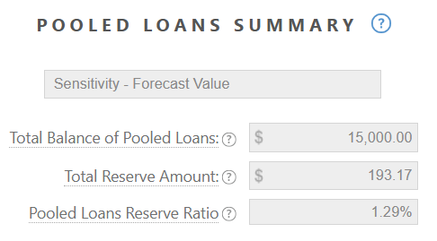
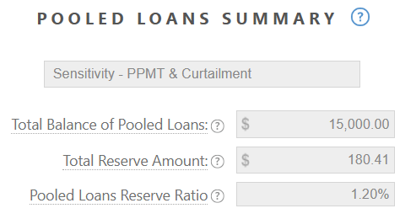
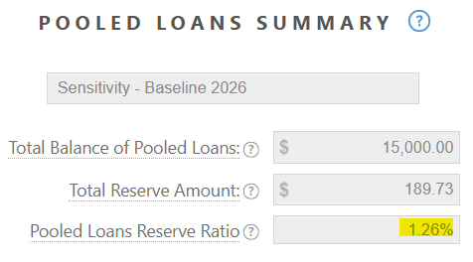
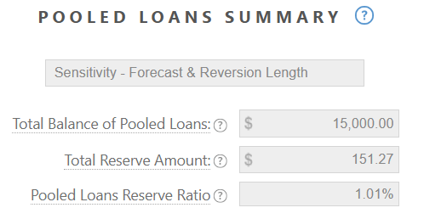
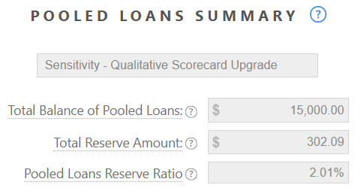
Sensitivity Analysis
The Results!!!

Slide 19
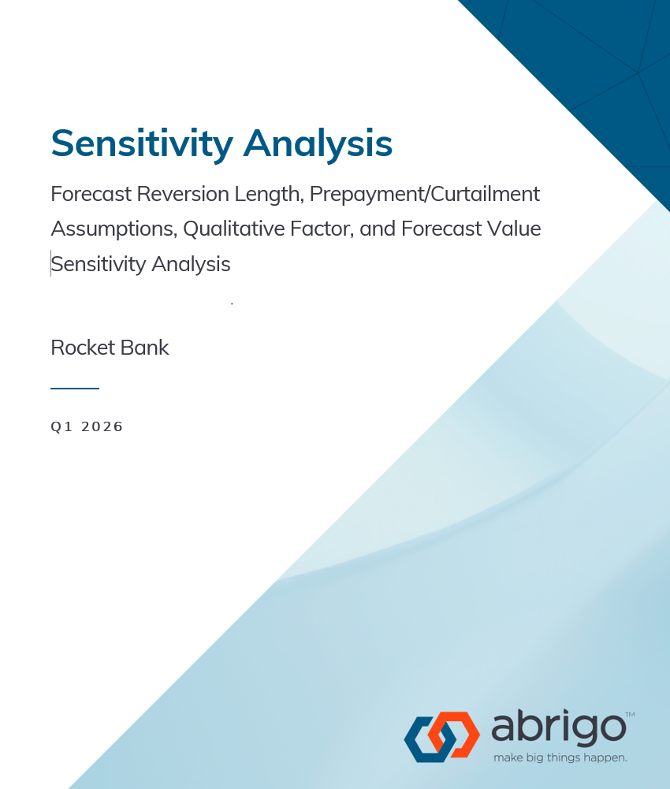
Sensitivity Analysis
Documentation
Document results at the portfolio level. Show comparisons.
Identify Segment-level discrepancies and notable observations.
Document baseline values in comparison to test values.
Are any areas overly sensitive, requiring model changes/updates?
Sensitivity Analysis should be considered part of a Model Risk Management Policy.

Slide 20
Sensitivity Analysis
Questions?

Slide 21
Thank you
Connect with the Abrigo team at Booth #6
justin.crawley@abrigo.com

