Slide 1
Basis Points Up for Grabs
June 30, 2026
Joe Kennerson | Managing Director | jkennerson@darlingconsulting.com
Billy Guthrie | Managing Director | wguthrie@darlingconsulting.com

Slide 2
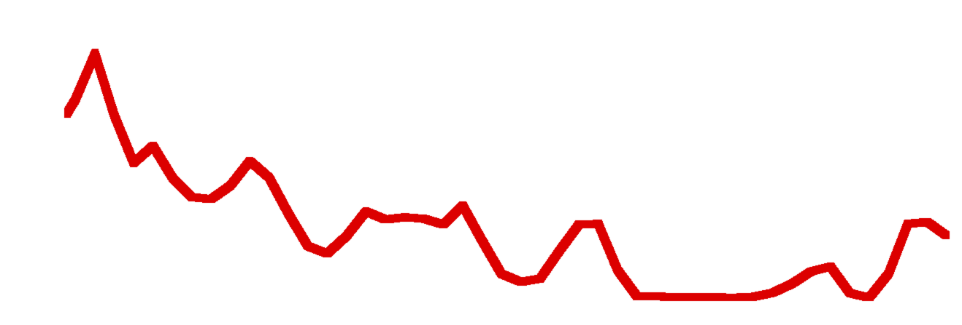
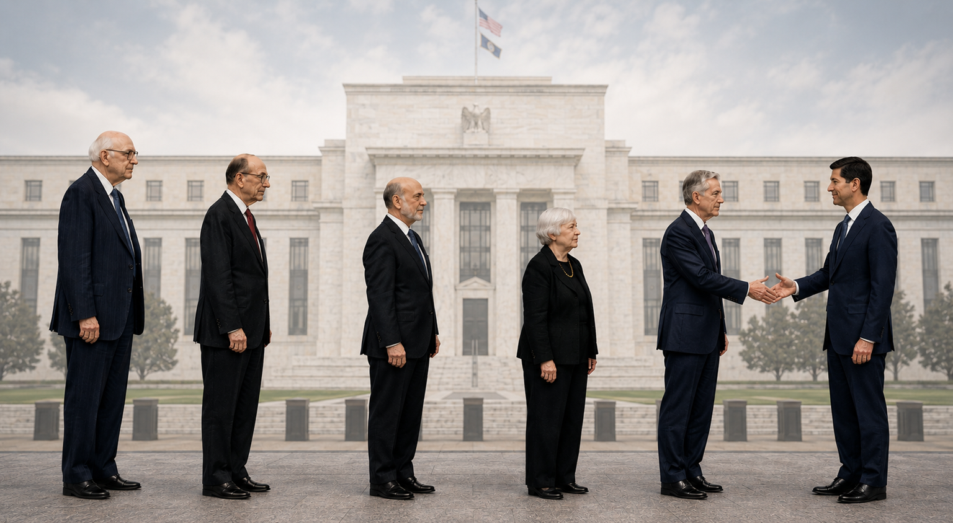
Fed Funds %
?

Slide 3
Three Areas of Focus for Today
1
2
3
DIVE DEEP
WINNING STRATEGIES
MINIMIZE
On CDs vs. MMDAs
In a Higher for Longer Environment
Competitive Influence

Slide 4
4 Steps Before Inviting Competition into the Conversation
1
2
3
4
Objective
Growth?
Cost Savings?
Liquidity
Position & Philosophy
Liquidity Outlook
Data
What’s It Telling Us?

Slide 5
Industry Trends Since Fed Started to Ease
Deposit Balances
↑ 5% Total
MMDA Balances
↑ 11%
Interest Checking
↑ 4%
Total Deposit Costs
↓ 41 bps
CD Balances
FLAT
Non-Interest Checking
FLAT
Source: Deposits360°®

Slide 6
Deposits Trends YTD (through May)
<1%
4 bps
Total Balances
Total Costs
Source: Deposits360°®

Slide 7
Deposits360°® Balance Forecast (Industry)
Forecasted 12-month balance change
Up 100bps 2%
Base 3%
Down 100bps 4%
Source: Deposits360°®

Slide 8
Deposits360°® Rate Forecast (Industry)
Forecasted 12-month balance change
Up 100bps +22bps
Base -1bps
Down 100bps -31bps
Source: Deposits360°®

Slide 9
CD Strategy
4 Considerations When Setting Rates

Slide 10
1. Separate Fact From Fiction
Fiction
Fact
CD Offering Rates
CD Average Rates
National Avg Rate
DCG Avg Opened
75th Percentile
6M Regular | 2.57%
6M Special | 3.66%
6M Regular | 3.46% | 3.59%
6M Special | 3.62% | 3.86%
Source: Deposits360°®

Slide 11
2. Understand Cost to Obtain vs Retain
3.55%
30bp
Obtain
Gap between retention vs. growth rate
3.25%
Retain

Slide 12
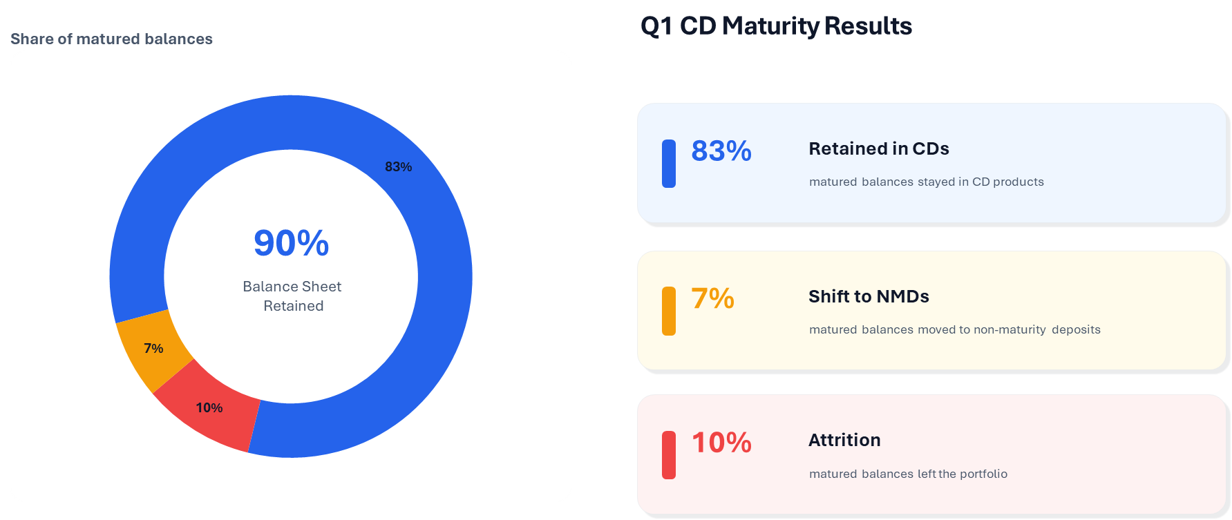
3. Understanding Rollover Activity
Share of Matured Balances
Q1 CD Maturity Results
Source: Deposits360°®

Slide 13
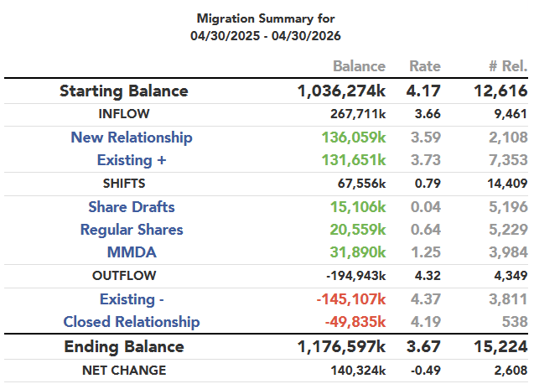
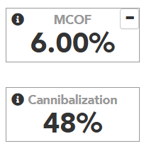

4. Answer the Question, “How Much Are My CDs Costing Us?”
Client Example
14%
YoY Growth
CD Offering Rates in the Top 25th percentile
Source: Deposits360°®

Slide 14
CD Strategy Thoughts
1
CDs Are Largely a Renewal Game, Act Accordingly
2
Don’t Chase Shoppers, CD Only Customers Are 3X More Likely to Leave
3
Rethink the CD Curve
4
Dust Off Rising Rate Playbook

Slide 15
Rethink CD Curve
Source: Deposits360°®

Slide 16
CD Book Remains the Shortest in History
Q1 CD Originations by Term
11%
65%
23%
1%
3 Month
6 Month
12 Month
18+ Month
Source: Deposits360°®

Slide 17
Can I Lower Rates Without Sacrificing Deposits?
Million Dollar Question

Slide 18
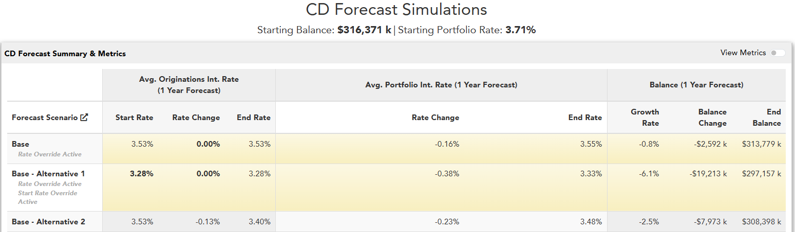
Can I Lower Rates Without Sacrificing Deposits?
What’s My Move?
Source: Deposits360°®

Slide 19
MMDA Strategy
3 Considerations When Setting Rates

Slide 20
1. Tiering Matters
Source: Deposits360°®

Slide 21
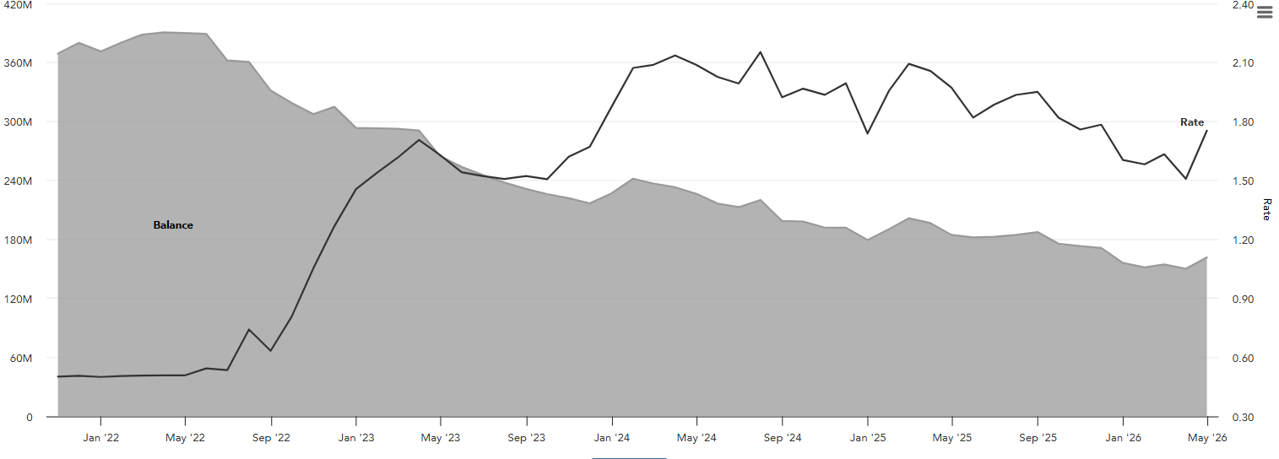
2. Understand Customer Flows
Case Study
Legacy MMDA Priced in “No Mans Land”
Legacy MMDA balances trending lower
Fearful of cannibalization on a new product

Slide 22
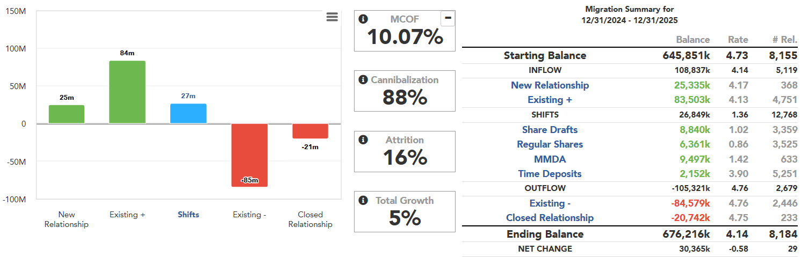
2. Understand Customer Flows
2025 CD Results
Case Study cont.
CDs were the only backstop

Slide 23
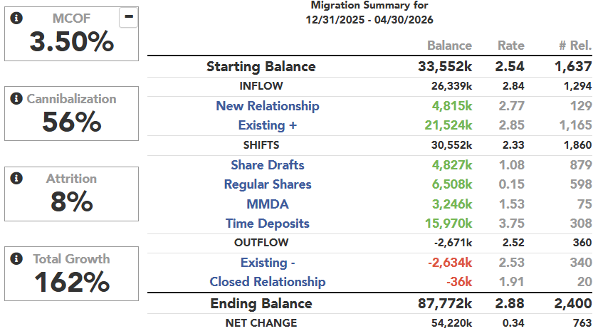
2. Understand Customer Flows
New HY Savings YTD
Case Study cont.
Launched HY Savings
Strong growth YTD
Driving CDs back to NMDs at a lower rate!

Slide 24
3. You Don’t Need to Be Priced as High as You Think
80bps
6%
Difference on 80th percentile MMDA rate vs 6M CD
Points more in balance
growth YoY vs. CDs
Source: Deposits360°®

Slide 25
MMDA Strategy Thoughts
1
Premium MMDAs Greatly Outperforming CDs
2
If Leaning on CDs or Exception Deals, May Have Tough Decisions Ahead
3
Tiering Is Critical
4
Expect Cannibalization, But You Need to Measure It

Slide 26
Two Case Studies

Slide 27
Case Study: Misaligned Tiers Driving Up Costs
Case Study #1
Higher Deposit Cost
Balanced Growth Outlook
Fearful of cannibalization on a new product

Slide 28
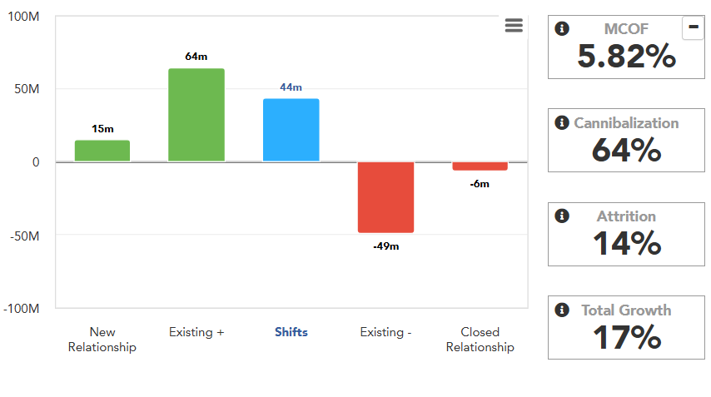
Tier Pricing Misalignment
High Yield MMDA:
Majority of Cannibalization from Smaller Tiers at Highest Spreads… What’s Next?

Slide 29
Tier Pricing Misalignment
High Yield MMDA:

Slide 30
Price Elasticity Matters

Slide 31
Case Study: Finding the Best Growth Path
Case Study #2
Attractive Premium MMDA
Competitive CD Special
What’s my sweet spot for each?

Slide 32
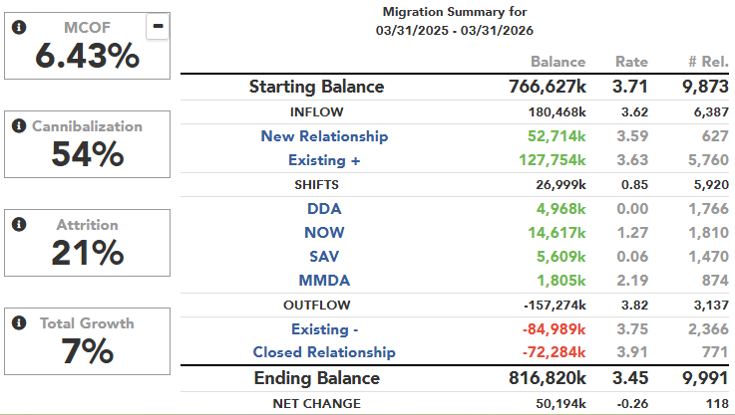
What Is Your CD Growth Costing You?
Client
Example
Source: Deposits360°®

Slide 33
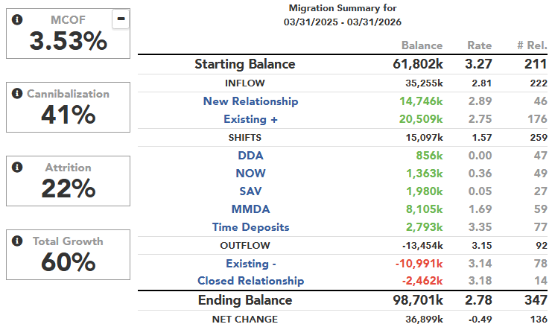
Same Bank, Premium MMDA Activity
Client
Example
Source: Deposits360°®

Slide 34
Understanding Cost of Cannibalization Saves Basis Points
True CD Cost
True MMDA Cost
Source: Deposits360°®

Slide 35
Today’s Takeaways
1
2
3
Don’t let competition drive your strategy
Understand the cost deposit promotions
Don’t wait on data analytics

Slide 36


Visit the Solutions Hub for an Inside Look at Deposits360°
Joe Kennerson
Billy Guthrie
Managing Director
Managing Director
jkennerson@darlingconsulting.com
wguthrie@darlingconsulting.com
603-408-5852
978-463-0400
www.linkedin.com/in/joekennerson/
www.linkedin.com/in/billy-guthrie-dcg/

