Slide 1
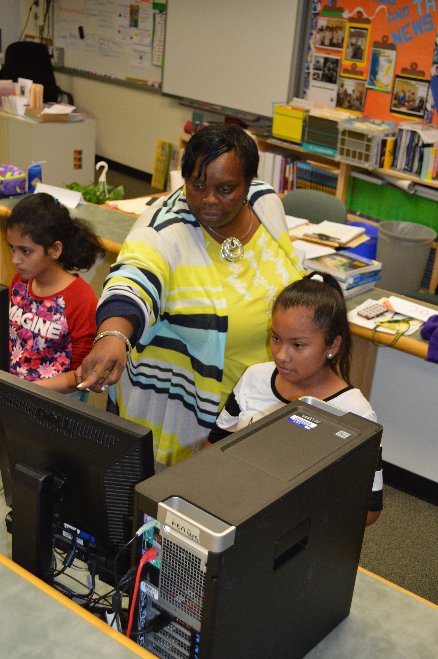
Presenter Information
Use the following presentation to promote your technology and engineering education programs.
Use as much or as little as you need.
Add information that may be specific to your school division or courses you teach.
If you have any questions or comments, contact jmoye@iteea.org.
Start presentation with next slide.
Notes:
NOTE FOR PRESENTER: This slide is for your information only, do not use it in your presentation. Start presentation with the title slide (next slide).

Slide 2
Technology and Engineering Education: A Valuable Resource
Notes:
Good morning/afternoon, my name is ____, I am a ______(teacher/administrator, etc.) and I would like to present you with some valuable information concerning technology and engineering education courses and programs. NOTE TO PRESENTER: You could mention whether or not you currently have technology and engineering programs in your schools. If you do, during the presentation, you could provide some specific examples of how your technology and engineering students benefit from those courses. If you do not currently have technology and engineering programs, you could modify this presentation to encourage leaders to adopt those courses into your elementary, middle, and/or high schools.

Slide 3
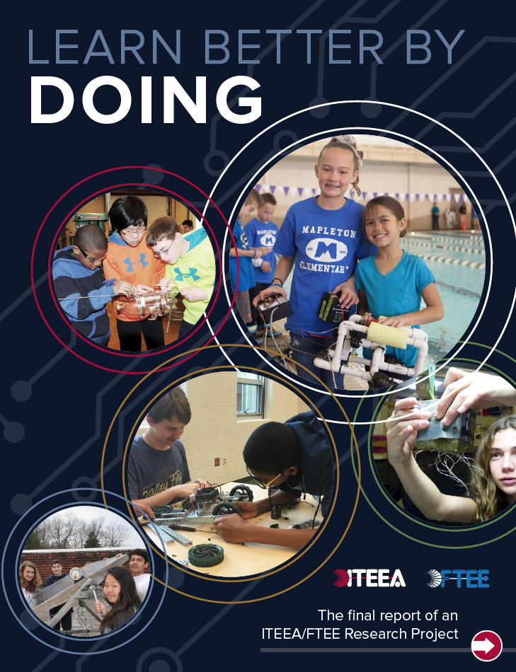
Purpose and Goal of Presentation
Purpose: To identify the benefits of technology and engineering education programs.
Goal: For education leaders to understand the value of their existing and possibly underutilized programs.
Notes:
The purpose of this presentation is to identify the benefits of technology and engineering courses and programs.

Slide 4
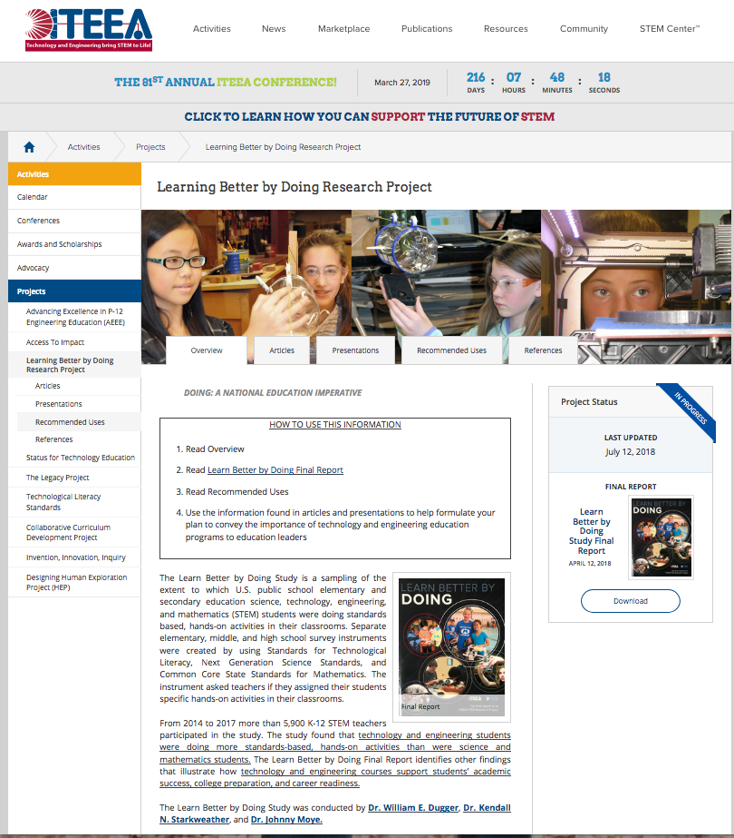
LBbD Study Information Online
ITEEA – LBbD Webpages
Learn about and promote the benefits of Technology and Engineering Education programs
Notes:
Before we get started with the content of this presentation, I would like to identify that ITEEA has web pages devoted to the Learn Better by Doing Study and benefits of technology and engineering education courses and programs.

Slide 5
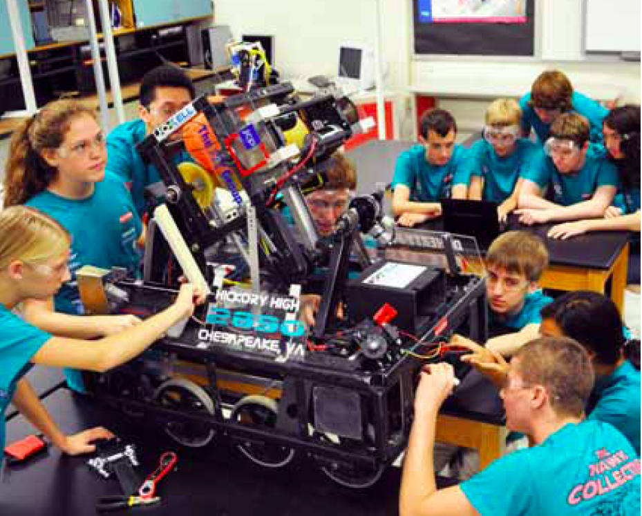
What to Expect
Educational Reform – TEE Involvement
LBbD results – Literature – Support TEE
Study and literature show benefits of technology and engineering
Notes:
We will quickly look at some points identifying that the United States is in the midst of education reform. TEE must be involved with this reform.
We will look at some of the LBbD Study results identifying and discussing the implications and benefits of TEE – based on those results. We will look at documentation supporting the benefits of TEE and how TEE programs should be part of any educational reform.
Lastly, we will see how this information illustrates the importance of technology and engineering programs as a valuable resource.

Slide 6
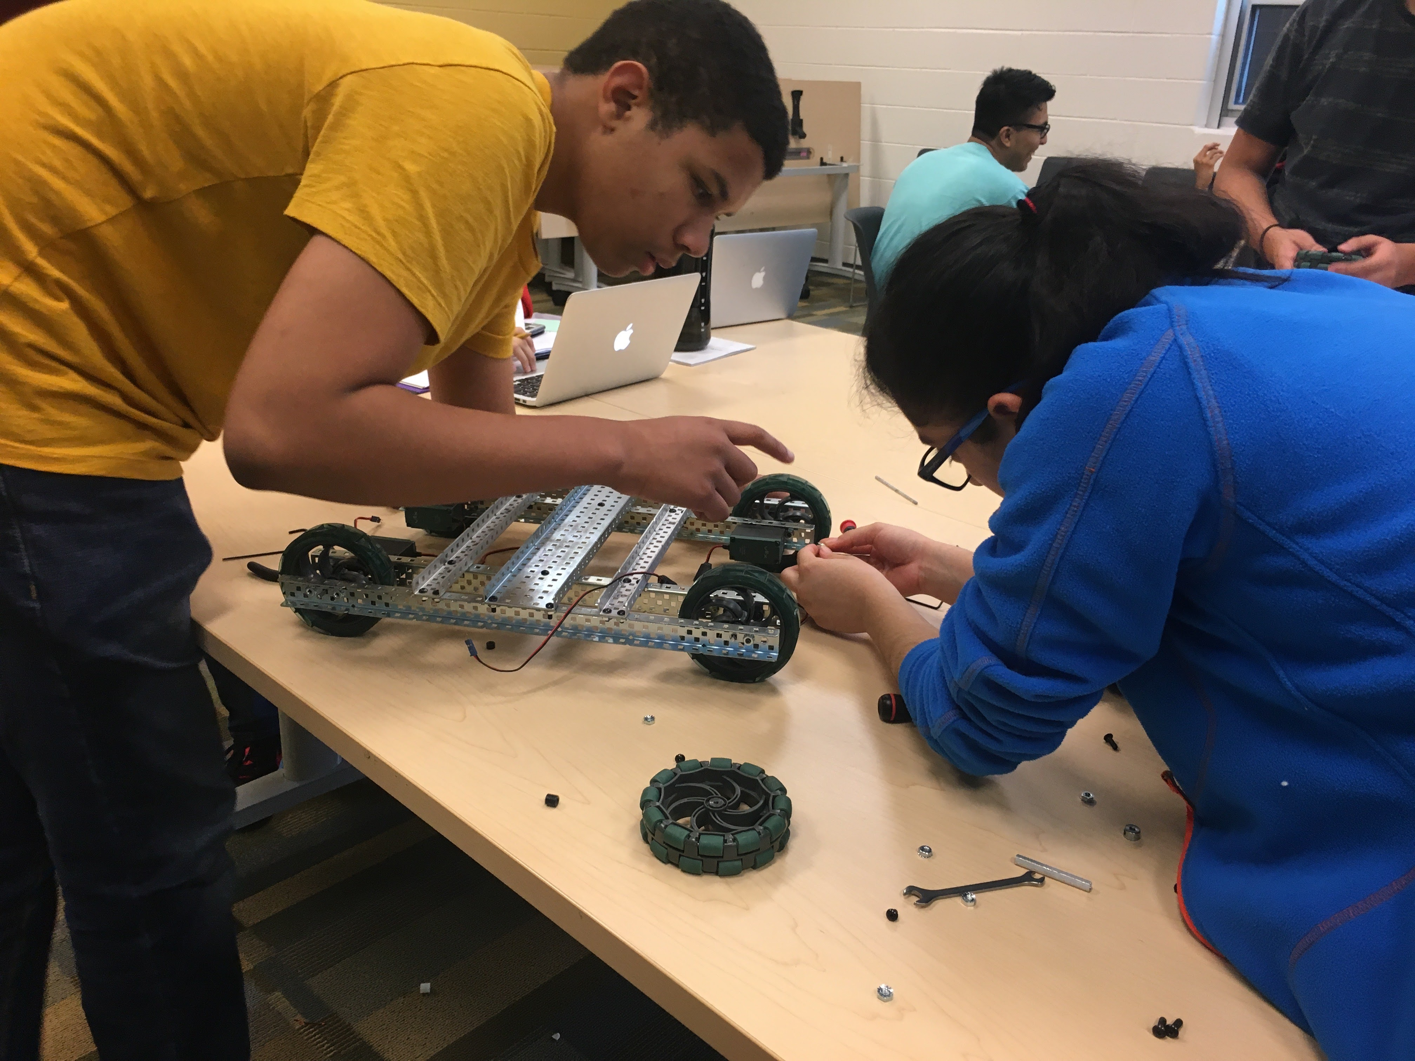
Need for Learn Better by Doing Study
Today’s students differ from previous generations
Different needs and wants
Reflected in society, workplace, schools, home
Notes:
Today’s students are much different from those in the past. People’s interests, attitudes, and actions are not what was expected, and sometimes even accepted, years ago.
We realize that things are different, but what are we doing differently to keep students engaged and moving forward in life, especially in education?

Slide 7
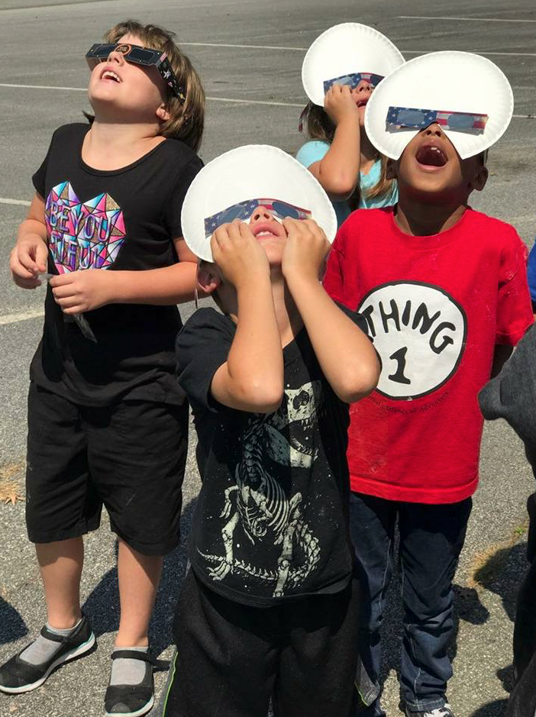
Need for Learn Better by Doing Study (Cont.)
One of the most pressing issues facing education today is that data need to be collected to determine the extent of “classroom coverage for content and practices [doing] in the Common Core State Standards for Mathematics and A Framework for K-12 Science Education” (NRC, 2013, p. 36)
Notes:
This is one reason why researchers conducted the LBbD Study. We now have data telling us in which classes students are “doing” standards-based, hands-on activities.
Now that we realize where "doing" in classes occurs, we need to do something with that information.

Slide 8
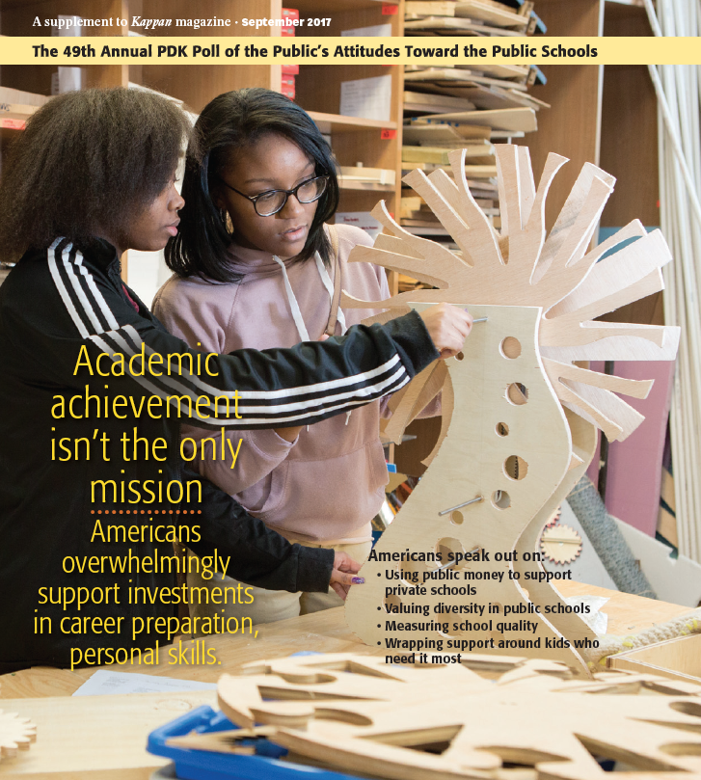
Need for Learn Better by Doing Study (Cont.)
Students need to take more technology and engineering courses to prepare them for life. (PDK, 2017)
“Middle school students learn engineering, not only as a career path, but as an endeavor with potential for doing social good.” (Hacker, M., Crismond, D., Hecht, D., Lomask, M. (2017).
Notes:
Preparing students to do well in school is a goal. But what does it mean to do well? Certainly it is more than just memorizing information long enough to pass a standardized test.
82% of U.S. adults surveyed in the 2017 Phi Delta Kappa Poll of the Public’s Attitudes Toward the Public Schools felt that students need to take technology and engineering courses to prepare them for life. We can assume that the surveyed people feel that what the technology and engineering courses offer is beneficial to students.
This finding would imply that the U.S. public feels that students also need to apply what it is that students are to learn. The LBbD study shows that TEE students use standards-based, hands-on activities to apply what it is that they are to learn in science, technology, engineering, and mathematics classrooms.
The second bullet is the title of one of the resources we will identify during this presentation. These resources, published articles, provide evidence of why TEE is important in preparing students for life. You will find that this presentation cites many references supporting each study finding.

Slide 9
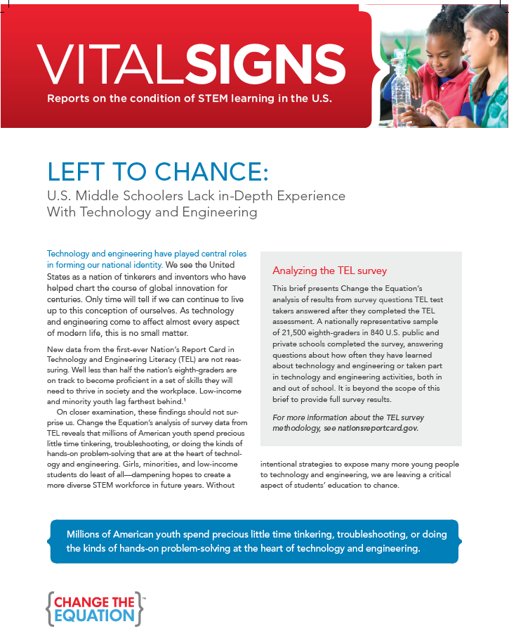
Need for Learn Better by Doing Study (Cont.)
NAEP – TEL Assessment – 2014
“U.S. Middle Schoolers Lack in-depth experience with technology and engineering” (CTEq, 2016, p. 1).
“Decades of research suggest that people often learn best by testing solutions through real-world problems through hands-on trial and error” (CTEq, 2016, p. 4).
Many more examples…
Notes:
Many of you are aware of the National Assessment of Educational Progress – Technology and Engineering Assessment administered to over 21,000 eighth grade students, across the nation, in 2014.
The Change the Equation organization provides STEM education related information to the U.S. public. The 2016 report stated that MS students lack in-depth T&E experience.
This is only one of many examples of evidence showing that students are not technology an engineering literate. Only 42% of those 8th grade students assessed were considered at or above proficient. (NAEP TEL 2014, n.d.).
The Vital Signs report also tells us that students benefit from doing hands-on activities in the classroom.
The previous four slides make the point that the US public feels that students need the experiences what TEE courses provide. This is an important point because we should realize the value of TEE courses and how they prepare students for life, both academically and in their chosen profession.

Slide 10
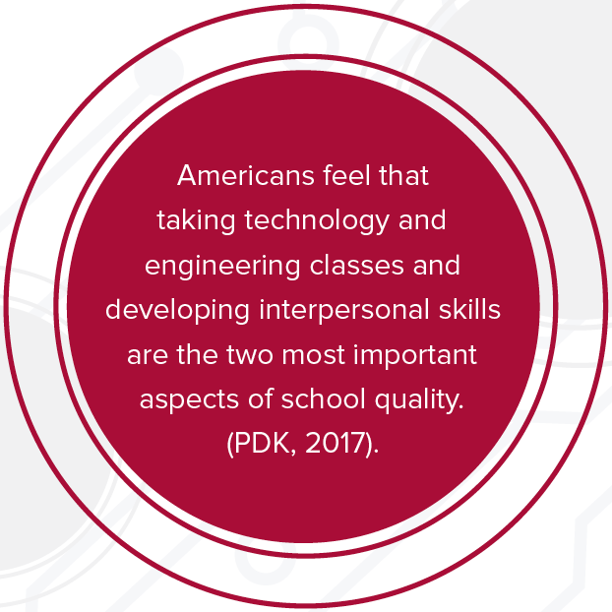
Technology and Engineering Promotes
Integrative studies
STEM/STEAM
21st Century Learning Skills
Notes:
These are a few concepts that educational leaders and law makers are considering and promoting.
Incidentally, these concepts are addressed and used daily in technology and engineering courses.

Slide 11
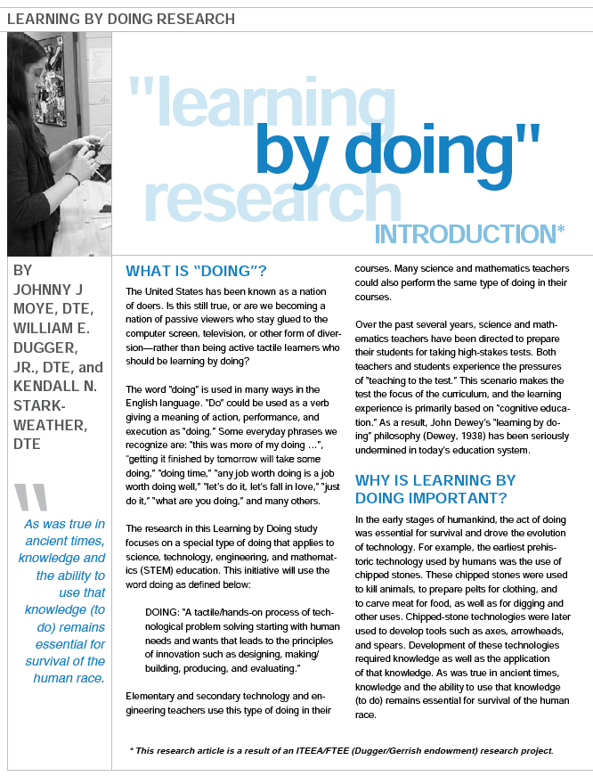
Learn Better by Doing Study Background
Determine the extent to which U.S. public school elementary and secondary education science, technology, engineering, and mathematics students were doing activities in their classrooms.
Standards-based activities (STL, NGSS, CCSSfM).
From 2014-2017 - 5,910 teachers participated.
Notes:
OK, lets shift gears. This is a little background of the LBbD study. It does not go into great detail about the study itself because this presentation is to identify and discuss some of the findings and how those findings illustrate the benefits of TEE courses and programs.
You can see here the purpose of the study.
The study instruments were based on Standards for Technological Literacy (STL), Next Generation Science Standards (NGSS), and Common Core State Standards for Mathematics.
Over 5,900 elementary, MS and HS STEM teachers participated in the study.

Slide 12
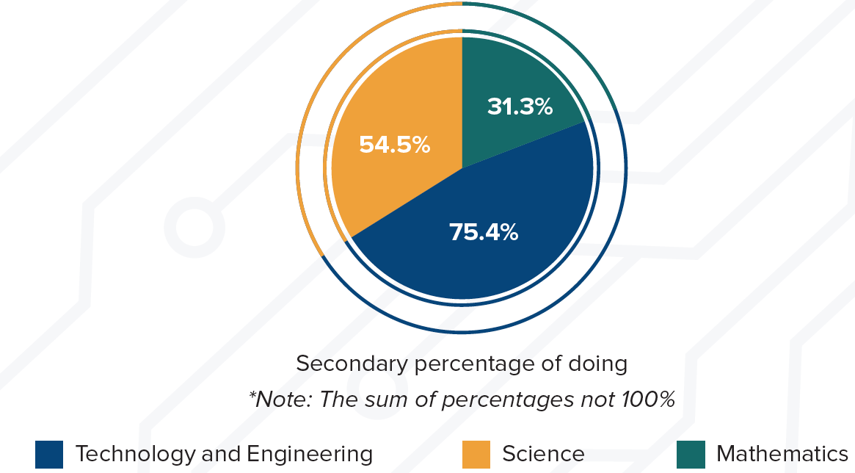
Technology and Engineering Students Are Doing More in Classes
Technology and engineering students do more standards- based, hands-on activities in class than do science and mathematics students (Moye, Dugger, Starkweather, 2018, p. 6). ¹
Notes:
Technology and engineering students do more standards-based, hands-on activities in class than do science and mathematics students.
This is a very important point.
Referring back to thoughts and concerns identified in previous slides:
1. The NAEP-TEL Assessment found that students lack in-depth technology and engineering experience.
2. The U.S. public feels students should take technology and engineering courses.
3. Students can learn science, technology, engineering, and mathematics (as well as other) content in a STEM classroom setting.
Technology and engineering courses and programs are a valuable resource to address, and resolve, these thoughts and concerns. Keep this point in mind as we progress through this presentation.

Slide 13
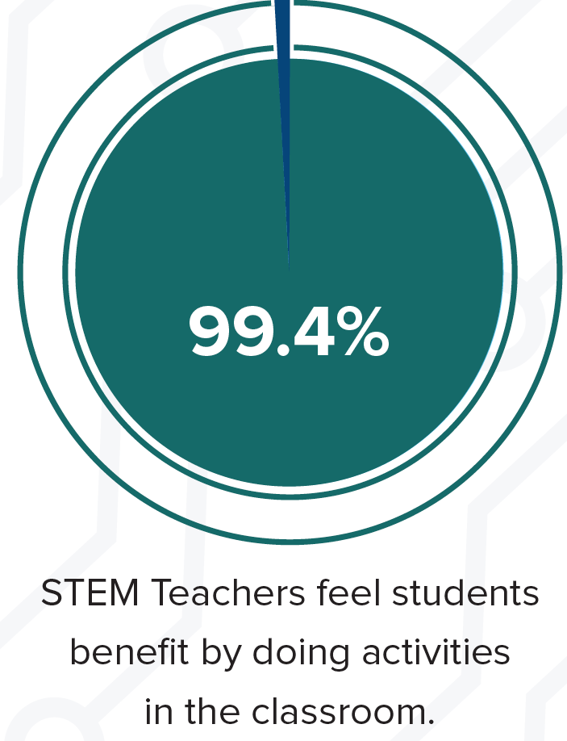
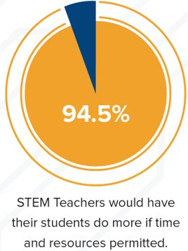
Students Learn by Doing
Notes:
Almost 100% of teachers indicated that they felt students benefit by doing activities in their classrooms.
94.5% of teachers would have their students do more if time and resources permitted.
These two findings identify that teachers feel that students learn by doing and would like for their students to do more hands-on activities in class. .
As identified in the previous slide, technology and engineering students are doing more hands-on activities in their classrooms than are science and mathematics students in their classrooms.
Remember, the U.S. Public feels students should take more technology and engineering courses to prepare students for life.
Keep these points in mind because they lay the groundwork to realize even more opportunities technology and engineering education provides students.

Slide 14
Doing and the Three Domains of Learning
Cognitive: TEE lessons and activities = STEM, Language/Social Arts, and other content. ² ³ ⁴
Affective: TEE courses provide students with opportunities to work in teams. Teamwork may help students develop positive attitudes and self esteem. ⁵ ⁶ ⁷
Psychomotor: TEE courses - hands-on activities, exercising students creativity and problem-solving skills solving real-world problems. ⁸ ⁹
Notes:
Why do teachers think that students learn by doing? Here are some thoughts.
Students doing hands-on activities support the three Domains of Learning: Cognitive, Affective, and Psychomotor.
The three domains and short descriptions are shown here. Students experience, and learn from, these three domains in technology and engineering courses.
Specifically addressing each domain, Integrative STEM/STEAM is a reality in Technology and Engineering Education that directly addresses the Cognitive Domain.
Concerning the Affective Domain: technology and engineering students often work in teams doing hands-on activities. As we have seen, hands-on activities are more available in technology and engineering than in other courses.
The Psychomotor Domain is where TEE students learn by using hands-on activities and is the area by which TEE courses may be best known.
Notice that we have included footnotes to each bullet. These footnotes are hyperlinked and by clicking on these footnotes, one may go to articles that specifically identify how technology and engineering courses support student learning in each of the three Domains of Learning. These footnoted references are also included in slides at the end of this presentation.
For example, we have identified three articles that show how technology and engineering courses support the Cognitive Domain, the titles of those articles are:
STEM integration: Solids, CAD, and 3D printers – Technology and Engineering Teacher.
Vocabulary development in technology and engineering education.
Beyond science and math: Integrating geography education.
All of these references provide specific information and activities used in technology and engineering courses.
As we progress through the presentation we will see how students are doing hands-on activities in technology and engineering courses directly addressing each of the Domains of Learning, as well as many other areas we educators should consider.

Slide 15
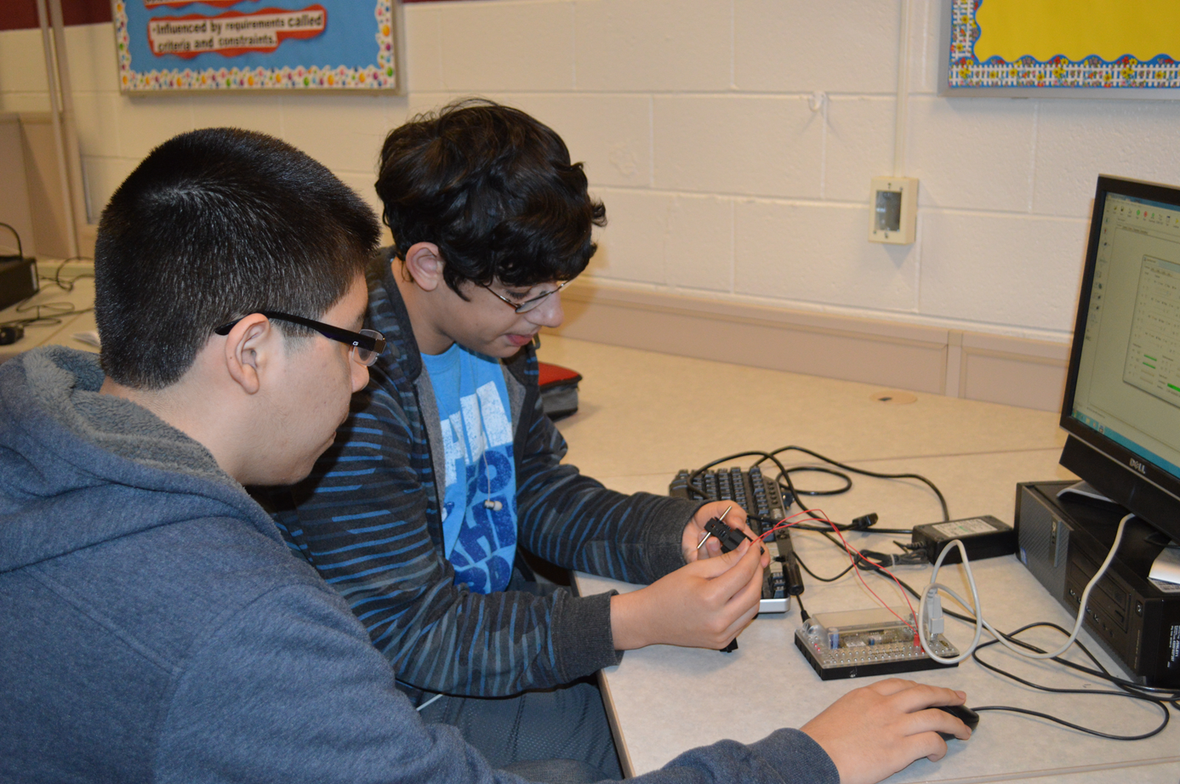
Technology and Engineering Courses Integrate STEM/STEAM
Students in science, technology, engineering, and mathematics courses complete activities that address the same standards.
TEE students do more standards-based activities.
Technology and engineering = Integrative STEM/STEAM education. ¹⁰ ¹¹
Notes:
As mentioned in a previous slide, the LBbD study instruments were based on STL, NGSS, and CCSSfM.
Science, technology, engineering, and mathematics teachers reported that a percentage of their students were doing activities that address specific and related science, technology and engineering, and mathematics standards.
This is an important point. If Integrative STEM is on the agenda of many educational leaders and lawmakers today, and if students learn by doing, coupled with the fact that TEE students are currently doing more of these standards-based activities in their classrooms, it is easy to see and understand that TEE is an important resource to achieve Integrative STEM in those classrooms.
Realizing these points, we should evaluate our current TEE programs, and determine how and if we could better utilize this resource to promote and realize authentic STEM education in our schools. An additional point – this could occur with no extra financial expense to the school division.

Slide 16
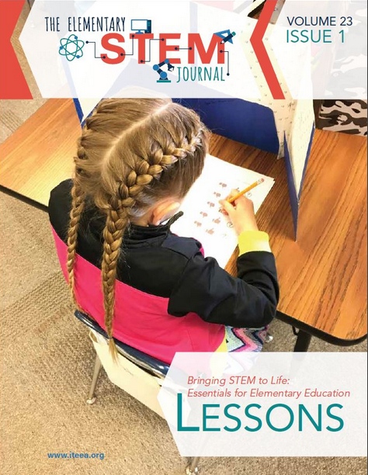
Elementary Students Learn and Use Engineering Design Process
Engineering Design Process – Tool
Students learn/use troubleshooting process – prepares them for school and life ¹² ¹³
Notes:
The adults surveyed in the 2017 PDK poll feels that students should take more technology and engineering courses to prepare them for life. But – why do they think technology and engineering is such a valuable resource?
During the next few slides, we will look at some additional benefits that technology and engineering can offer students academically, as well as into their future lives.
An engineering design process is a tool. As we know, there are different examples of engineering design processes. One consistent point is that people (students included) can use this tool, or process, to determine and design solutions to problems. As we have seen in the literature, including the 2014 NAEP-TEL Assessment results, U.S. students’ problem-solving skills are lacking.
Students will benefit by learning and practicing an engineering design process early in their school years. This knowledge and ability to “do” things will help students in their classes, and also in life.

Slide 17
Design and Modeling Engineering Design Process
Engineers, Scientists, Technicians, Everyone - Life
Design and Model – Key Components in Design Process
Cognitive, Affective, Psychomotor Skills
Thinking, Collaborating, and Doing
Secondary TEE students Design and Model more than science and mathematics students. ¹⁴ ¹⁵ ¹⁶
Notes:
The Engineering Design Process is used by many professionals.
Again – we can see the three Learning Domains that TEE students experience while Designing and Modeling to find solutions to problems.
Designing and Modeling are two key components in the EDP. The LBbD study found that TEE students use the EDP more frequently than do science and mathematics students.
To reiterate, the 2017 PDK poll found that 82% of U.S. adults feel that students need to take more technology and engineering courses in school to prepare them for life… Those adults seem to realize the benefits of TEE programs. We, as educators, should also realize the benefits of Engineering Design, realize where it is being used in our schools, and continue to develop that resource in an effort to make our students more academically and personally successful.

Slide 18
Design and Modeling Engineering Design Process
Notes:
Here are the specific LBbD Study findings.
A specific point to be made here:
Teachers in all three content areas report that, to some extent, their students are Designing and Modeling in their classrooms. This reiterates an earlier point, that an integrative studies course, designed for all students, would be easily accomplished in technology and engineering courses and programs. School leaders and teachers may just need to further develop what is already occurring in TEE courses.
Integrative STEM in TEE courses is a natural fit.

Slide 19
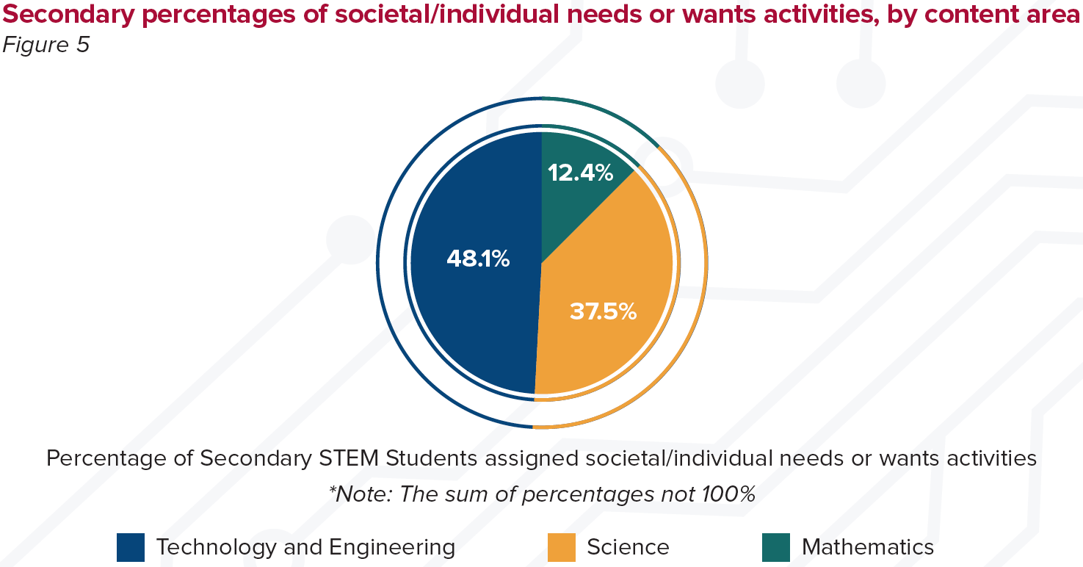
Increase Female Students’ Participation in STEM Education and Occupations
Female students prefer studies and occupations that directly benefit society and/or individual needs and wants.
TEE courses introduce interesting and challenging real-world scenarios involving societal and/or individual needs and wants. ¹⁷ ¹⁸ ¹⁹
Notes:
The literature tells us that females tend to prefer studies and occupations that directly benefit society and/or individual needs and wants.
The Change the Equation – Vital Signs document previously mentioned states: “Educators who harness TEL’s vision of literacy in technology and engineering may well attract many more girls to those fields. The TEL results are an important reminder that we are squandering much of the nation's female talent" (CTEq, 2016, p. 9).
That is a very strong statement designed to remind us that we could be, squandering, opportunities to encourage female participation in STEM education and professions.
The graphic on this slide shows the percentage of activities focusing on social and or individual needs and wants. This is a good illustration of how TEE encourages female student involvement and experiences in STEM education. It should be noted that this trend may be changing as our society changes. The ”Technology and Society” area of the NAEP TEL shows “no significant difference” between female and male results. This is a totally different point that can be developed. But – the point is, that both female and male students feel a need to focus on benefits of society and/or individual needs and wants. And – TEE provides that focus more frequently than does science and mathematics courses. https://www.nationsreportcard.gov/tel_2014/#results/overall

Slide 20
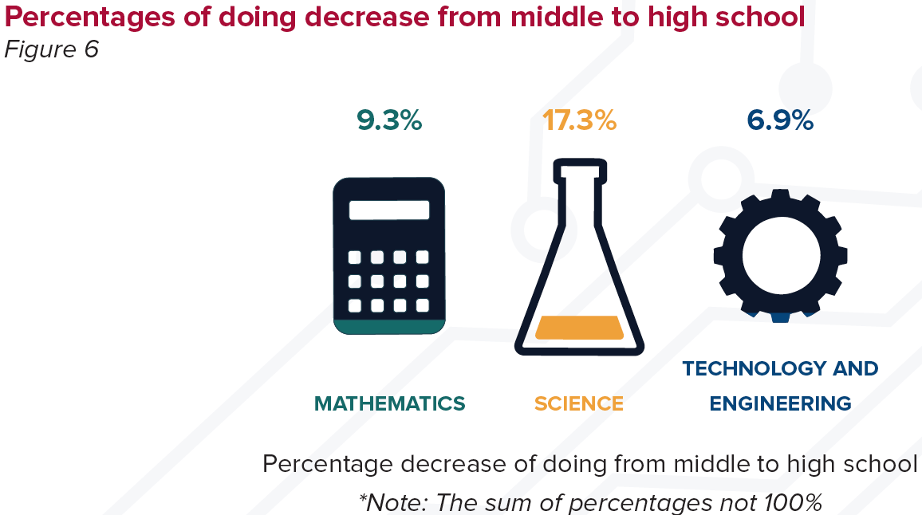
Doing: From Middle to High School
Doing decreased from middle to high school in each content area each year—but—less in technology and engineering classrooms.
Notes:
The literature tells us that many students lose interest in school while in high school (NRC, 2004).
The study found that “doing decreased from middle to high school in each content area each year.” But, the data also show that the percentage of “doing” decreased less in TEE courses than it did in science and mathematics courses.
The question exists, is there a correlation between the decrease of “doing” in HS and the decrease of interest and participation in HS?
This is another good point. Although, for the most part, graduation rates have improved over the past few years, there is still work to be done to encourage students to stay engaged and in school.
TEE courses could help keep students interested in school.

Slide 21
So - What Does This All Mean?
The U.S. public feels that students should take more technology and engineering courses.
Teachers feel students learn by doing and would have students do more if they had the time and resources.
Technology and engineering students are doing more standards-based, hands-on activities in their classrooms.
Literature and research supports benefits of TEE courses. 20
Notes:
So, what does all of this mean? We have covered a lot of information in this presentation. You may not remember everything but keep in mind that the the presentation is available on the ITEEA website for your review and use.
The main points of this presentation are:
The U.S. Public feels that students should take technology and engineering courses to be successful in life.
NAEP-TEL Assessment results tell us that students should have more technology and engineering experiences in schools.
3. Teachers feel that students learn by doing and they would have their students doing more hands-on activities in class if they had the time and resources.
4. TEE students are doing more standards-based (STL, NGSS, CCSSfM), hands-on activities than are science and mathematics students.
There are many other benefits to TEE courses. Education leaders, policy makers, and law makers should realize the importance of TEE courses and programs.

Slide 22
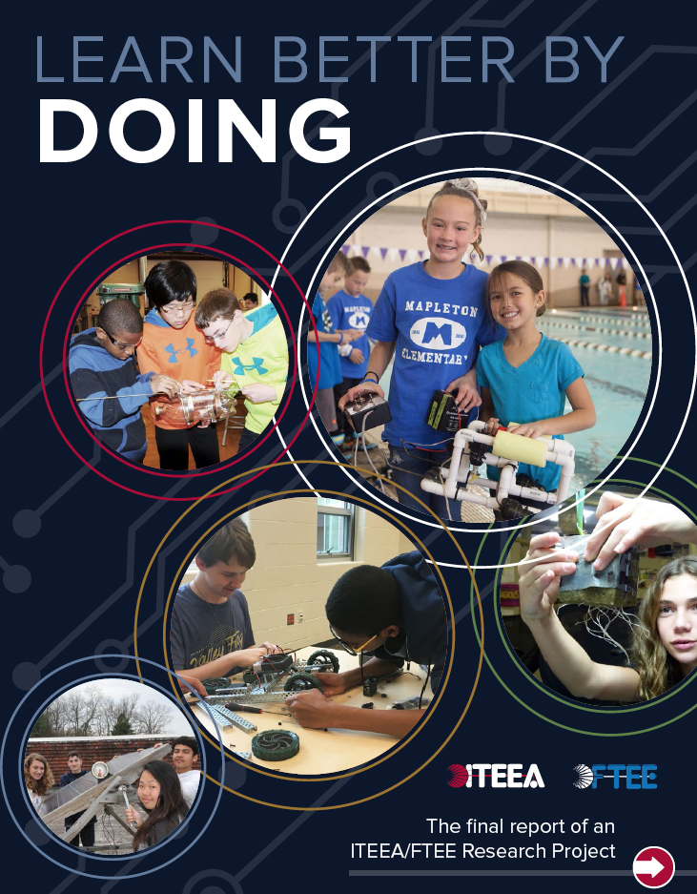
So - What Does This All Mean? (Cont.)
Our nation is in the midst of education reform.
Technology and engineering is an excellent resource and must be included in this reform.
Study results and literature identify benefits of technology and engineering education programs.
Notes:
As the great Poet Laureate, Bob Dylan, said many years ago, “The Times They Are A Changin’.” That was true in the 1960s and it remains true today.
Education leaders realize that changes to our system of education are on the horizon. National assessments have identified that U.S. students are not technology and engineering literate. The U.S. public has told us what is needed. We need to realize that the answer is already in place in technology and engineering education. Our students would benefit if we revaluate what we already have, make any necessary changes, and move forward with this valuable resource.

Slide 23
Conclusion
Bottom Line:
Technology and engineering education provides the content, contexts, and experiences that prepare students for success in school and life.
Notes:
This is the bottom line: Technology and engineering.....
The question is – how are we using this resource?

Slide 24
Comments and Questions
http://www.ifunny.com/pictures/yes-elmo-i-see-your-point/
Notes:
Thank you for your time and attention. Please, let us discuss comments and answer any questions.

Slide 25
Footnote References
Footnotes:
Moye, J. J, Dugger, W. E., Jr., Starkweather, K. N. (2018). Learn better by doing. Reston, VA. ITEEA.
Fujiwara, Y. (2018, May/June). STEM integration: Solids, CAD, and 3D printers. Technology and Engineering Teacher 77(8), pp. 5-9. (Identifies learning AP Calculus and NGSS Engineering, Technology, and Application of Science).
Klink, P., Loveland, T. (2015, November). Vocabulary development in technology and engineering education. Technology and Engineering Teacher 75(3), pp. 8-13. (Students can participate in a variety of vocabulary-development activities to deepen their understanding of technical word meanings as they relate to technology and engineering education).
Grubbs, M. E., Grubbs, S. (2015, December/January). Beyond science and math: Integrating geography education. Technology and Engineering Teacher, 74(4), 17-21. (A World Geography and Technology teacher collaborates to align their units through overlapping concepts that appeared at “natural intersections” of the learning process).
Blue, C., Mupinga, D., Ernst, J., Clark, A., DeLuca, V. W., Kelly, D. (2018, April). Premiere PD: Multiculturalism in the classroom. Technology and Engineering Teacher, 77(7), pp. 25-31. (In a succession of group activities over time, adopting a process of random selection of group membership and scaffolding of content is a proven methodology for developing within-group and group-to-group learning activities that ensure group diversity.)
Mentzer, N. (2014, November). Holding Students Accountable in Team Projects. Technology and Engineering Teacher, 74(3), pp. 14-20. (Describes an efficient peer evaluation process that can be implemented at the middle and high school levels).
Notes:
These are the footnote references that are associated with each footnote identified in this presentation.

Slide 26
References
Luna, E. A., Ernst, J. V., Clark, V., DeLuca, V. W., Kelly, D. (2018, March). Premiere PD: Enhancing classroom creativity. Technology and Engineering Teacher, 77(6), pp. 26-31. (The ability to think creatively and work in teams have both become defining skills sought after by businesses. Educational institutions can fulfill these needs by building these skill sets in their students.)
Hemming, J. (2018, April). RITE. Drawbridge by design: Civil engineering for middle school. Technology and Engineering Teacher, 77(7), pp. 40-44. (With Next Generation Science Standards including engineering goals, science programs have had to take a look at what is taught and what student’s experience).
Ernst, J. V., Clark, A., C. (2009). Technology-Based Content through Virtual and Physical Modeling: A National Research Study. Journal of Technology Education, 20(2). (A study of technology-based content and the application of conceptual modeling, data-driven visualizations, physical modeling, and presentations simultaneously promote technological, technical, and visual literacy).
Notes:
These are the footnote references that are associated with each footnote identified in this presentation.

Slide 27
References (Cont.)
Wu-Rorrer, R. (2017, October). Filling the Gap: Integrating STEM into Career and Technical Education Middle School Programs. Technology and Engineering Teacher, 77(2), pp. 8-15. (The field of STEM education is an educational framework that has surged in application over the past decade. Science, Technology, Engineering, and Mathematics (STEM) is infused in nearly every facet of our society. The central strength to the current CTE and academic integration efforts has been linking learned academic knowledge and skills directly with authentic applications).
Hughes, W., Mona, L., Wilson, G., McAninch, S., Seamans, J., Stout, H. (2017, September). An Object in Motion: An Integrative STEM Approach to Accelerating Students’ Interest in Newton’s Laws of Motion. Technology and Engineering Teacher, 77(1), pp. 10-16. (An integrative STEM approach to accelerating students’ interest in Newton’s Laws of Motion).
Wright, G. A., Jones, M.D. (2018, February). Innovation in the elementary classroom. Technology and Engineering Teacher, 77(5), pp. 8-13. (Outlines an innovation curriculum that can be taught to elementary-aged students to expand their creative and innovative abilities and potential).
Notes:
These are the footnote references that are associated with each footnote identified in this presentation.

Slide 28
References (Cont.)
Kelley, T., Euisuk, S. (2017). Examining Elementary School Students’ Transfer of Learning Through Engineering Design. Using Think-Aloud Protocol Analysis. Journal of Technology Education, 28(2). (Research findings indicate that participants increased the amount of time spent on mathematical thinking by 34% when given a math-specific design task. Pre-and post-tests showed that participants gained significant science content knowledge).
Wicklein, R.C. (April, 2006). Five good reasons for engineering as the focus for technology education. The Technology Teacher, 65(7), 25-29. The author identifies and explains the primary rationale for having the field of technology education to direct its focus on engineering process.
Lammi, M., Becker, K. (2013). Engineering Design Thinking. Journal of Technology Education, 24(2). Design is often complex, involving multiple levels of interacting components within a system that may be nested within or connected to other systems. Systems thinking is an essential facet of engineering design cognition).
Mentzer, N., Farrington, S., Tennenhouse, J. (2015, May/June). Strategies for Teaching Brainstorming in Design Education. Technology and Engineering Teacher,74(8), pp. 8-13. (Six brainstorming techniques are discussed along with how students are evaluated in applying the techniques).
Notes:
These are the footnote references that are associated with each footnote identified in this presentation.

Slide 29
References (Cont.)
Cameron, D., Lammi, M. (2014). Building a Framework for Engineering Design Experiences in High School. Journal of Technology Education, 26(1). (The teaching of engineering design at the secondary level can help students develop critical–thinking and teambuilding skills and provides a platform for the integration of science, technology, engineering, and mathematics (STEM) subjects).
Lammi, M., Becker, K. (2013). Engineering Design Thinking. Journal of Technology Education, 24(2). (Design is often complex, involving multiple levels of interacting components within a system that may be nested within or connected to other systems. Systems thinking is an essential facet of engineering design cognition).
Brown, R., Ernst, J., Clark, A., DeLuca, W., Kelly, D. (2017, November). Engaging Females in STEM. Technology and Engineering Teacher, 77(3), pp. 29-31. (Despite students’ actual abilities in STEM, their self-perceptions can be the ultimate deciding factor in courses they choose to pursue).
ITEEA: Learn Better by Doing Research Project. Web Resource.
Milgram, D. (2011). How to Recruit Women and Girls to the Science, Technology, Engineering, and Math (STEM) Classroom. The Technology Teacher, November 2011, pp. 4-11. This article addresses the problem of low the number of females in STEM classes and offers suggestions as how to improve those numbers.
Weber, K. (2012) Gender Differences in Interest, Perceived Personal Capacity, and Participation in STEM-Related Activities. Journal of Technology Education, 24(1). (This research article provides an overview of student engagement, perceived personal capacity, and continuity, and describes the gender-related findings).
Notes:
These are the footnote references that are associated with each footnote identified in this presentation.

Slide 30
References
Achieve Inc. (2013). Next generation science standards. National Academies Press. Washington, DC.
Common Core State Standards for Mathematics (CCSSfM). (n.d.). Mathematics standards. Retrieved from: http://www.corestandards.org/Math/
Change the Equation (CTeQ). (2016). Vital signs: Reports on the condition of STEM learning in the U.S. Retrieved from http://change the equation.org/left-to-chance
Hacker, M., Crismond D., Hecht, D., Lomask, M. (2017, November). Engineering for All: A Middle School Program to Introduce Students to Engineering as a Potential Social Good. Technology and Engineering Teacher, 77(3), pp. 8-14. (Middle school students learn engineering, not only as a career path, but as an endeavor with potential for doing social good).
International Technology and Engineering Educators Association (ITEEA). (2007). Standards for technological literacy: Content for the study of technology. Reston, VA. Author.
Notes:
These are additional references cited in this presentation.

Slide 31
References (Cont.)
National Assessment of Educational Progress (NAEP). (n.d.). 2014 Technology and engineering literacy (TEL). Retrieved from https://www.nationsreportcard.gov/tel_2014/#results/overall
National Research Council and the Institute of Medicine (NRC). (2004). Engaging schools: Fostering high school students’ motivation to learn. Committee on increasing high school students’ engagement to learn. Board on Children, Youth, and Families Division of Behavioral and Social Sciences and Education. Washington, DC: The National Academies Press.
National Research Council (NRC) (2013). Monitoring progress towards successful K-12 STEM education: A nation advancing? Committee on the Evaluation Framework for Successful K-12 STEM Education. Board on Science Education and Board on Testing and Assessment, Division of Behavioral and Social Sciences and Education. Washington, DC: The National Academies Press.
Phi Delta Kappan (PDK). (2017). The 49th annual poll of the public’s attitudes toward the public schools. Kappan, 99(1).
Notes:
These are additional references cited in this presentation.

