Slide 1
Setting Up Classes and Groups in EbD-BUZZ A Tutorial for EbD Teachers

Slide 2
Teachers: Before you begin this tutorial, please view the “Introduction to EbD-BUZZ for EbD Teachers” tutorial.
All EbD teacher tutorials are located on the EbD-BUZZ Resources page:
https://www.iteea.org/STEMCenter/EbD/EbD-BUZZ-Online-Resources.aspx#tabs

Slide 3
One Teacher Copy per EbD Course
EbD Teachers will be given one copy of each EbD course they are teaching. There will not be a separate copy per class period. However, teachers will be able to organize their students into different sections, as needed.
In EbD-BUZZ, these sections are called “Groups.”

Slide 4
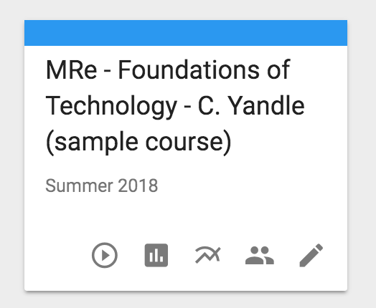
1. Select Your Course Copy and Click on the “People” Icon
To begin, select your course copy on the Teacher View Page in EbD-BUZZ. Then click on the “People” icon (on the course copy graphic) to see your student enrollment for the course.

Slide 5
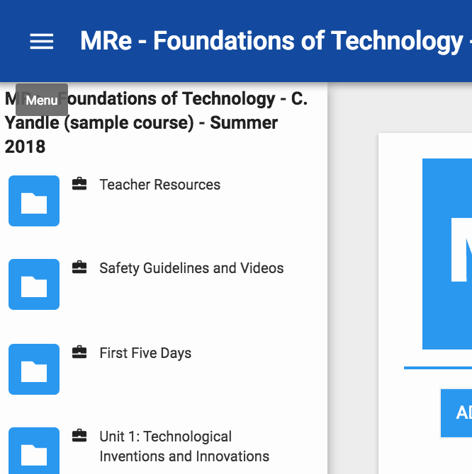
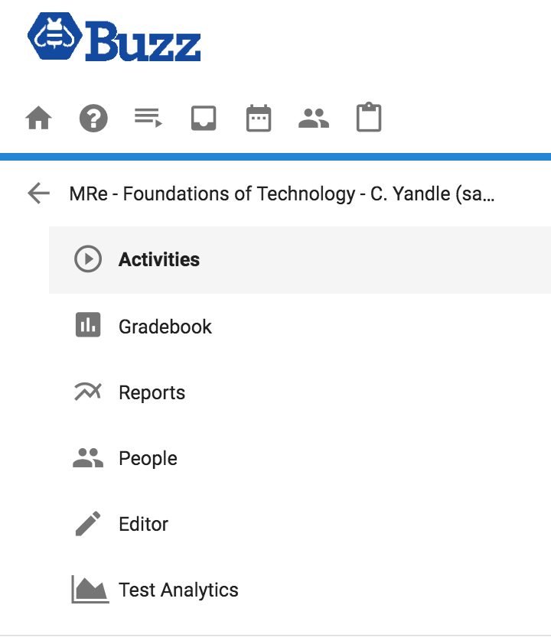
You can also access your student list by clicking on your course copy and then selecting “People” from the dropdown course menu at the top left of your screen:

Slide 6
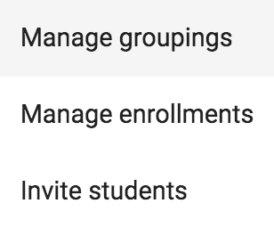
2. Manage Groupings
When you have opened your course copy, select the “Tools” icon at the top of the page. Then select “Manage Groupings” from the popup window.
Tools icon

Slide 7
3. Add Grouping
Select “Add Grouping” to create your student groups.

Slide 8
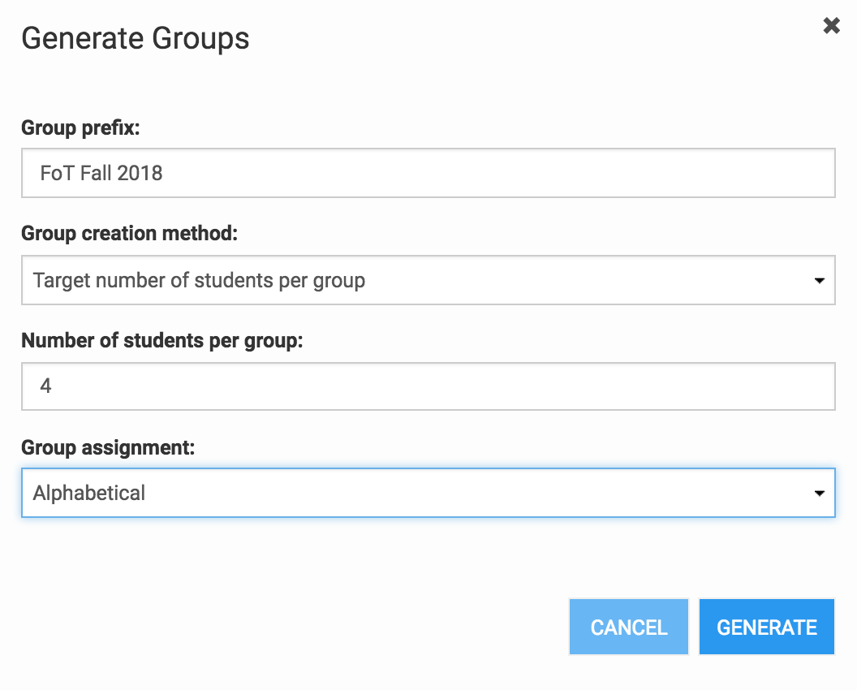
4. Generate Student Groups
In the “Generate Student Groups” window, type your group name (Example: FoT Fall 2018) and specify how you would like to customize your group. You can then organize your group by class period.
Click “Generate.”

Slide 9
5. Organize Your Students by Class Period
Click the “Edit” icon to name your class periods or subgroups. You can add or remove students by clicking on the row beside their name, under the heading for the correct class period.

Slide 10
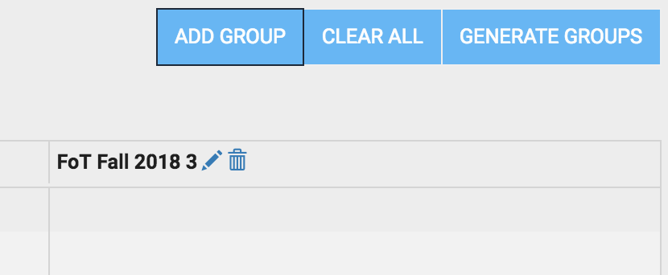
6. Add Groups
Click “Add Groups” to include additional class periods.

Slide 11
7. SAVE Your Work
Be sure to click the “SAVE” button at the top right corner of your screen.
Now your students are organized into groups within your course copy. Repeat the steps in this tutorial for each EbD course you will be teaching.

Slide 12
For additional questions about organizing your classes, please contact EbD-BUZZ Support at ebdbuzzsupport@iteea.org.

