Slide 1
TNWORKS: Aligning Tennessee’s workforce ecosystem

Slide 2

WORKFORCE OPPORTUNITIES FOR TENNESSEE
Macroenvironment of Tennessee
Our Challenge
Core and emerging industries are growing
Manufacturing, nuclear, healthcare, logistics, and tech services are among the top, fastest-growing sectors
AI, automation, and technology are innovating
University of Tennessee’s AI Tennessee Initiative: A new research and education initiative focused on the TN’s unique AI strengths and opportunities
Tennessee’s IT strategy to position the state as a leader in enabling technologies, service delivery, and security and data privacy
Increased focus on private investments
State Point-of-View: Competing for Talent and Employers in a Shifting Economy
Support Tennessee's vision of making the state #1 in economic success for both businesses and residents​
Provide a seamless, business-friendly experience ​
Eliminate fragmented service delivery across state agencies ​
Align workforce development with economic development priorities
Our Solution
Employer Point-of-View: Enhanced Workforce Support
Critical need for consistent, coordinated, accessible, and forward-looking support from the State in navigating workforce-related programs and services​

Slide 3

THE WORKFORCE SOLUTION - TNWORKS
Born through multi-agency collaboration, TNWorks was created to be Tennessee's single source for workforce needs.
Our Vision:
Tennessee (TN) is #1 in the country in economic success for both business and Tennesseans.
The primary goals of the new TNWorks team are to:
Translate the state’s vision and workforce strategy into action and economic development results
Serve as a special projects' hub for priority industries and key statewide initiatives and engage employers related to those initiatives
Develop and cultivate a compelling brand for TNWorks in the market
Coordinate the activities of key economic development and workforce development partners to meet the needs of TN businesses and people

Slide 4
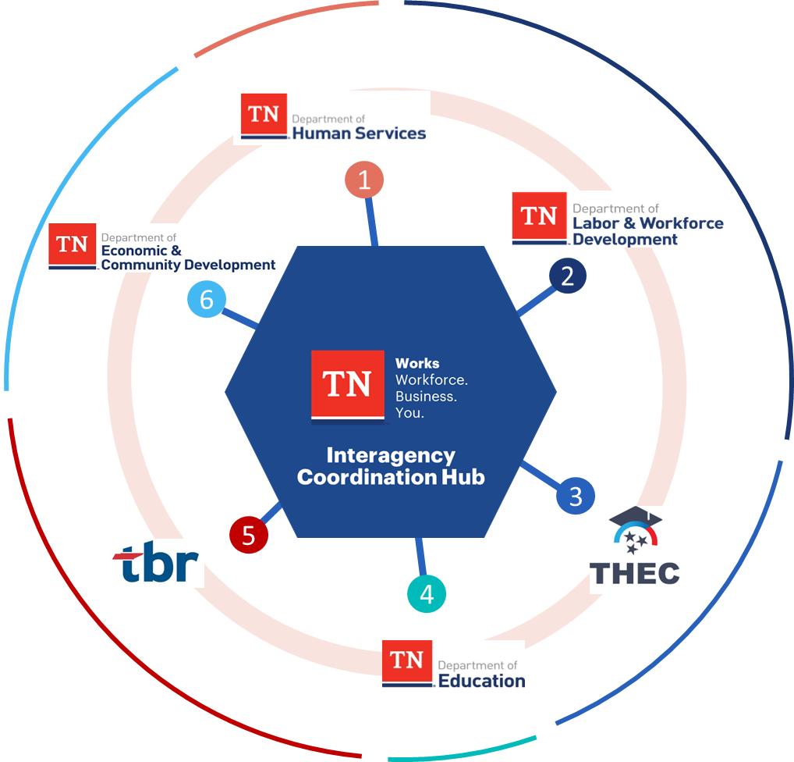



TNWORKS AS THE ONE-STOP-SHOP
TNWorks connects businesses to workforce solutions through a seamless and coordinated experience.
TNWorks staff initiate employer outreach or respond to employer requests to connect, provide support, and coordinate interactions and tasks with appropriate state agencies.
State agencies work with TNWorks staff and the employer to custom-fit the State's support package and provide other workforce solutions to meet the employer’s workforce needs and manage program implementation.

Slide 5
TNWORKS WORKFORCE PRIORITIES
TNWorks will serve as our collective brand for connecting employers to all of Tennessee’s workforce-related services and for delivering customized workforce solutions.
TNWorks will support employers who are the focus of Governor-driven special projects and initiatives that meet the following criteria:
High-growth and competitive wage jobs with strong industry demand
Increased investment in key sectors*
based on the State’s Workforce Board, Governor priorities
Focus on hiring, retaining, and developing skilled talent pipelines
TNWorks will…
Align agencies around shared workforce goals
Make it easier for businesses to navigate workforce services
Lift up and scale local teams with tools, data and communication
Integrate and amplify local success stories
TNWorks will not…
Replace or override intra-agency processes
Interfere with relationships across state agencies or create bureaucracy
Duplicate any existing workforce efforts and/or projects
Disrupt the strength and effectiveness of local partnerships
* Includes, but not limited to, manufacturing, logistics & distribution, automotive, sustainable and nuclear energy, information technology, healthcare

Slide 6
TNWORKS EMPLOYER ENGAGEMENT PROCESS
How TNWorks helps employers address workforce challenges
  1. Connect to employers through portal or referral
  3. Match employer needs to best agencies & services
  5. Implement and coordinate plan
  1
  2
  3
  4
  5
  6
  2. Provide customized workforce insights
  4. Deliver comprehensive TNWorks plan
  6. Monitor results & provide continuous support

Slide 7
THANK YOU!
Questions?
Learn more at www.TNWorks.com or contact TNWorks staff at TN.Works@tn.gov.

