Slide 1
concierge medicine, for all

Slide 2
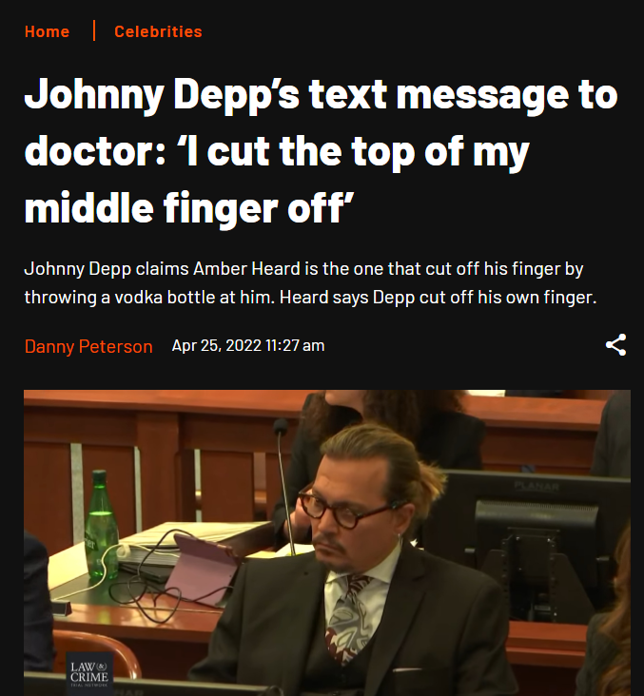
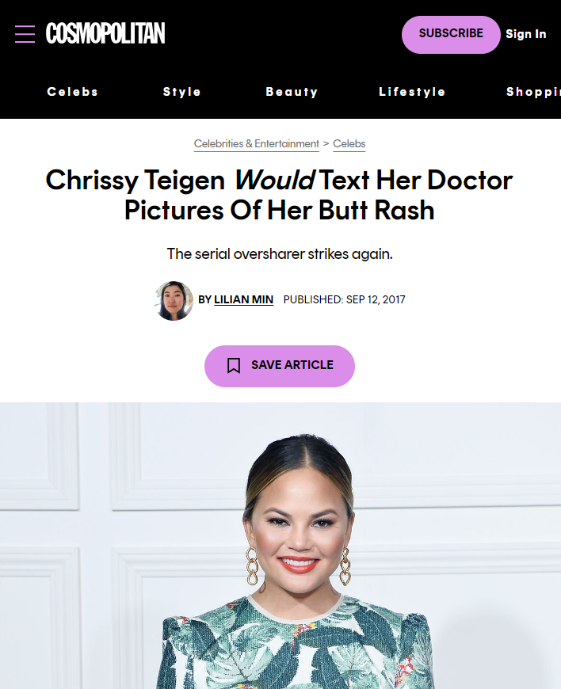

Slide 3
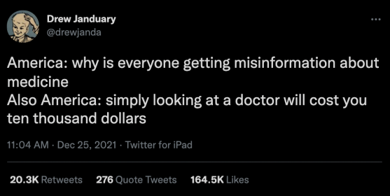
healthcare today:
“I can’t afford to make a doctor’s appointment nor can I afford to take the day off to go.”
Reddit User /u/PRSwensson

Slide 4
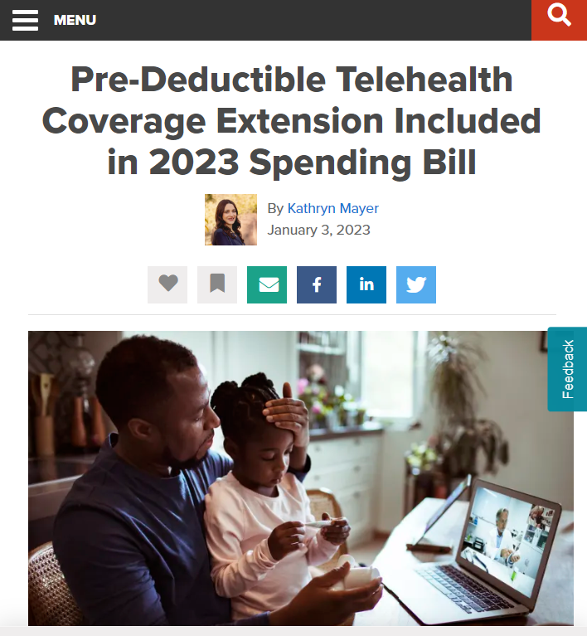
So what?
Regulatory changes
have removed barriers
to care.
…which creates a unique
opportunity for employers,
especially in hospitality.

Slide 5
Hop on the Omnibus
"Pre-deductible coverage helps employees because it allows insurance providers to cover telehealth services without requiring a co-pay or deductible upfront."
"Employers need the flexibility to design benefit plans that improve employees' well-being and help retain top talent.”
Emily Dickens, SHRM chief of staff, head of public affairs and corporate secretary.

Slide 6
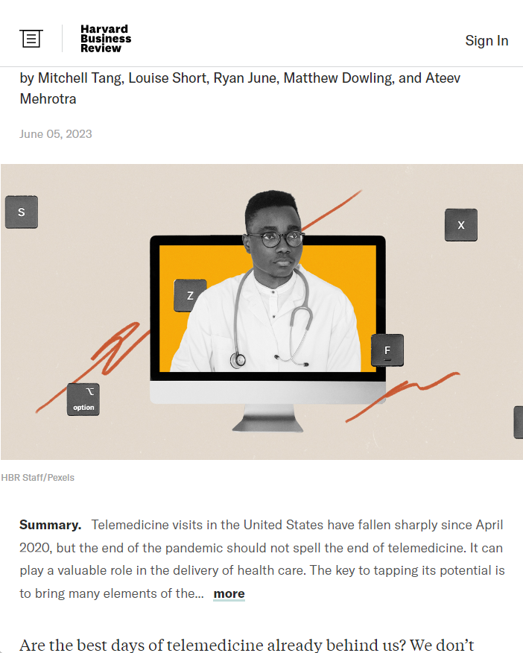
But…
274,000,000 Americans have access to telehealth
and don’t use it.
Why?

Slide 7
Why?
Traditional telehealth isn’t convenient.
Apps.
Long wait times.
No provider relationship.
Most plans still have copays.

Slide 8
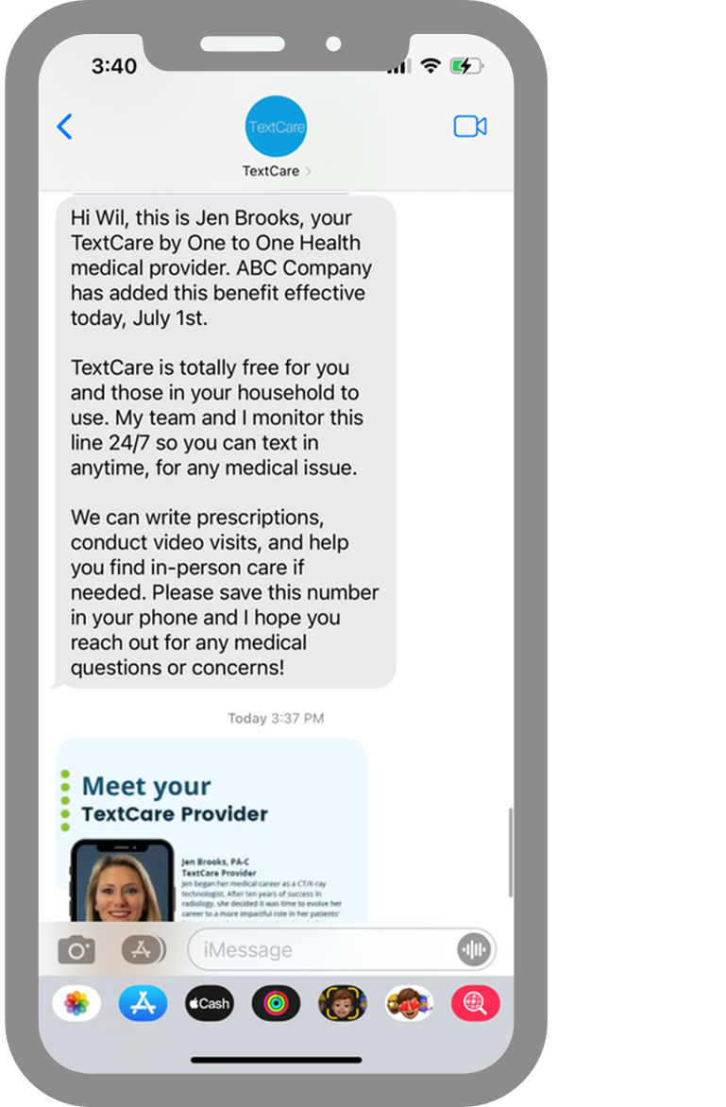
Meet TextCare.
Alex
Nurse
Text, talk to, or video chat with your One to One Health care team 24/7 in <5 minutes.
Initiate care with a text. It’s that easy.
Jen
Primary Care Provider
David
Internal Medicine Physician

Slide 9
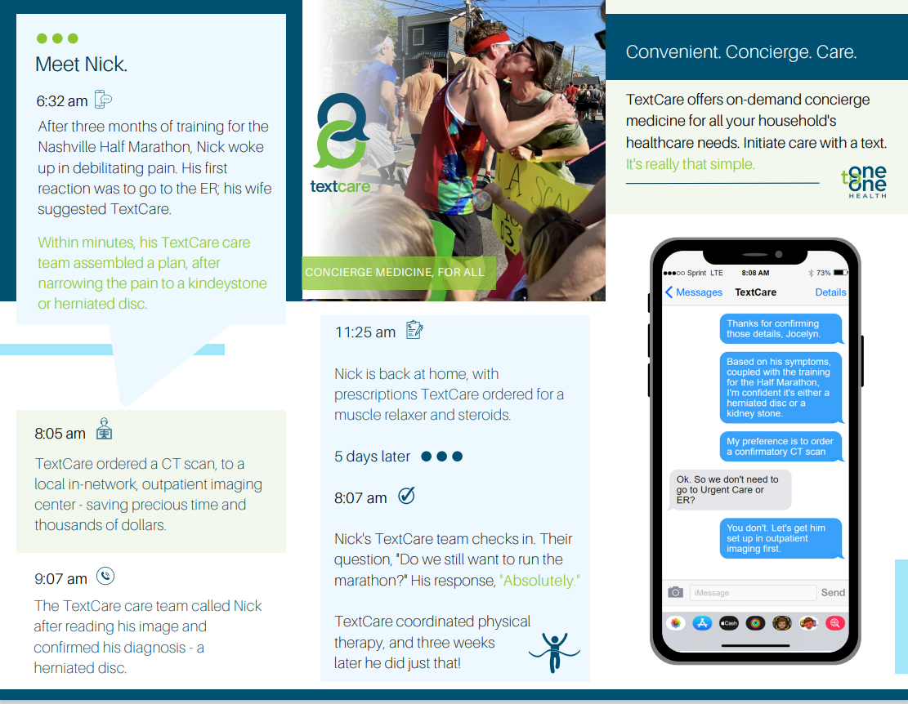

Slide 10
How can I use it?
What do I have?
Chat about symptoms, upload pictures or one-click into a video visit with a provider
Should I go to the ER?
Care coordination to avoid long waits in the Urgent Care or unnecessary, costly trips to the Emergency Room
What can I take?
As necessary, prescription and medication refills
How can I improve?
Control chronic conditions and access to dieticians, health coaches, and personal trainers
Concierge medicine, for all:
On-demand access to care 24/7
Response time in <5 minutes
Full-time One to One Health clinicians
Post-visit provider follow up, symptom evaluation
Prescription fill / RX adherence
Order and review Lab results
Provider-driven referrals to high-quality, high-value specialists and imaging
Coordination of care (scheduling appointments, closing care gaps)

Slide 11
Lower Costs
$1,142 savings per employee/year
71% of TextCare patients say they avoided ER or Urgent Care
Increased productivity
2.7 hours savings per single use
The power of Text:
Text messages have a 98% open rate
For 88% of the population, texting is the top reason they use their phone
Americans are 2X as likely to text vs call
Happier employees
96 Net Promoter Score
How would your organization benefit by increasing virtual visits
sevenfold?
TextCare’s average increase in monthly visits from a national competitor is 760% (6 total visits per employee, per month)

Slide 12
TextCare: Case Study – Service Industry
An engagement boost and effort to curb excessive ER utilization, all while delighting employees. Boosting monthly visit average by 769% in first 60 days.
Before TextCare:
81 ER Visits
4.2 Teladoc Visits/Month
12-minute average response time
29.5% Annualized Utilization*
*(YTD Visits X 12/ # Months Accrued / YTD Average Primary Members)
TextCare Results (after 1 year)
36.5 Visits/Month average (8X)
29% total employee engagement
Dramatically reduced ER visits
Visit Patterns:
94.5% Text, 4.1% Video, 1.4% Call
84.9% resolved 1st visit, 11% provider follow-up, 4.1% In-Person required
248.9% Annualized Utilization*
*(YTD Visits X 12/ # Months Accrued / YTD Average Primary Members)

Slide 13
Healthcare for hospitality
The war for talent in hospitality is real.
TextCare is a benefit that helps the whole family, and employees love it (96 NPS)
Productivity and staying at work is critical.
24/7 access in <5 minutes means less time in waiting rooms or missing work.
The hospitality workforce is diverse
Improve access to care for all employees, especially those with no relationship with primary care

Slide 14
Thank you & Questions
Let’s connect:
WTrohanis@121.health
Text us: 347-387-5961

