Slide 1



Managing Gen Z in the Hospitality Industry
Courtney Leyes
(615) 488-2902
cleyes@fisherphillips.com
Jenny Kiesewetter
(615) 488-2905
jskiesewetter@fisherphillips.com

Slide 2
Agenda
  Gen Z in the Hospitality Industry
  Defining Gen Z
  Zoomers in the Workplace
  Attracting Zoomers
  Diversity and Inclusion
  Retaining Zoomers

Slide 3
Gen Z in the Hospitality Industry
Gen Z is excited to work in a “people” industry.
Gen Z possesses more positive than negative attitude towards the hospitality industry.
However, GEN Z wants more stability and better working conditions.
International Journal for Hospitality Management, 2022

Slide 4
Defining Gen Z

Slide 5

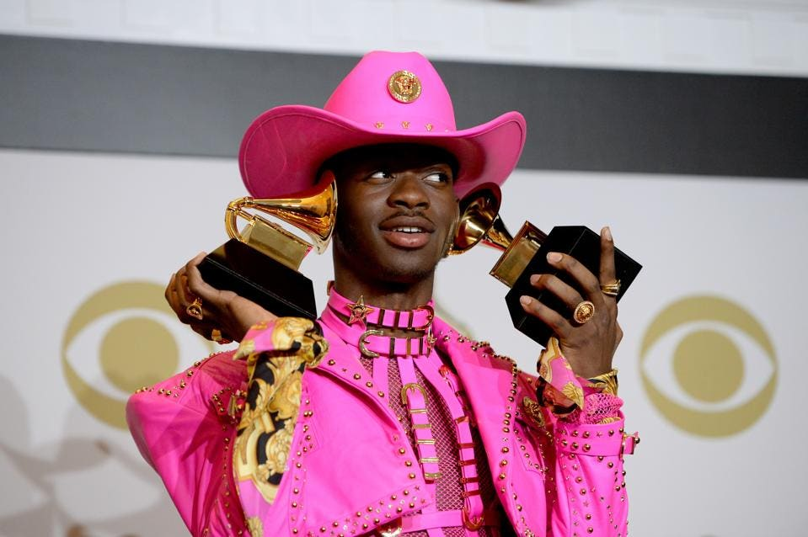

What is a Zoomer?
Demonstrate Commitment to Policies
Zoomer noun
A person born in the late 1990s to early 2000s; a member of generation Z.
Merriam-Webster
Notes:
Coloquial nickname for those born in Gen Z.
Gen Z is the next largest generation after the “Boomers” born after World War II
The nickname highlights the similarities to the Boomer generation while also pointing to the stark differences in generations
It plays on the notion that a majority of Gen Zers have experienced years of school on Zoom.
Famous Zoomers include Zendaya (born in 1996; she is on the cusp of Millennials and Gen Z); Kylie Jenner (born in 1997); Lil Nas X (born in 1999).

Slide 6
Moments that define Gen Z
Digital natives
The internet has consistently been a part of their lives since birth; the first iPhone was released in 2007 before many were even born.
Environmental crisis
Global warming has had its most impactful years during their childhoods with the 10 warmest years in history, being every year from 2010 to 2020.

Slide 7
Moments that define Gen Z
Political changes
American Zoomers have experienced some of the greatest changes in the political landscape with advancements in LGBTQ rights being the among the most prominent changes.
Health Crisis
Many Zoomers “coming of age” years have been thwarted by the COVID-19 pandemic.
Increase in gun violence in schools has led to gun violence being the leading cause of death for Zoomers aged 10-19.

Slide 8
Moments that have defined other generations
Millennials
Gen X
9/11
Social media/mass media development
Great Recession
Creation of the personal computer/internet
Fall of the Berlin Wall
Challenger Explosion
Baby Boomers
Civil Rights Movement
Moon landing
Cold War

Slide 9
Impact of defining moments
Out of Boomers, Gen X and Millennials, Zoomers are:
The most DIVERSE generation (25% are Hispanic, 40% are “minority”)
The most educated generation
The most likely to leave their job in the next 2 months
The least happy at work (25% are dissatisfied with their work)

Slide 10
Zoomers in the Workplace

Slide 11
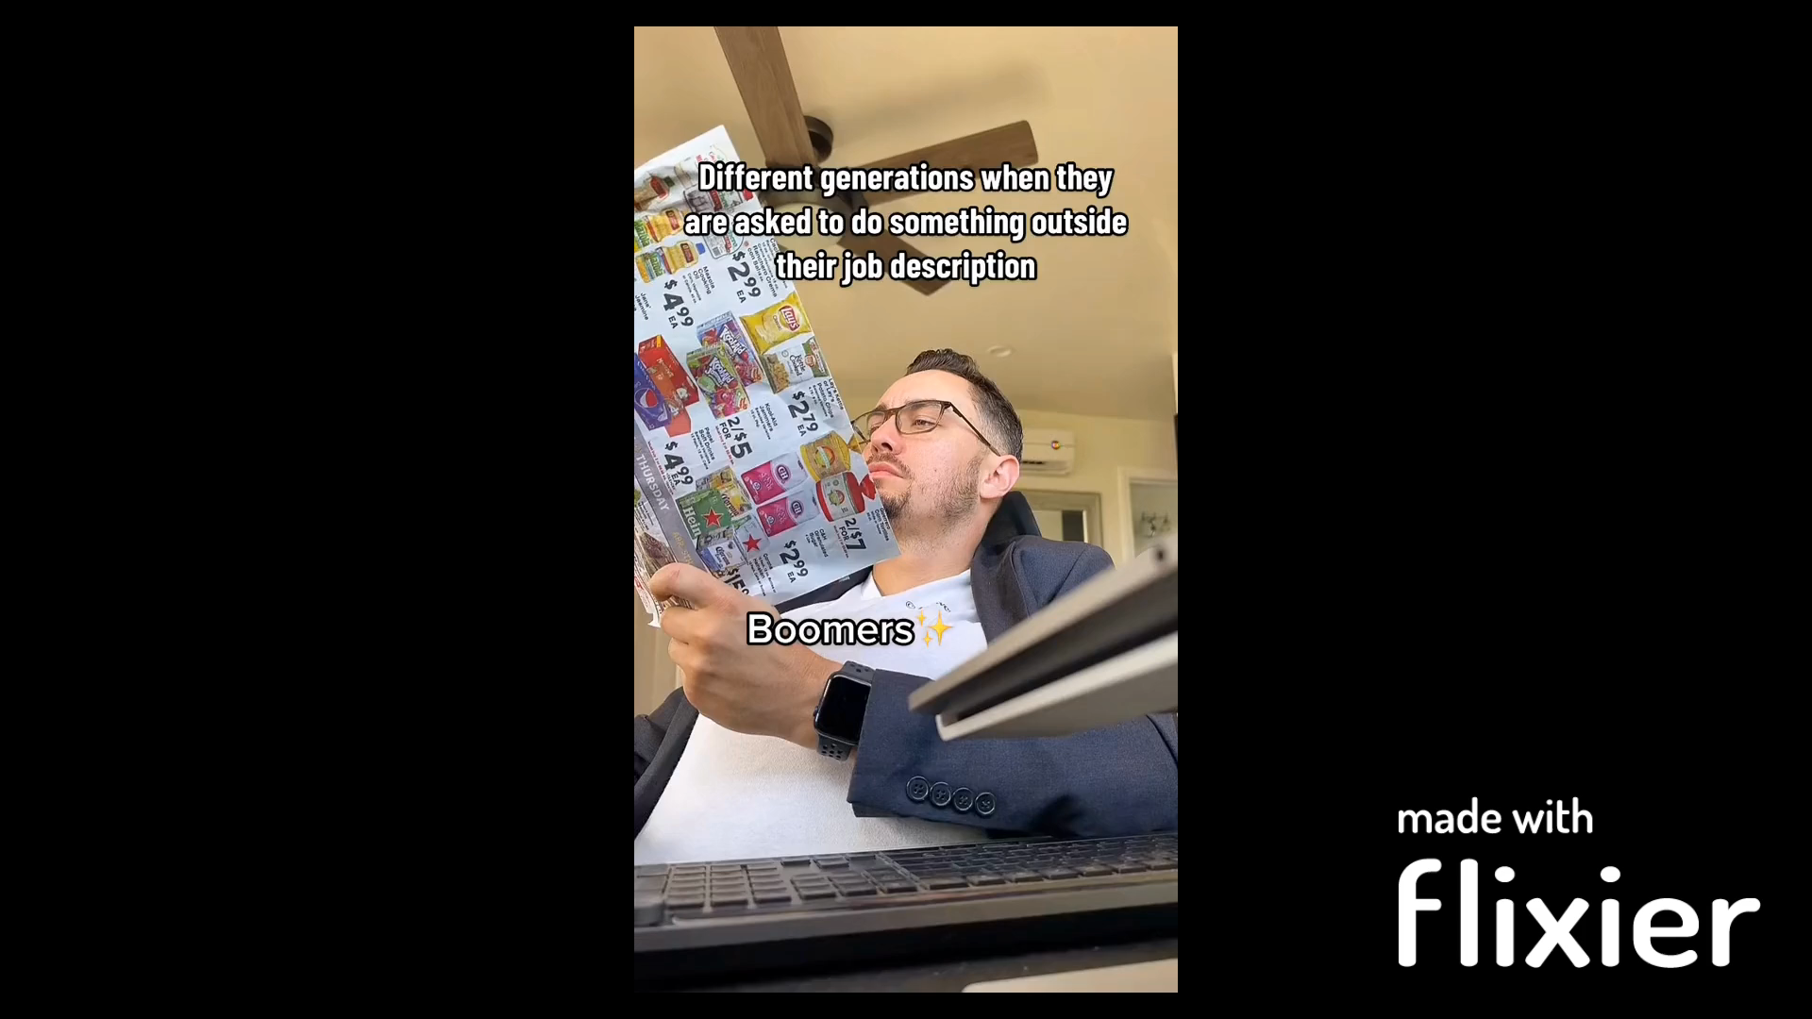
Zoomers in the workplace

Slide 12
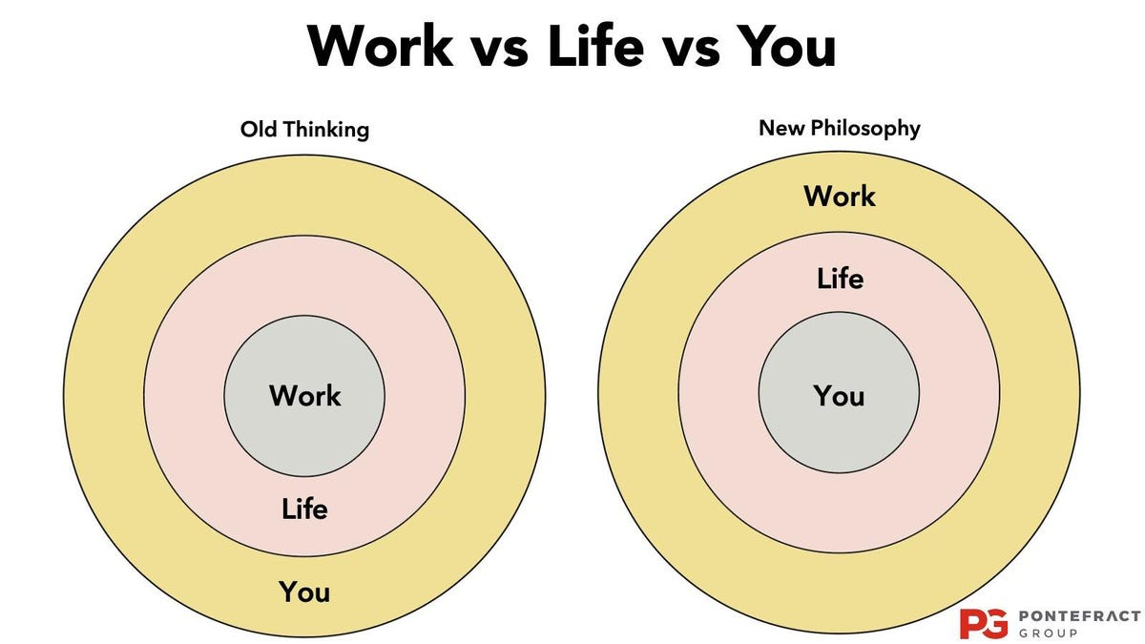
Zoomers in the workplace
Zoomers WORK to LIVE! They have reframed how society views work-life balance by scheduling work to fit AROUND their lives.

Slide 13
Zoomers in the workplace
Hard workers that are more likely to go where they are appreciated.
They want to do meaningful work with a sense of autonomy.
They want to find a job that aligned with her values, and where she would feel welcome and supported.

Slide 14
Zoomers in the workplace
Global warming is their top concern, and they want their employers to take a stance.
They are not attached to the “material grind.”
Also, Gen Z is less afraid to ask for what they want and need (as well as everyone else’s wants and needs, but they are too afraid to ask).

Slide 15
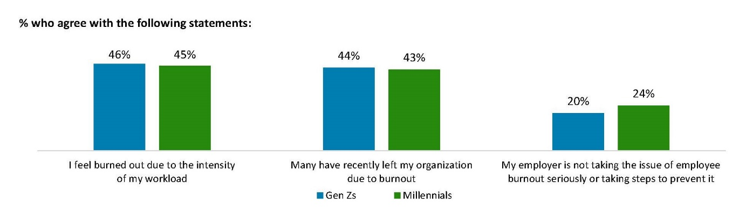
Battling burnout
Millennials and Zoomers makeup the youngest population of workers but are both weary of burning out before they reach their prime earning years.

Slide 16
Battling burnout
With the highest dissatisfaction rates, Zoomers have the lowest retention rates.
Zoomers have reported to be “happiest” at work when their employers are promoting social change.

Slide 17

Now what?
The differences between generational workers has led many employers wondering:
How can we give Zoomers what they really want in a workplace?

Slide 18
Attracting Zoomers

Slide 19
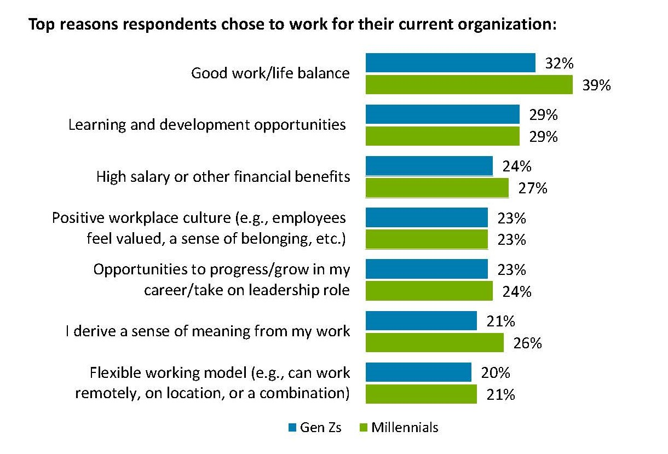
Deloitte 2022 Survey
Notes:
Work life balance is the top priority

Slide 20
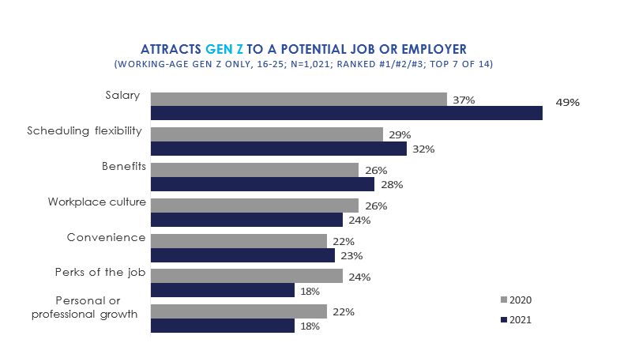
The Center for Generational Kinetics

Slide 21
Characteristics of an Attractive
Gen Z Employer
Presents itself as a value-based company (and lives up to those values).
Prioritized pay equity.
Focuses on social & cultural competency.
Provides employee benefit packages that include flexible PTO and health insurance.

Slide 22
Characteristics of an Attractive
Gen Z Employer
Provides career development opportunities.
Prioritizes diversity, equity, and inclusion.
Prioritizes mental health and wellness.
Provides continuous, clear feedback occurring throughout the year.
Makes feedback specific and constructive to show you care about their career growth.

Slide 23
Let’s look at some specific examples . . .

Slide 24
Pay Equity
Majority of Zoomers would opt for receiving a paycheck everyday.
Zoomers are 56% more likely than any other generation to share their paycheck amounts with coworkers.
62% of college students and recent graduates said they would be more likely to apply to a company if it was committed to equal pay. Therefore, companies that offer equal pay are more likely to see employee retention.

Slide 25
Social Consciousness
Zoomers list global warming as their top concern for the future.
They want to see companies that want to improve society.
Additionally, they are reportedly happier and more productive when the company they work for shares their own values.

Slide 26
Employee Benefits
Gen Z has had the largest increase of participants in an employer-backed 401k plan over every other generation at their age.
Zoomers are looking for employers that offer health insurance (including mental health benefits) and flexible leaves.

Slide 27
Learning and Development
Personal and professional development is one of the leading characteristics that Zoomers are looking for in an employer.
According to a recent Employee Well-Being Report, employees see “opportunities to learn and grow” as the top driver of work culture.

Slide 28
Learning and Development
A positive learning culture not only engages your existing employees, but can also help attract young talent who seek an employer that prioritizes learning.
Gen Z are the current generational leaders in seeking more opportunities to move up or increase responsibilities (61%) and more opportunities to learn or practice new skills (76%).

Slide 29
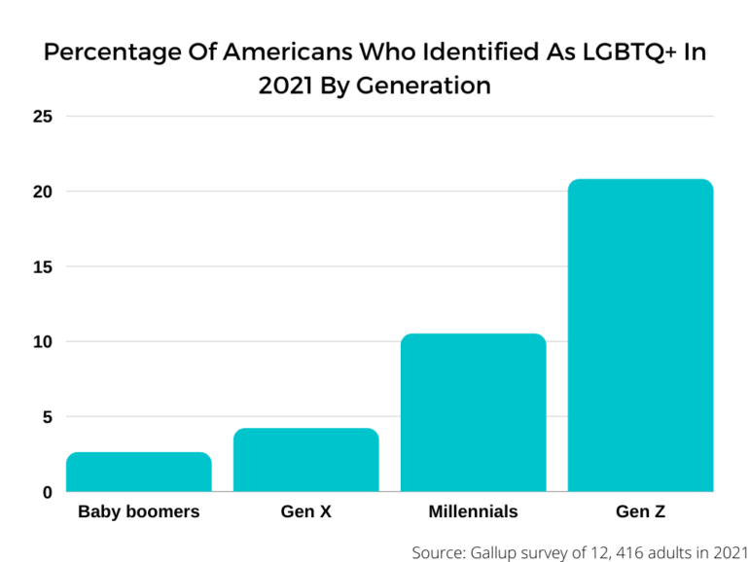
DEI: Gen Z is the most diverse generation
Zoomers care about cultural competency in the workplace.
88% want you to ask for gender pronouns in the hiring process.

Slide 30
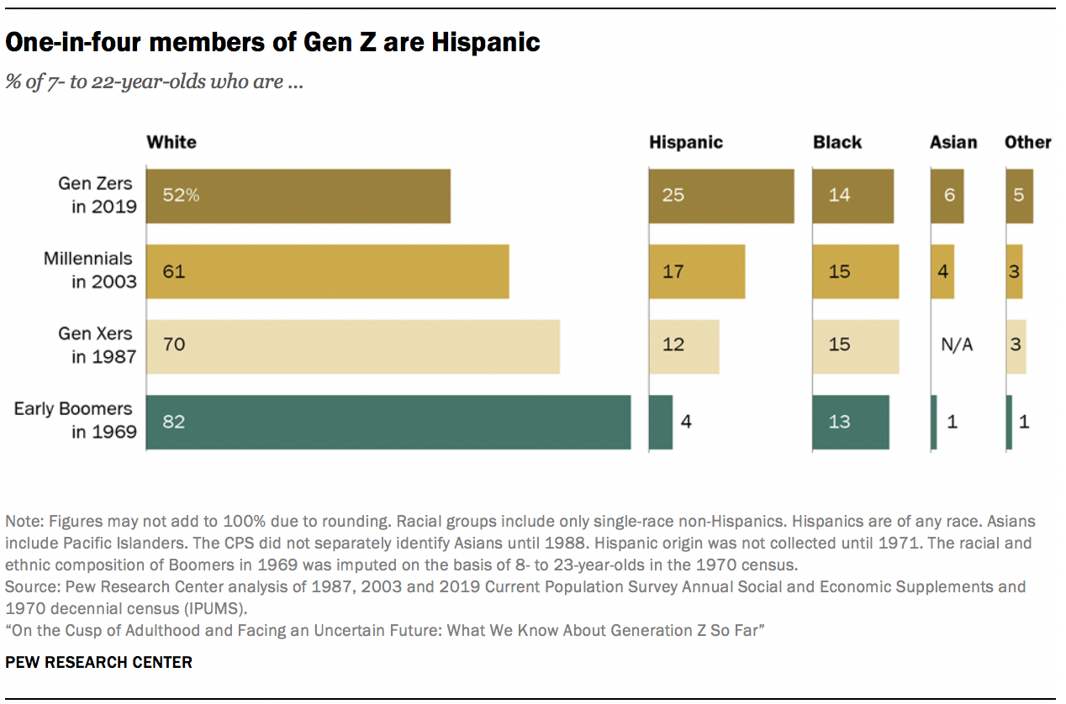
Gen Z: The most diverse generation

Slide 31
DEI is an expectation – not a “nice to have”
Zoomers expect diversity in the workplace.
Gen Z is more likely to define diversity as a mix of experiences, identities, ideas and opinions, rather than more traditional definition of diversity, such as underrepresented racial, ethnic, and gender demographics.
Equal pay, cultural understanding, and social change are all determining factors for DEI.

Slide 32
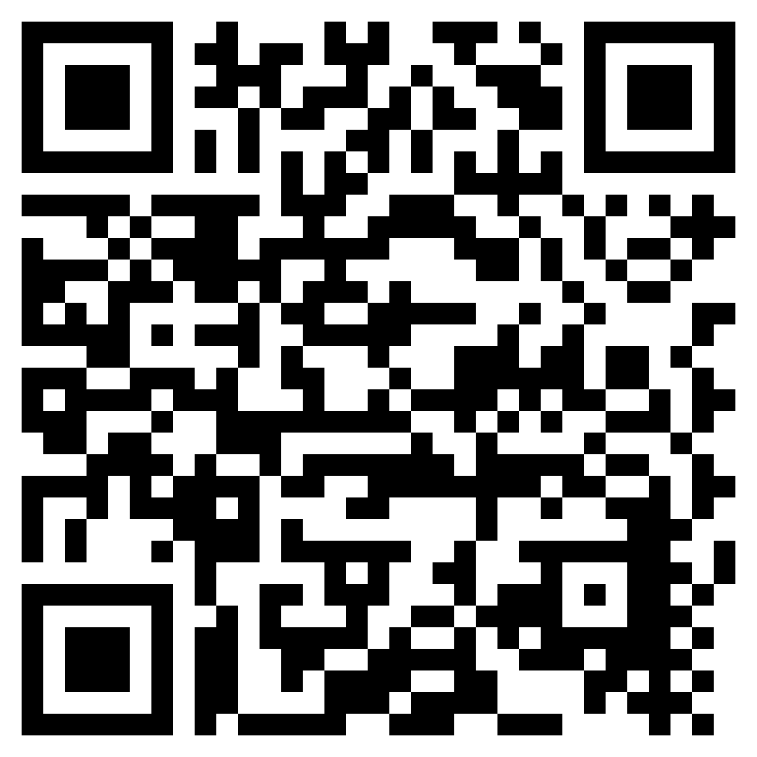

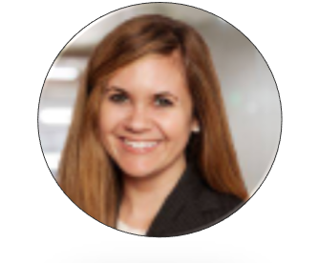
Final Questions?
Presented by:
Courtney Leyes
(615) 488-2902
cleyes@fisherphillips.com
Jenny Kiesewetter
(615) 488-2905
jskiesewetter@fisherphillips.com

