Slide 1
AI at Work
Hype, Hazards, and Reality
Brad Davis

Slide 2
Roadmap
New AI Vocabulary
Traps for the Unwary
AI Laws in Tennessee
How I'm Using AI
Is AI Going to Take My Job?

Slide 3
Three
Takeaways

Slide 4
1. Tool, Not Master
AI is a tool
Morally neutral
Your servant,
not your master
You maintain agency

Slide 5
2. Delegate Tasks, Not Judgment
AI handles execution
You retain judgment
Give the task to AI
Grade its work

Slide 6
3. Augmentation, Not Replacement
Get there faster
Force multiplier
Does not replace
judgment or leadership

Slide 7
New AI Vocabulary
AGI (Artificial General Intelligence)
A system that performs tasks at human level
Singularity
The hypothetical point where AI improves itself faster than humans can control it

Slide 8
New AI Vocabulary
Agentic AI
AI that does not just respond – it plans, acts, and executes tasks

Slide 9
New AI Vocabulary
Human-in-the-Loop
When a human remains responsible for oversight, correction, and final decision making

Slide 10
New AI Vocabulary
Shadow AI
AI tools used “off the books” by employees for work purposes

Slide 11
Traps for the Unwary
Data Confidentiality
  The Trap
Employee uploads confidential company info into free AI tool
  The Fix
  Build a sandbox
Enterprise account under contract
  No contract
  Written AI-use policy
  No oversight

Slide 12
Traps for the Unwary
Hallucinations
  The Trap
  The Fix
  AI is an intern
Double check your intern
Wrong, but confident it’s right
You are the human in the loop

Slide 13
Traps for the Unwary
Discovery
  The Trap
  The Fix
AI-specific data retention policy
Are AI chat histories discoverable?
Consistent implementation
Message discipline

Slide 14
Traps for the Unwary
Attorney-Client Privilege
  The Trap
  The Fix
Using AI for legal advice
Enterprise accounts
Lawyer in the loop
Uploading privileged info

Slide 15
AI Laws in Tennessee
Niche, Not Comprehensive
Guardrails, Not Anti-AI

Slide 16
How I'm Using AI At Work
Junior Associate
Co-Counsel
Summaries
First Drafts
Research Memos
Editing
Stress Testing
AI “Fight Club”
“Am I missing anything?”

Slide 17
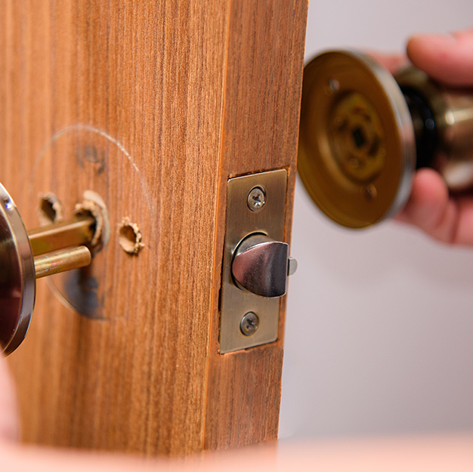
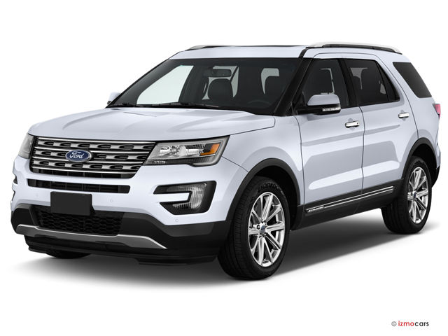
How I'm Using AI Outside Work

Slide 18


How I'm Using AI Outside Work

Slide 19
Is AI Going to
Take My Job?

Slide 20
The Pessimistic View
Entry-level tasks are automating
Capability improving rapidly
Markets are rewarding AI-driven efficiency

Slide 21
The Reality Check
Tech timelines are routinely overstated
Adoption lags behind innovation
Professions adapt.
They don’t disappear.

Slide 22
What Actually Protects You
  Exercise judgment amidst uncertainty
  Interpret nuance
  Manage risk
  Build credibility
  Make hard decisions
  Cultivate Relationships

Slide 23
Brad Davis bdavis@chamblisslaw.com
423.757.0291

Slide 25
