Slide 1
District 6 President's Project: Mental Health Awareness
District 6 President School: Pompano Beach High School
District 6 President: Mia Campbell

Slide 2
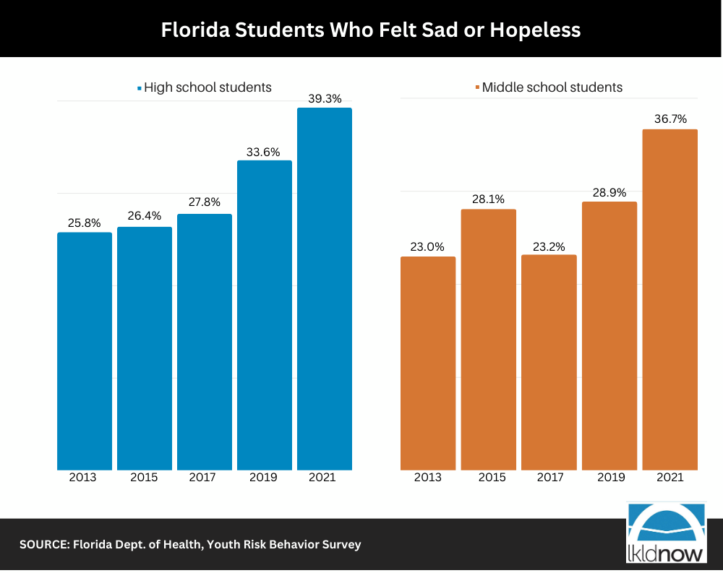
Why Mental Health?
According to the U.S department of Health and Services, one in five students in the state of Florida are faced with mental health problems.
To erase negative stigmas, we must educate ourselves and utilize our resources.

Slide 3
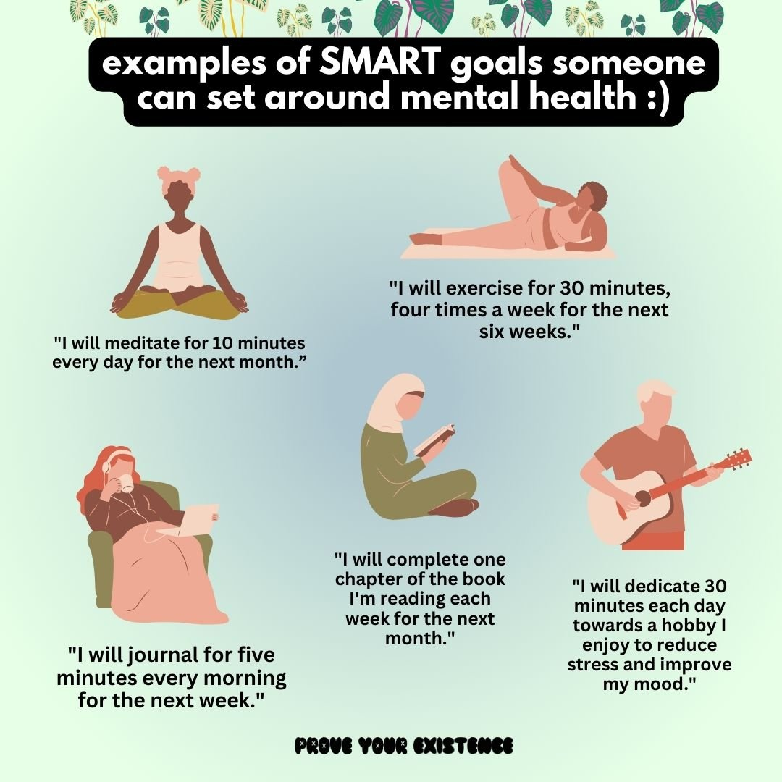
SMART Goals
Inform students and ADULTS on the issue of students’ mental health
Offer resources to everyone especially those in critical need
Safe space

Slide 4
How do we accomplish this?
Reach out to other schools and collaborate
Social Media (Instagram posts, Tik Toks, etc.)
Ask for student input (create surveys)
Work with each other

Slide 5
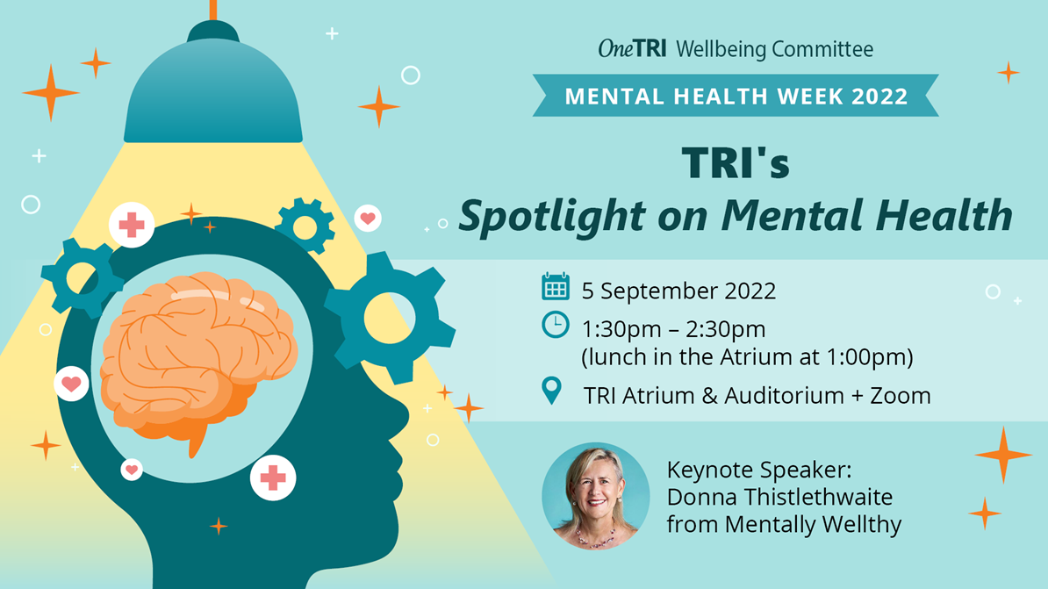
Ideas:
Provide resources
Create a zen room
Workshops
Guest speakers
Mental health-based spirit week
Wellness Wednesdays
Mental health notes

Slide 6
More Resources
Need any help?
District 6 president's email: miacambell08@gmail.com
Follow the District 6 instagram, @d6fasc

