Slide 1
Child Care & Development Transition Quarterly Stakeholder Call July 13, 2021

Slide 2
English-Spanish Interpretation
Click on the interpretation symbol in the meeting controls.
2. Click the language that you would like to hear (we have Spanish and Mandarin interpretation available for this meeting).
3. Optional: to hear only the interpreted language click “Mute Original Audio”

Slide 3
Interpretación Inglés-Español
1. En las opciones, seleccione el símbolo de interpretación.
2. Elija el idioma que desee escuchar (para esta reunión, solo se ofrece interpretación al español)
3. Opcional: si solamente quiere escuchar el idioma interpretado, seleccione “Mute Original Audio”

Slide 4
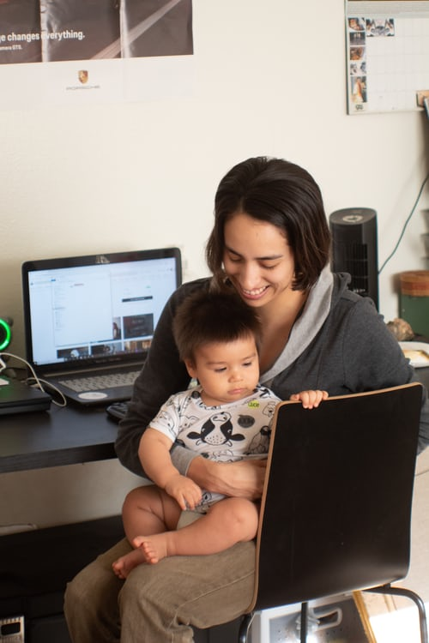
Agenda
Welcome
Administrative Transfer of Programs
Budget Updates
Ongoing Stakeholder Engagement

Slide 5
Welcome
Dr. Mark Ghaly, Secretary of California Health and Human Services Agency
Kim Johnson, Director of California Department of Social Services

Slide 6
Fourth Quarter Progress: Ensuring a Smooth Administrative Transfer Link to June 2021 Quarterly Report: https://bit.ly/3B3GHwH

Slide 7
CDE & CDSS Ongoing Collaboration
Child care and development programs and a number of staff transferred to CDSS as of July 1, 2021
Interagency Agreements will preserve some existing payment, reporting and monitoring functions at CDE until more streamlined systems can be developed at CDSS
CDE will continue to administer the Early Head Start-Child Care Partnerships Grant
Loan Back Inter-Agency Agreement (IAA) will allow transferring staff to continue to access CDE systems to ensure that CCDD & CACFP programs continue to run smoothly

Slide 8
Key Milestones and Transition Timeline
A high-level overview and timeline for how administrative, auditing, fiscal and contractual processes are being transferred
Link: https://www.cdss.ca.gov/Portals/9/CalWORKs/CCT/CDE-Transition-Key-Milestones-Timeline.pdf

Slide 9
Trailer Bill Language

Slide 10
Child and Adult Care Food Program (CACFP)
The USDA approved the transfer of the CACFP program from CDE to CDSS
The CACFP program will be its own branch (alongside the CalFresh & Nutrition Branch) in the Family Engagement and Empowerment (FEED) Division
Emergency Cost Reimbursement Funds
Online Trainings

Slide 11
Website Content Transition
Transferring all web content and creating new CDSS Child Care & Development and Child and Adult Care Food Program websites
CDE will continue to post relevant forms, documents, and webpages as needed until CDSS transfers all content

Slide 12
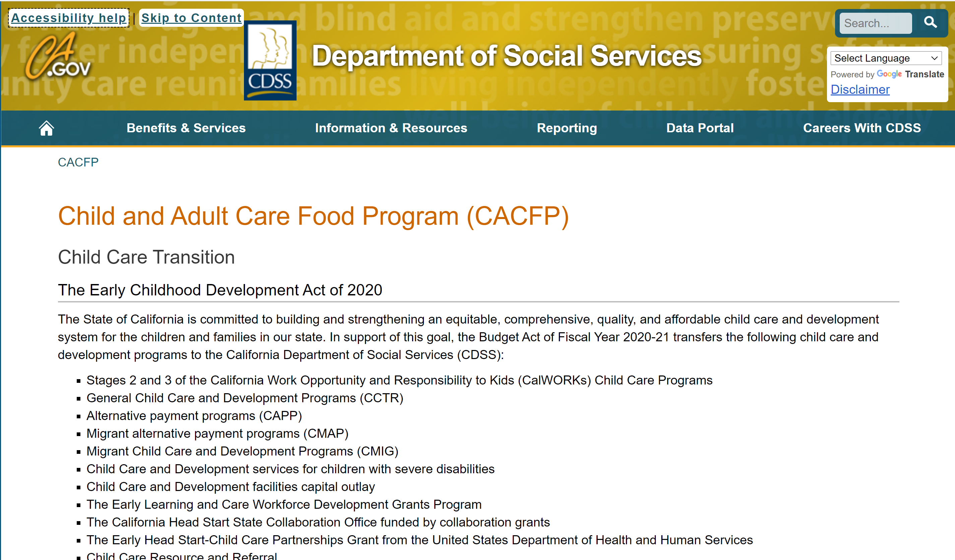
Child and Adult Care Food Program Webpage
Program Information and Resources available on or linked from this site. Additional updates coming.
CONTACT US
Website:
www.cdss.ca.gov/cacfp
Email: CACFPinfo@dss.ca.gov
Phone: 833-559-2420

Slide 13
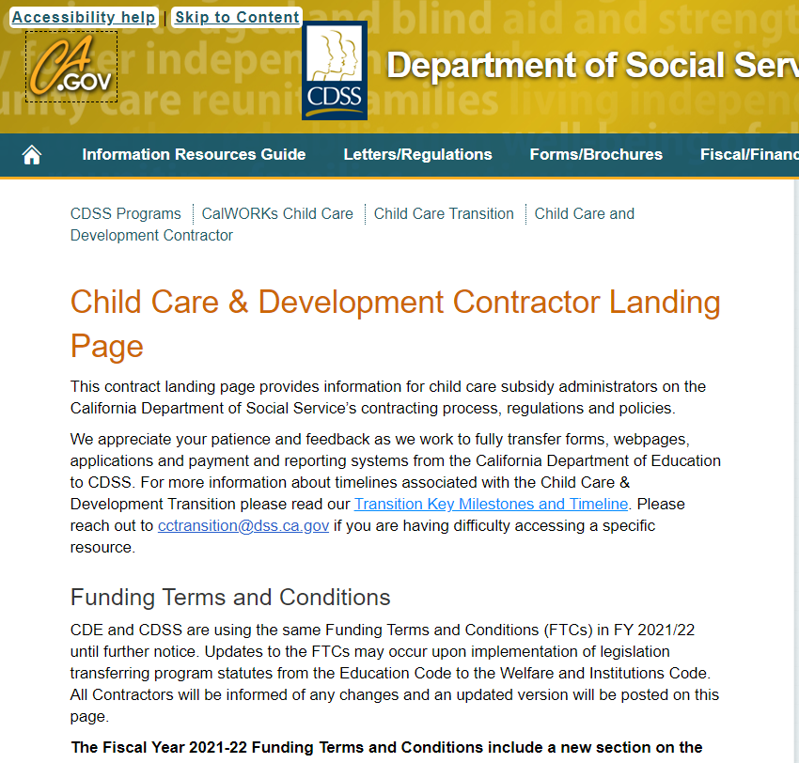
CCDD Online Resources
Child Care & Development Webpage
Child Care & Development Contractor Landing Page
Funding Announcements

Slide 14
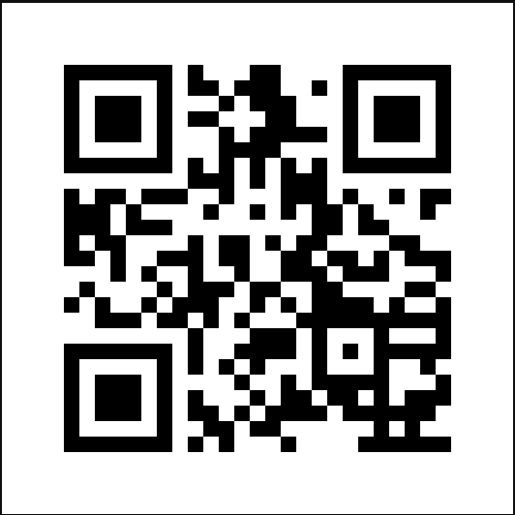
Child Care and Development Updates
Child Care Bulletins:
California Department of Social Services (list-manage.com)
Child Care Listserv Sign Up (or QR Code):
CDSS (list-manage.com)

Slide 15
Staffing Update
Authority for approximately 185.7 positions has transferred to CDSS on July 1, 2021
The 2021-22 budget included 79 additional positions to support California's Child Care and Development System, as well as to implement program enhancements and to support our whole-child/whole-family approach to child care

Slide 16
CACFP Org Chart
CACFP
Community Nutrition Programs Section
Program Integrity Bureau
Education & Nutrition Policy Section

Slide 17
CCDD Org Chart
CCDD
Head Start State Collaboration Office
Program Innovation, Policy & Research Branch
Program Quality & Improvement Branch
Data Research & Planning Office
Learning Innovation & Improvement Office
Child Care Administration Bureau
Child Care Policy & Development Bureau
Program Quality and Improvement North
Program Quality and Improvement South
Program Integrity and Improvement Section
Data & Research Unit
Learning Innovation & Improvement Unit
Policy Unit
Division Administrative Support Section
Admin Service Unit
Funding Application Unit
Appeals Unit
Child Care and Intergenerational Services Section
Program Policy Unit
Bargaining Unit
Program Integrity & County Operations Unit
Policy Implementation Unit
PQI North Unit
PQI South Unit
Program Integrity Improvement Unit A
Program Integrity Unit B

Slide 18
Contracts Status Update
Child Care and CACFP Direct Services Contracts - As of 7/12/21, 727 agreements were processed to date as follows:
430 Agreements are signed and returned for execution
276 Agreements are pending contractor's signature
21 Agreements are pending release
Please send all signed agreements and documents to:
Department of Social Services
Contracts and Purchasing Bureau
Child Care Contracts Section
744 "P" Street - OB9 6th Floor
Mail Stop #9-6-747
Sacramento, CA 95814
You may also send signed contracts electronically to: ChildcareContracts@dss.ca.gov
If you have any questions regarding contracts, please feel free to contact us at: ChildcareContracts@dss.ca.gov

Slide 19
Child Care and Development Division: Consultant Assignments

Slide 20
PQI Administrators
Lisa Velarde: Northern Region
Rosanne Pitz: Southern Region

Slide 21
Regional Consultant Contacts, North
Deborah Rawson: Alameda, Butte, Lassen, Plumas, Shasta, Tehama
Marijyane Patterson: Contra Costa, Del Norte, Humboldt, Lake, Mendocino, Modoc, Sonoma, Siskiyou, Trinity
Monica Grimes: Marin, Napa, San Francisco, Solano
Vacant (Deborah Rawson, interim): Santa Clara, Santa Cruz
Jocelyn Ward-Richardson: Colusa, El Dorado, Glenn, Nevada, Placer, Sacramento, Sierra, Sutter, Yolo, Yuba
Christina Toney: Alpine, Amador, Calaveras, Mariposa, Merced, San Joaquin, San Mateo, Stanislaus, Tuolumne

Slide 22
Regional Consultant Contacts, South
Deborah Wacker: Fresno, Inyo, Kings, Madera, Mono, Monterey, San Benito, San Luis Obispo, Tulare
Katina Boulai: Santa Barbara, Ventura, Los Angeles – SPA 1, SPA 4
Yer Xiong: Kern, Los Angeles - SPA 3, SPA 5
Megan Jones: San Bernardino, Los Angeles – SPA 7, SPA 8
Michael Benton: Orange, LA – SPA 2, SPA 6
Jonathen Yang: Imperial, Riverside, San Diego

Slide 23
Quality Group Inboxes
QCC@dss.ca.gov: Quality Counts California Block Grant
QCCWorkforce@dss.ca.gov: Quality Counts California Workforce Pathways Grant
CPHSP@dss.ca.gov: California Preventative Health and Safety Practices Grant
LPC@dss.ca.gov: Local Child Care and Development Planning Councils
CRRL@dss.ca.gov: California Renovation and Repair Loan
CCFRF@dss.ca.gov: Child Care Facilities Revolving Loan Fund

Slide 24
Programmatic and Policy Group Inboxes
CCTransition@dss.ca.gov: Child Care Transition
CCDDstakeholders@dss.ca.gov: Child Care & Development Stakeholders
CCPB@dss.ca.gov: CalWORKs Child Care
CCDDAppeals@dss.ca.gov: Appeals Office
CCTRRFA@dss.ca.gov: General Child Care and Development Application
CCDDcontracts@dss.ca.gov: Child Care & Development Contracts

Slide 25
Child Care Provider Database
Launch of Brilliant Beginnings Initiative to modernize the child care data landscape
CDSS is working to create a child care provider database related to the workforce registry, estimated to be completed in 2022
Updated database will link to CDSS licensing systems for improved user experience
CDSS will work with Alternative Payment Programs (APP), Resource & Referral Programs (R&R) and Local County Welfare Departments

Slide 26
FY 21-22 State Budget
The 2021-2022 State Budget is still being finalized.
Budget bills that contain the proposed appropriations are AB 128, AB 164, SB 129 and SB 164.
Trailer bills that contain proposed statutory changes are AB 131 & SB 131.
We anticipate legislative hearings on the trailer bills later this week.
The text of budget and trailer bills can be found online at: https://leginfo.legislature.ca.gov/.
CDSS will be sharing updates as additional information is available and once the budget is finalized.

Slide 27
Family Fee Waivers
Subject to finalization in state statute that will conform to the budget bill authority, family fees are waived for all Child Care & Development Programs administered by CDSS through June 30, 2022, including:
Alternative Payment Programs (CAPP), including Migrant Alternative Payment Programs (CMAP)
Migrant Child Care & Development Programs (CMIG)
General Child Care and Development Programs (CCTR)
Family Child Care Home Education Networks (CFCC)
Child Care and Development Services for Children with Special Needs (CHAN)
CalWORKs Stages One, Two (C2AP) and Three (C3AP)
Emergency Child Care Bridge Program for Foster Children
Notes:
/2021/CCB%2021-01.pdf?ver=2021-07-02-160501-353

Slide 28
Child Care and Development Block Grant
CDSS became the lead agency for the CCDF State Plan on July 1, 2021
The Administration for Children and Families (ACF) is expected to approve the CCDF State Plan between July 1st and Sept. 20th
After July 1st, CDE is available to CDSS for consultation and support regarding the CCDF State Plan

Slide 29
Stakeholder Engagement:
Quarterly Update Calls
Contractors Meetings
Parent Engagement
Tribal Child Care Association of California
Child Care Providers United
Early Childhood Policy Council (ECPC

Slide 30
Upcoming Child Care Bulletins
Parent Appeals
Equipment Purchases
Desired Results Developmental Profile (DRDP)
Family Fee Schedule
Revised State Median Income (SMI) Ceilings
Budget Enactment
Child Care Provider Stipends
Ongoing use of MyChildCarePlan.gov for Child Care Resource & Referral
California Supporting Providers and Reaching Kids (CalSPARK) Engagement Opportunities

Slide 31
Apportionments and Payments
Due to the delayed approval of the budget, the department’s budget has not been released.
We are working with control agencies to ensure delays are minimized, but at this time, it is likely that payments for initial apportionments will be delayed.

Slide 32
Collaboration with Federal Partners
We are in very regular communication with:
The Administration for Children and Families and the Office of Child Care &
The USDA concerning CACFP
We also regularly gain knowledge from and exchange information with other states and national organizations
Includes weekly meetings organized by the Center for Law and Social Policy (CLASP) regarding operationalizing federal funding

Slide 33
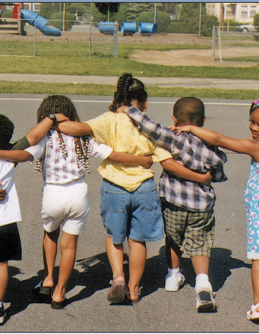
Child Care and Development Transition FAQs:
Transition FAQs
Contractor Specific FAQs
Any other questions …
(please raise your hand or enter your question in the question and answer tab)

Slide 34
Upcoming Activities
Upcoming Stakeholder Update Calls: TBD in October and December
Contractor Call: To be announced

Slide 35
Thank You!
Child Care & Development Transition Website
Please email us with any comments for questions at
cctransition@dss.ca.gov
ccddstakeholders@dss.ca.gov

