Slide 1
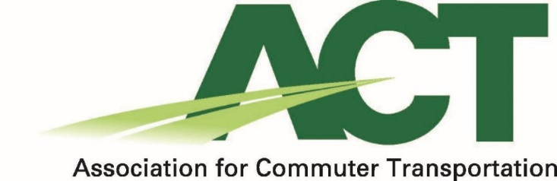
The premier organization for TDM professionals
www.actweb.org

Slide 2
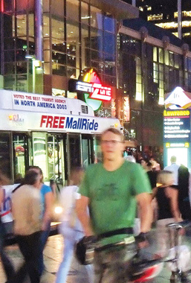

Our Vision
A better journey for everyone
Our Mission
ACT strives to create an efficient multimodal transportation system by empowering the people, places, and organizations working to advance TDM in order to:
  Improve the Quality of Life of Commuters
  Enhance the Livability of Communities
  Stimulate Economic Activity
Notes:
ACT is the premier association for TDM professionals, our goal is to build a strong community of individuals and organizations working to advance and implement TDM at their work sites and within their communities, with the goal of creating an efficient transportation system that moves people, reduces congestion, improves air quality, and supports economic activity. ACT is your organization for the latest information and best practices in TDM.

Slide 3

Our Goals
  Create a strong community of TDM professionals
  Become a center for learning & professional development
  Establish ACT as an originator of research and distributer of information
  Advance TDM policy & support member advocacy
  Develop a vibrant and growing organization

Slide 4
This is Your Association
Community:
1,150+ TDM professionals
USA, Canada, & Globally
Professional Development: Virtual & in- person learning, networking
Career Growth:
Certification, mentoring, leadership training
Industry Advancement: Advocacy, public policy, government affairs
www.actweb.org
Notes:
For TDM professionals – Transportation Planners, Parking & Transportation staff, Employee Transportation Coordinators, Human Resources, and others working to improve transportation options for commuters…. ACT is your association.
ACT provides you valuable professional development opportunities with dozens of virtual and in-person events a year.
ACT supports your growth as a professional from the moment you enter the field until you retire through mentoring, leadership development, and our soon to launch professional certification via the TDM-CP exam.
ACT works to advance the entire TDM industry through advocacy and influence of federal, state, and local policies supportive of TDM. We are at a very important point in time in regards to building support for TDM at the federal level as ACT has succeeded in incorporating TDM throughout the INVEST in America Act.
As the largest network of TDM professionals, bringing together nearly 1200 of your colleagues and peers across the United States, Canada, and in countries around the world creating a community to learn from and collaborate with. This has been invaluable as we have had to deal with the challenges brought on by the global pandemic. It’s been wonderful to watch hundreds of members gather on our weekly calls and working together to develop our recently release resource document on how to “Supporting Commuters Returning to Work Post COVID”

