Slide 1

The premier organization for TDM professionals
www.actweb.org
info@actweb.org

Slide 2
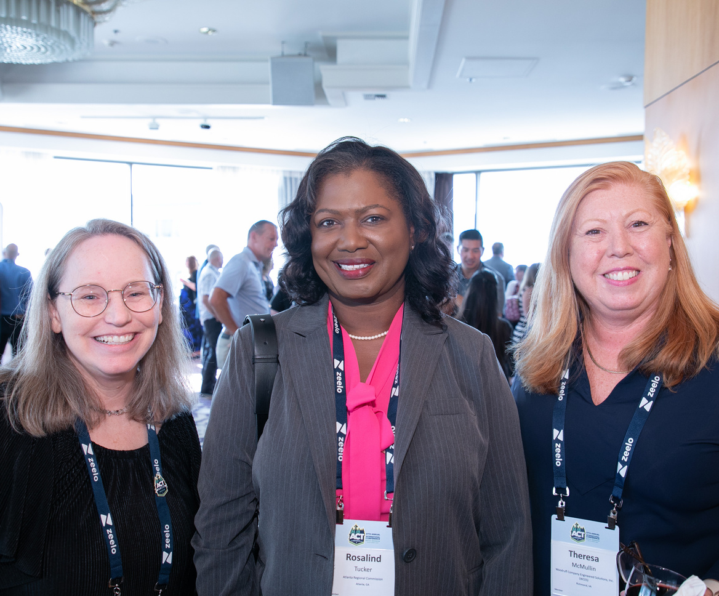
Our Vision
A better journey for everyone
Our Mission
ACT strives to create an efficient multimodal transportation system by empowering the people, places, and organizations working to advance TDM in order to:
  Improve the quality of life of commuters
  Enhance the livability of communities
  Stimulate economic activity

Slide 3
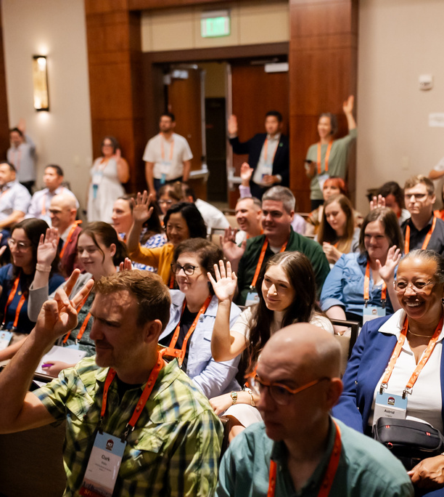
Our Goals
  Create a strong community of TDM professionals
  Become a center for learning & professional development
  Establish ACT as an originator of research and distributor of information
  Advance TDM policy & support member advocacy
  Develop a vibrant and growing organization

Slide 4
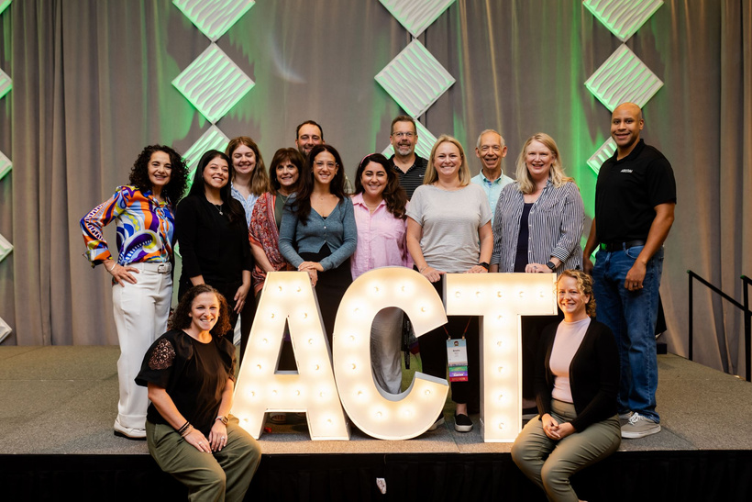
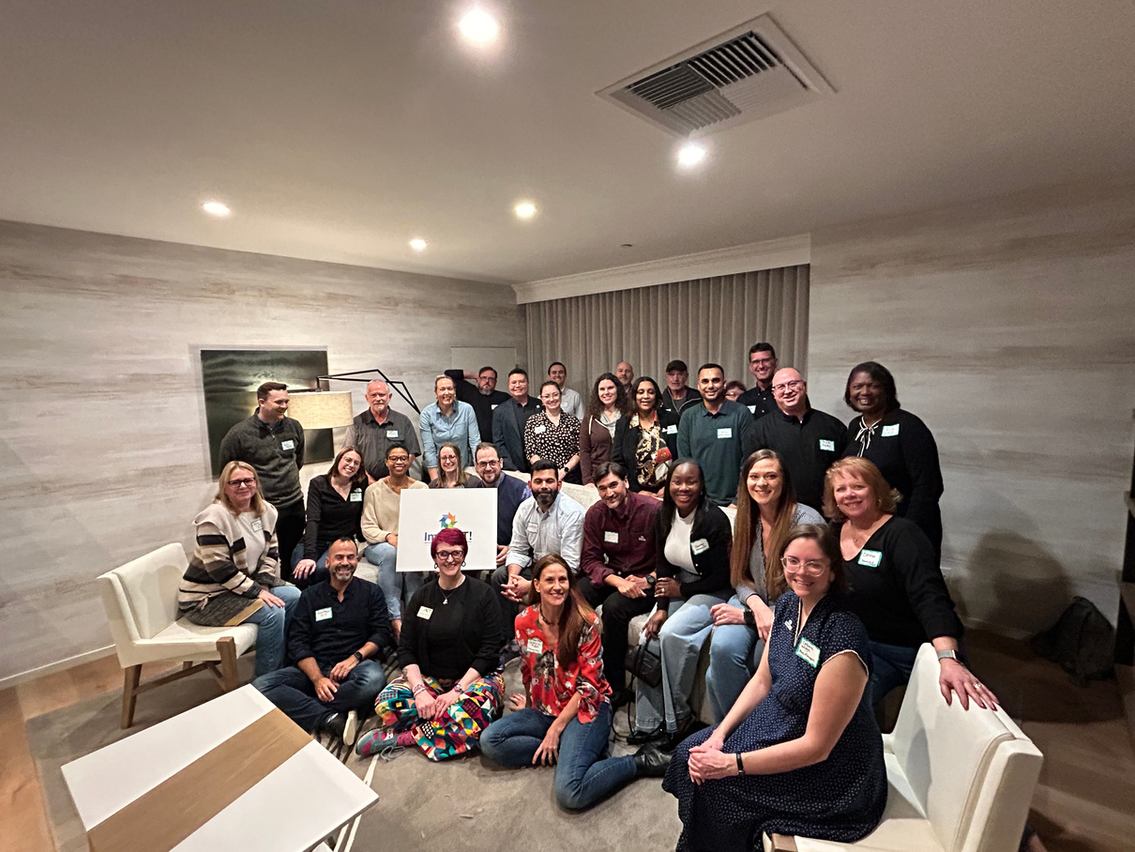
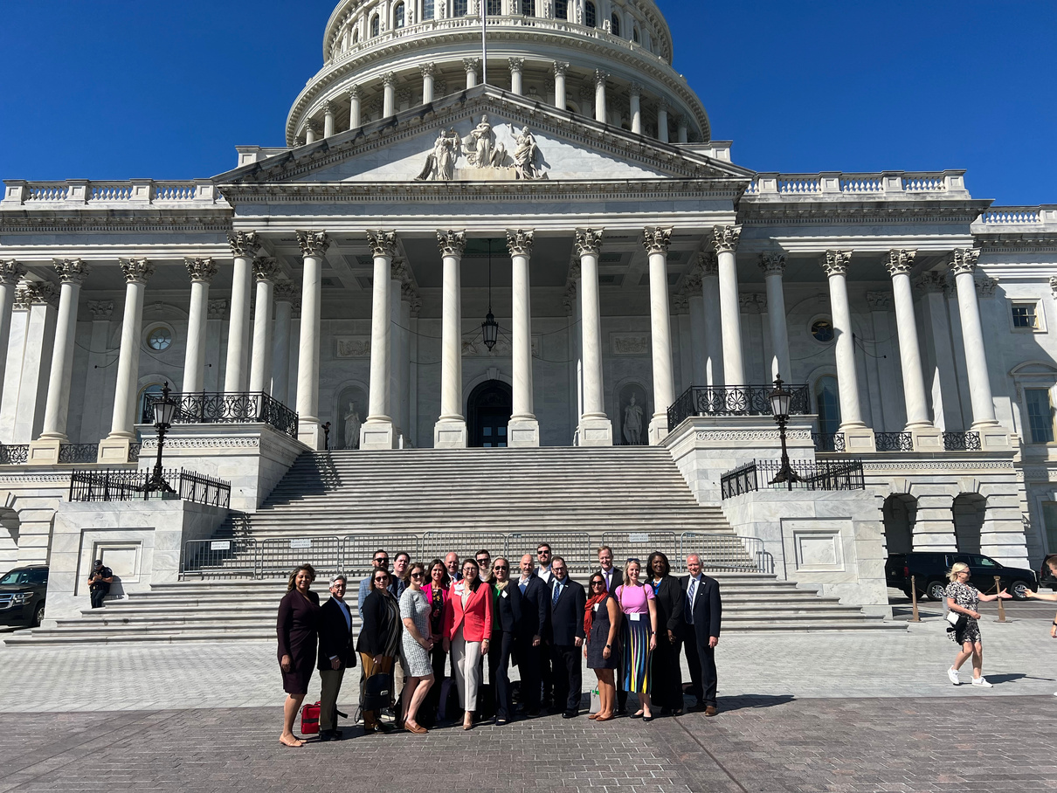

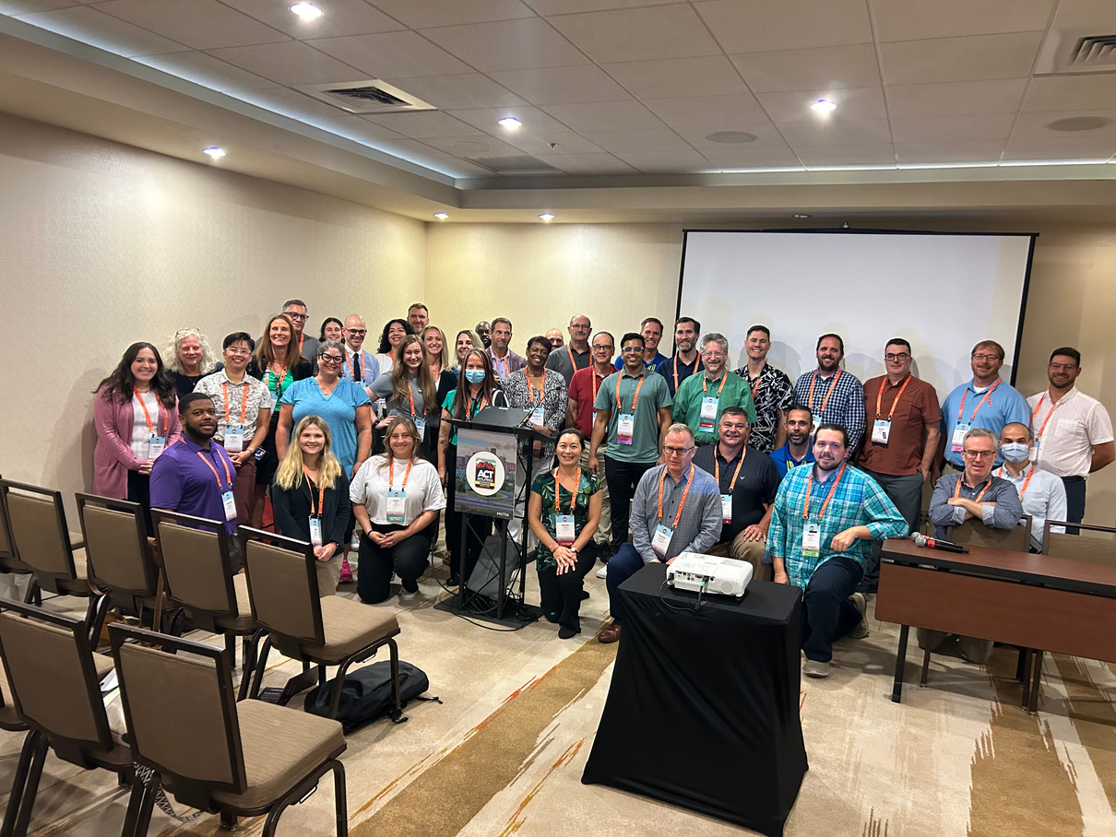
This is Your Association
Community
Professional Development
Industry Advancement
Career Growth
1,700+ TDM professionals
USA, Canada, & globally
Visual and in-person learning & networking
Certification, mentoring, and leadership training
Advocacy, public policy, and government affairs

