Slide 1
Employment Supports and Community Engagement
Presented by
Paige Raetz, PhD., BCBA-D November 10, 2022

Slide 2
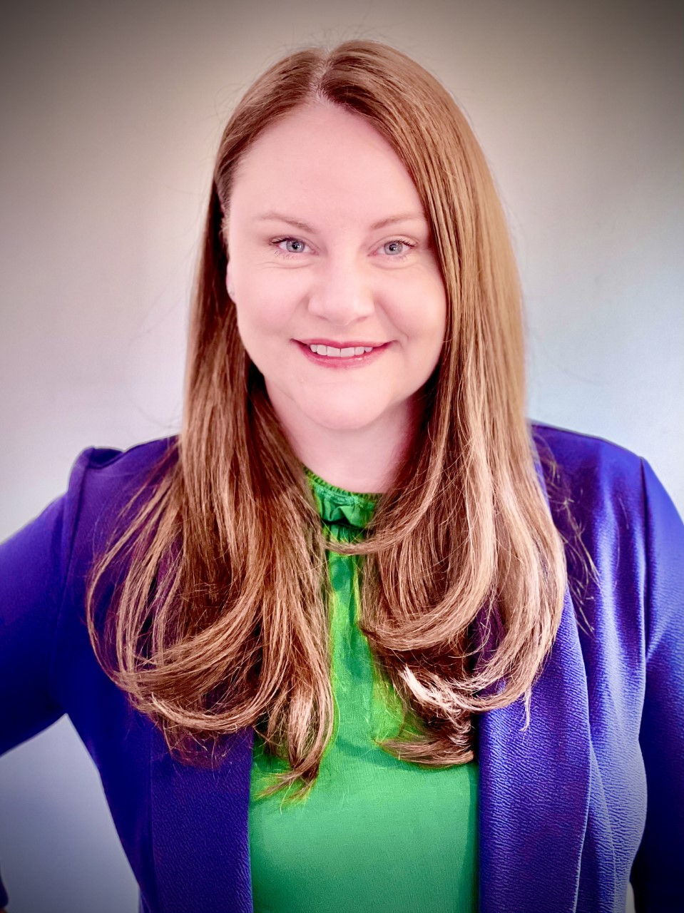
Speaker Affiliations
Paige Raetz, PhD., BCBA-D is the current Clinical Director at the Southwest Autism Research and Resource Center (SARRC) in Phoenix, AZ. Dr. Raetz is a Board-Certified Behavior Analyst (BCBA-D) and is licensed as a behavior analyst in the state of Arizona. In addition to her work at SARRC, Dr. Raetz currently services on the governor’s appointed committee on behavior analysis as well as current Vice President of the Autism Provider Exchange (APEX).
Notes:
Very pleased to welcome Dr. Moore to speak with us today.
I’ve know Rusty since the late 80’s when we were in veterinary school together at Ohio State.
As you can see from his bio, he is one of the most intelligent people you will ever meet and he made a significant impact in the field of veterinary medicine. He is currently the Dean at OSU CVM and in that capacity is also making a difference in the areas of DEI.
If you have every attended the Autism Law Summit, you know that the tagline for that conference is “A gathering of doers in the world of autism law and policy.”
Well, Dr. Moore is a doer in the world of DEI. All of us on this webinar today recognize that racism and discrimination is a problem but I know that many of us struggle with how we can make a difference.
In Dr. Moore’s presentation, he will describe the actionable steps that he and his team at OSUCVM have taken and the measurable outcomes they have achieved as it relates to improve DEI in their student body.
But first, KKB and Dallas (co chairs of CASP DEI SIG) are going to offer some parallels between veterinary medicine and the field of ABA that may help you to contextualize some of Dr. Moore’s comments.
We will hear from them again after the presentation to share their plans for the SIG.

Slide 3
CASP DEI SIG
Thank you to the leadership and members of the CASP Diversity, Equity, and Inclusion SIG for bringing this webinar to us!

Slide 4
Housekeeping
Please submit your questions and monitor for responses in the Q&A box.
This webinar is eligible for 1 BACB CEU credit.
Please limit use of the chat box for comments

Slide 5
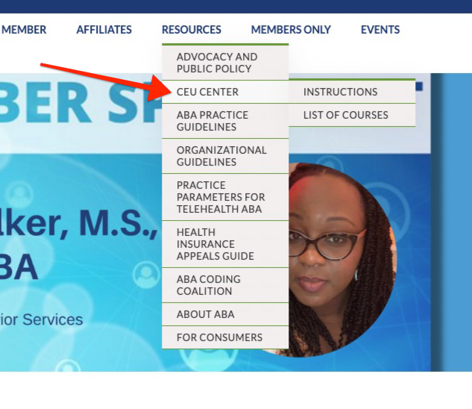
CASP Online CEU Center
Visit www.casproviders.org

Slide 6
CASP Recorded Webinars
Visit www.casproviders.org

