Slide 1
      2023 PG&E Updates
      Monday, March 20th, 2023
Youran Kim
Senior Customer Relationship Manager
PG&E
youran.kim@pge.com

Slide 2
Agenda
Topics
Welcome
NEM2 Sunsetting
Rates Updates and Forecasts
10,000 Mile Undergrounding Program Update

Slide 3
NEM2 Sunsetting

Slide 4
NEM2 Sunsetting
If you have any planned projects and want to qualify for NEM2, please submit the
following by 11:59 PM PST on 04/14/2023:
Completed application, free of major deficiencies (e.g. no blanks, incomplete/inaccurate document, and/or changes requiring resubmission per Rule 21)
A single-line diagram
A signed CSLB Disclosure and Solar Consumer Protection Guide (For residential, non-self install only)
A signed Agreement and Authorization Form (For systems 30kW or less)
Final inspection clearance must be submitted before April 15, 2026, to retain NEM2
eligibility.
After this time, In-progress but unsubmitted Rule 21 generation applications will be
cancelled (excluding NEM Aggregation, Virtual NEM and ZNE generation
applications).
For additional information, please go to https://www.cpuc.ca.gov/nemrevisit/. I also encourage you to reach out to me if you have specific questions.

Slide 5
Rates Updates and Forecast

Slide 6
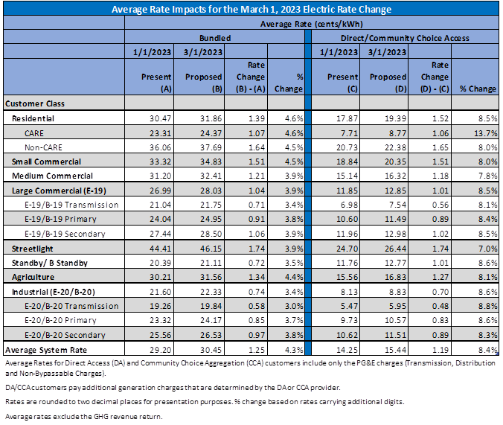
Rates Updates and Forecast
The webinar at the link below, as well as review the presentation slides.
2023 Rates Outlook Webinar
2023 Rates Webinar Presentation
For additional gas rates support, please see these forecasts (updated on the 10th of every month).
PG&E GNR-1 Forecast : Sm_Commercial.pdf (pge.com)
PG&E GNR-2 Forecast : Lg_Commercial.pdf (pge.com)
PG&E G-EG Forecast: EG.pdf (pge.com)
All rates and tariffs can be found on our website: Pacific Gas & Electric - Tariffs (pge.com)

Slide 7
10,000 Mile Undergrounding Program Update

Slide 8
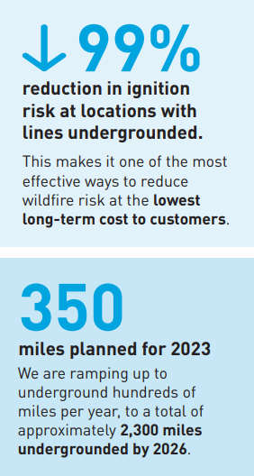
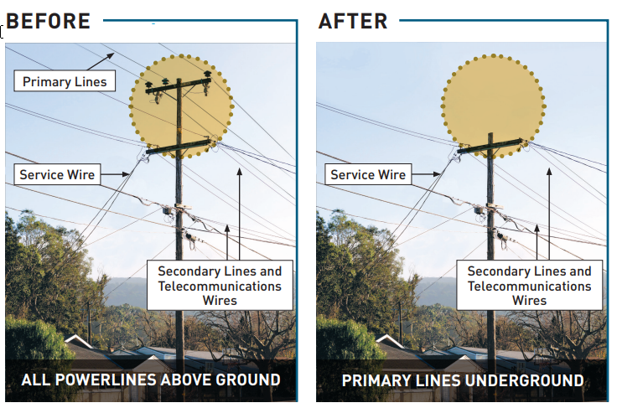
10,000 Mile Undergrounding Program Update
Time-of-Use Period Change Overview
We met our 2022 goal of undergrounding 175 miles (180 miles completed) — more than double what we did in 2021.
Next: 2023 goal of undergrounding 350 miles in the highest fire-risk areas to make our system safer and more resilient, while positioning us to better serve our customers and respond to our state’s evolving climate challenges. (Link for more information)
Notes:
TOU periods different for commercial and industrial but same for Ag
Hours are 365 days/year but the values of the rates will change based on season and holidays/weekends

Slide 9
Public Safety Power Shutoff (PSPS) Program & CAISO Flex Alerts
QUESTIONS?
youran.kim@pge.com

