Slide 1
Scholarship of Education
SIG Meeting
Educational Leadership Conference 2018

Slide 2
Announcements
ELP - adopted the 9 action items and 30 recommendations from the Excellence and Innovation in PT Ed study (attached) as the education research agenda.
There will be a Research Networking Breakfast event at ELC on Saturday from 6:30 AM to 8:00 AM. It will be similar to the one held at CSM.
Someone from the PAC will be stopping into the meeting
Zoom research call at noon PST Friday October 19
Nominations are open for officers for the SIG
  Secretary and Vice Chair are open
Call for assistance and ideas on developing resources for the website

Slide 3
Thoughts on Theoretical Frameworks
APTA Scholarship of Education SIG
Educational Leadership Conference
Jacksonville, FL 2018

Slide 4
What is a theoretical framework?
The underlying structure and scaffolding of your study
  Explicitly stating the theory and logic that behind the assumptions that drive your study
It is derived from the perspective or orientation you bring to your study
This sets how you are framing your observations/data in your study

Slide 5
“Theory allows seeing what we would otherwise miss.”
~(Thornton, 1993: cited in Merriam, 2009)

Slide 6
How do you identify your theoretical framework?
Draws on concepts, terms, definitions, models and theories within the literature base and/or disciplinary tradition
Your literature review shapes your framework
What is the theory driving your study?

Slide 7
How does your framework influence your research?
What data you collect and how you analyze it is influence by the theory driving your work
How you make sense of your findings is influenced the theory and the prior literature in that area

Slide 8
Your work is influenced by theory and should influence theory

Slide 9
Some steps to building your framework
(Simon & Goes, 2011)
What is your research question or concern?
What are the key variables you will examine?
Review the relevant literature and Identify key authors
Identify your key constructs or variables
Examine and explain how your constructs/variables of interest relate to theory (does theory explain how these variables should behave?)

Slide 10
Steps continued
Revisit your literature search, include specific searches for theories you have identified
Examine the assumptions of each theory and its relevance to your research
Also consider other theories that might challenge your assumptions. Consider the limitations of the theory you choose.

Slide 11
An Example of Framework and Developing Theory

Slide 12
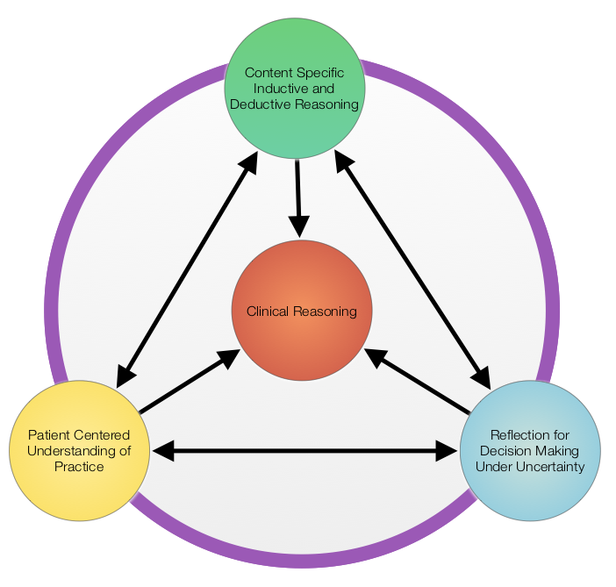
Preliminary Framework
Notes:
Content specific evident (errors in accessing or using information flexibly)
Orientation: parallels of characterizations and actions during encounter -> suggests perspective drives practice
Reflection: necessary for flexible reasoning during encounter, also in long term learning (drawing on prior clinical experiences)

Slide 13
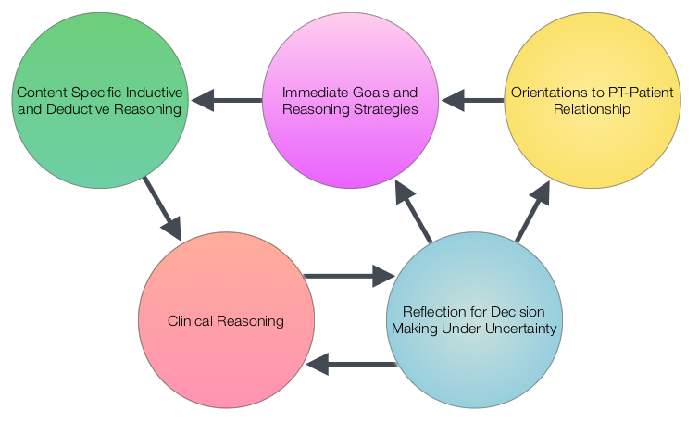
Revised Model
Notes:
Moment to moment goals are influenced by beliefs and values -> these drive actions (Schoenfeld, 2010)
For PT reasoning -> immediate goals drive knowledge and skills drawn on in the moment
Reasoning strategies and hypotheses indicate immediate goals -> focus of reasoning process
Explicit goals and priorities for patient intervention were consistent with goals of examination
These goals evident in reasoning strategies were consistent with the students’ orientation (evident in characterization)
Knowledge and skills necessary to act on goals (errors evidence limitations in this link)
Reflection necessary for revising immediate goals and long term learning

Slide 14
Some recommended resources
Merriam, S. B. (2009). Qualitative research: A guide to design and implementation. San Francisco: Jossey-Bass.
Patton, M. Q. (2002). Qualitative research & evaluation methods (3rd ed.). Thousand Oaks, CA: Sage Publications, Inc.
Simon, M. K. and Goes, J. (2011). Developing a theoretical framework. Excerpted from Dissertation and Scholarly Research: Recipes for Success. Seattle, WA: Dissertation Success LLC (www.dissertationrecipes.com)

