Slide 1
Scholarship of Education
Special Interest Group
Business Meeting
October 13, 2023
5:30pm EST

Slide 2

Agenda
Announcements
Foundation for Physical Therapy Research
Qualitative SIG
Academy of Education updates
Scholarship of Education SIG business updates
Grant Writing

Slide 3
Announcements

Slide 4
SoE SIG Objectives
Promote educational scholarship in physical therapy.
1
Provide role modeling, mentorship and support for researchers interested in educational research.
2
Foster networking and collaboration among educational researchers.
3
Assist in the exploration of best practices in physical therapy education and facilitate the translation of these findings into practice.
4

Slide 5

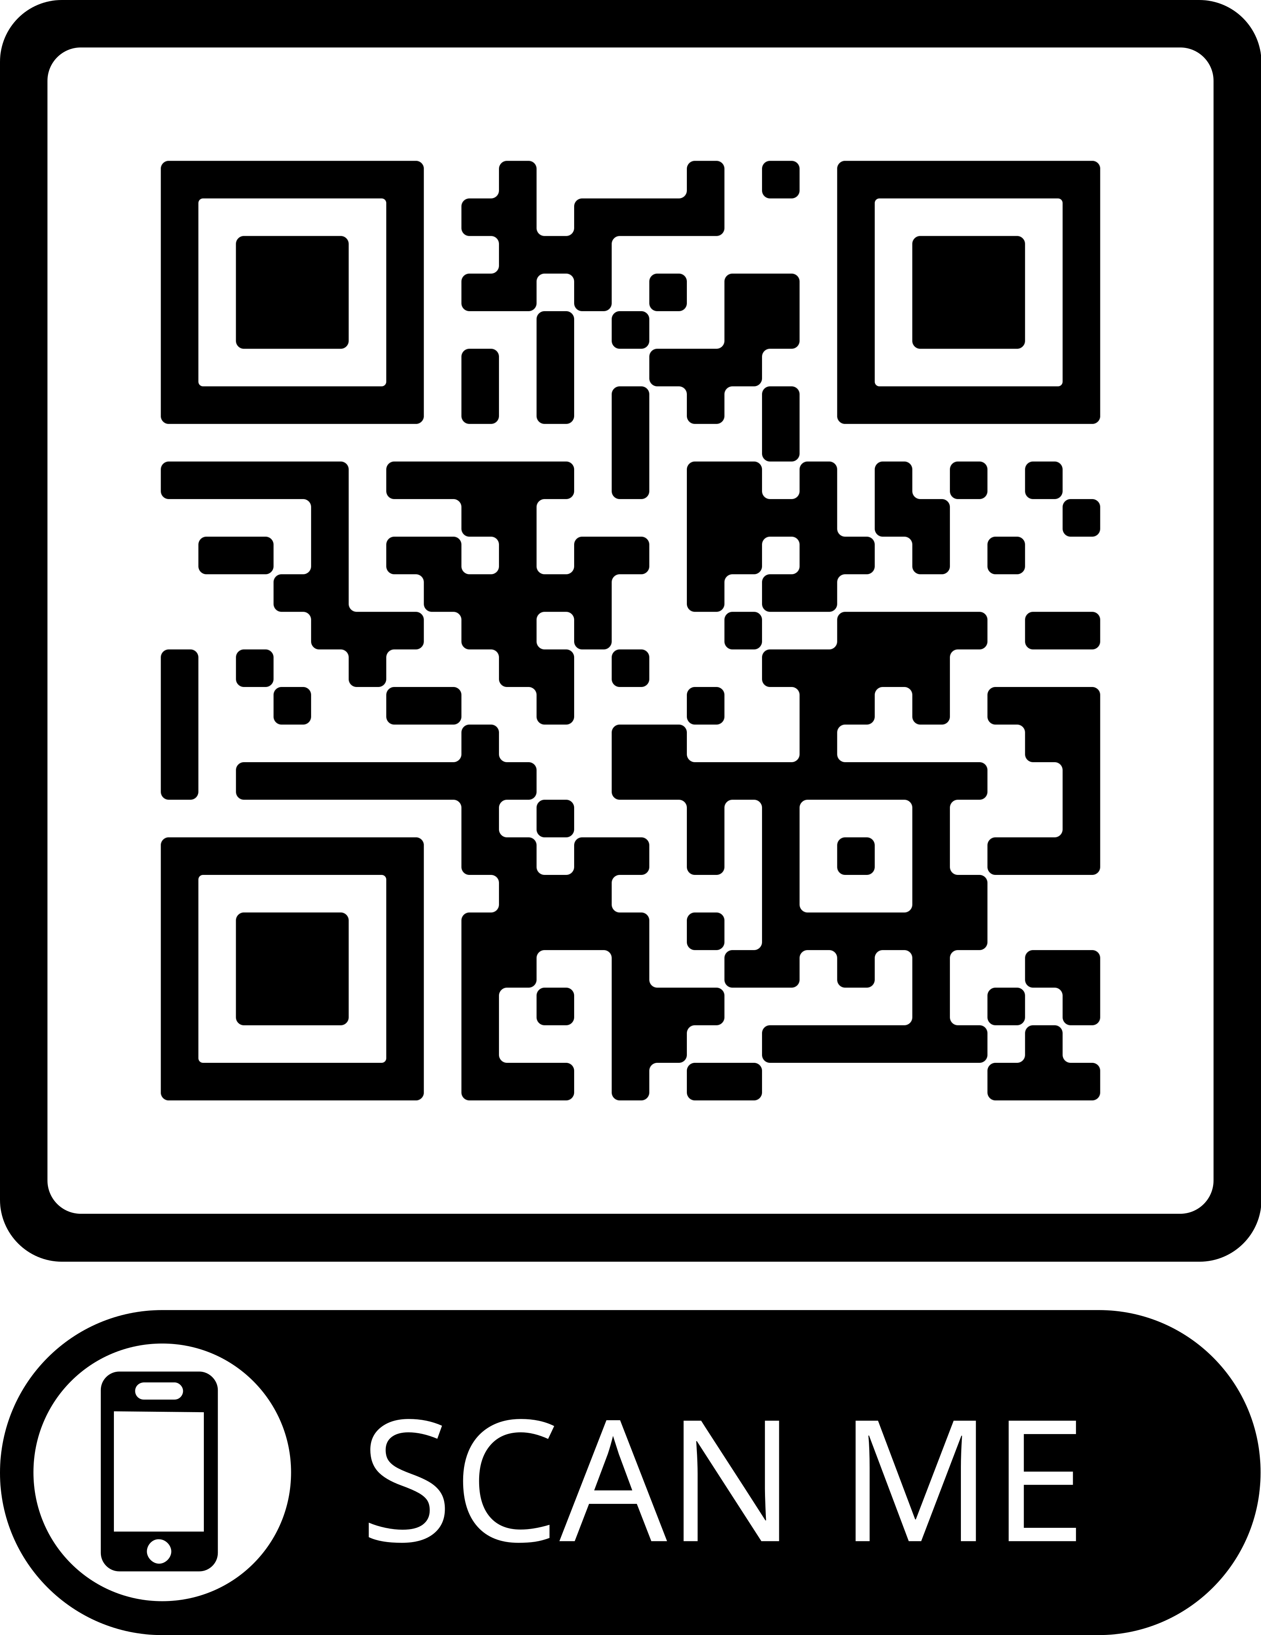
Sign up for the SoE SIG

Slide 6
2023 Education Research Network Event
Friday, October 13 from 8:15-9:30pm
Level 5 Ballroom
Desserts and Cash Bar
Recognition of Research supporting
the ACAPT Excellence Framework
Networking and Discussions on Education Research

Slide 7
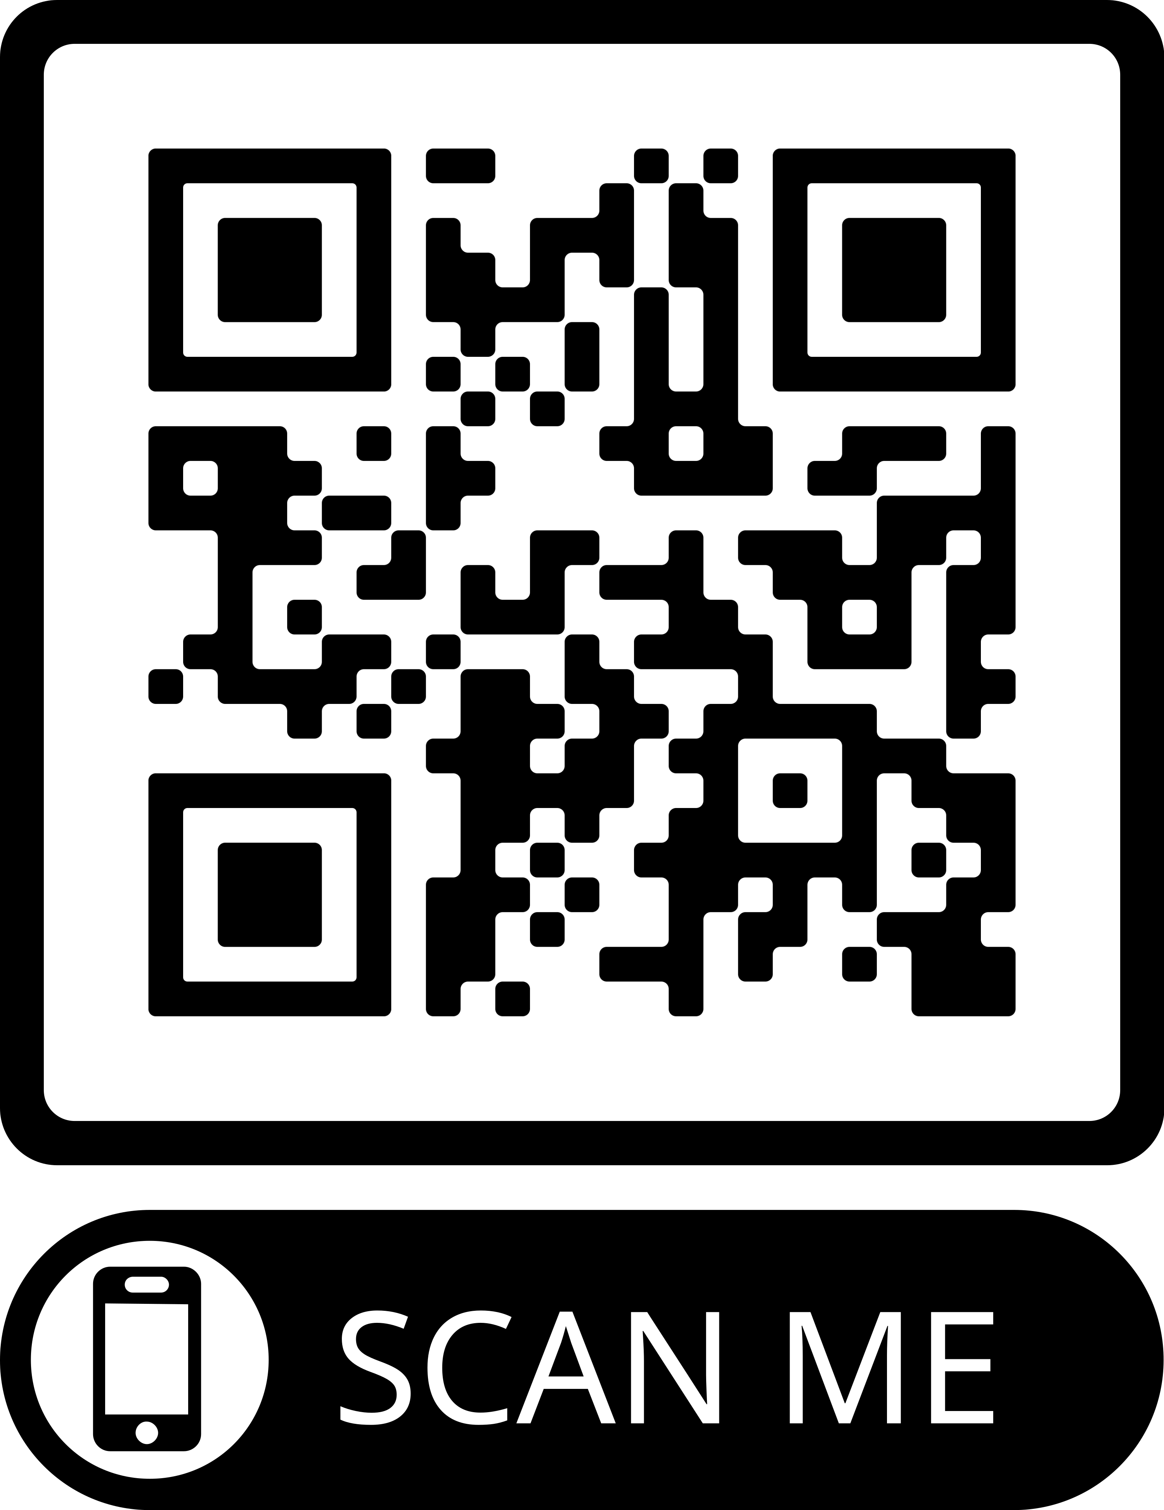
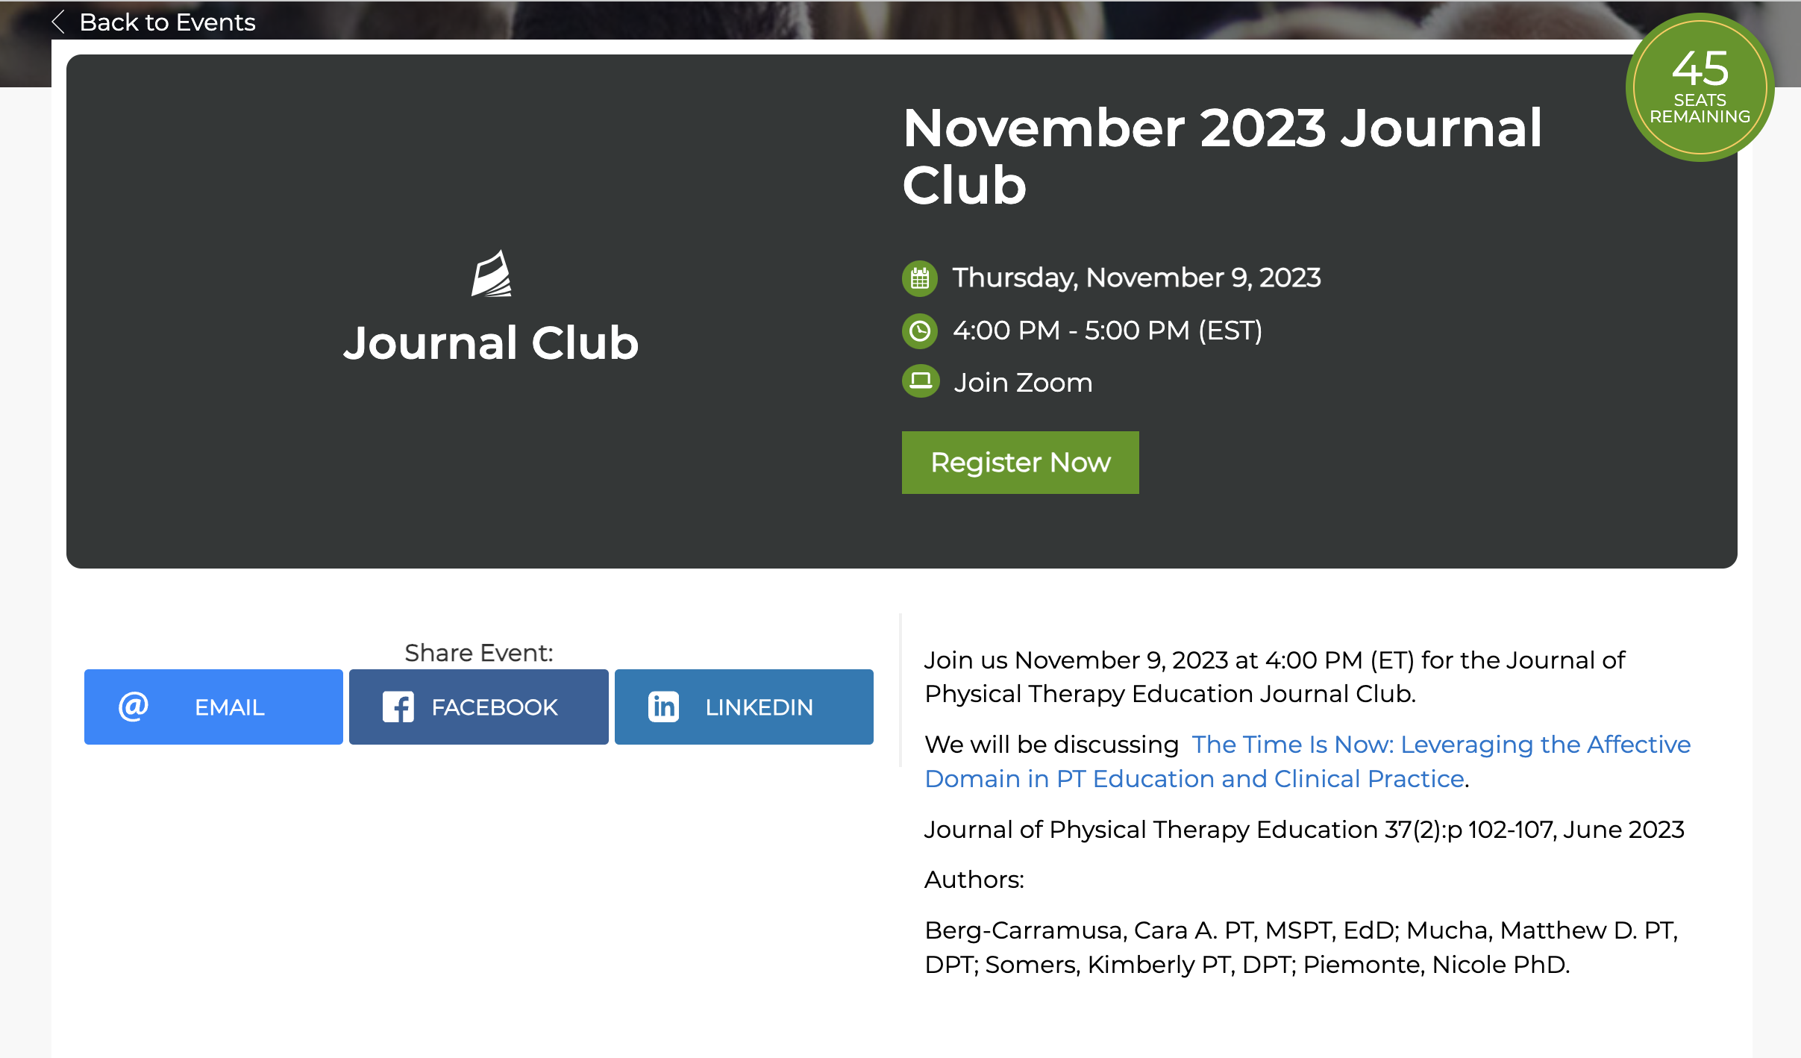
JOPTE Journal Club

Slide 8
Foundation for Physical Therapy Research

Slide 9

Rebecca Craik, PT, PhD, FAPTA

Slide 10
ABOUT US
Beginning
Mission
Success
Established in 1979 to address growing need for research
Our mission is to fund research and develop researchers to optimize movement and health
The Foundation has awarded more than $22.7 million in grants, fellowships, and scholarships

Slide 11
A DECADES LONG PARTNERSHIP
The Foundation was started with seed funding from APTA members. The Foundation is the funding organization for APTA.
We are an independent 501(c)3 and a related organization of APTA.
The Foundation also receives funding from APTA Academies and Chapters, individual donors, organizations, and corporations.

Slide 12
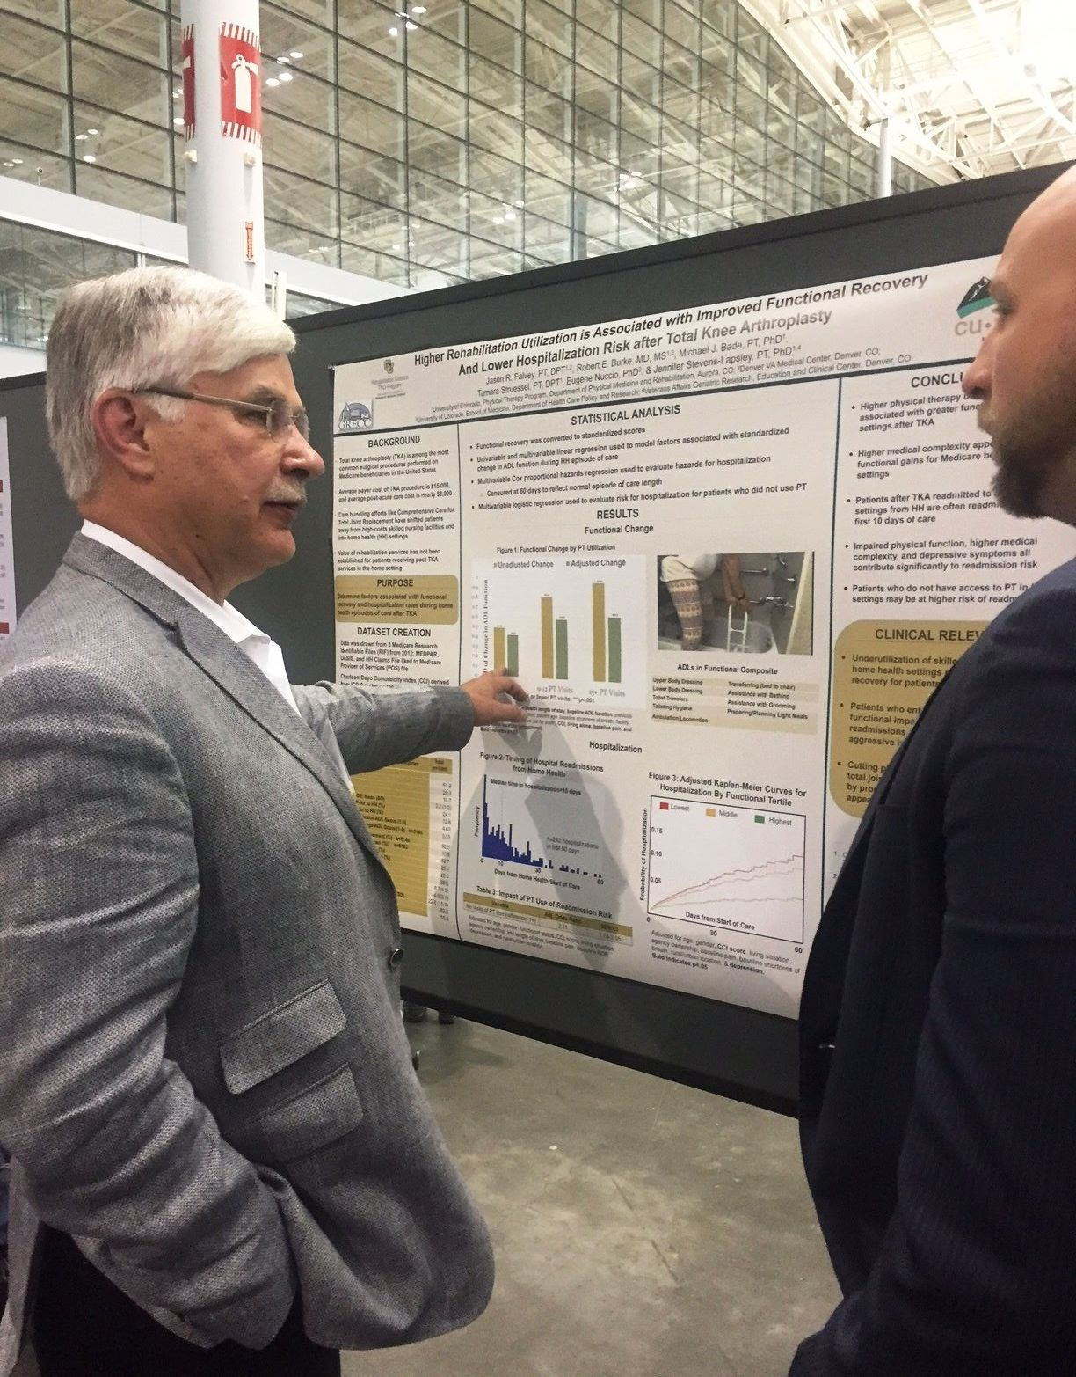
Center on Health Services Training and Research (CoHSTAR) and Learning Health Systems Rehabilitation Research Network (LeaRRn)

Slide 13

COHSTAR STATS

Slide 14




$40,000 Research Grants Anticipated for 2024
Foundation Research Grant
(any area of research)
Academy of Orthopaedic Physical Therapy Research Grant
Geriatric Research Grant
Acute Care Research Grant
Additional opportunities include the Snyder Research Grant, Moffat Geriatric Research Grant.
*Opportunities open in Early April with application Deadlines in Early August
Notes:
Snyder is $40,000 – evaluate PT services or innovative treatment; Moffat - $40,000 – evaluate effectiveness of exam/intervention for Geriatric PT

Slide 15
2024
Education-Focused Grant Funding

Slide 16

Education Research Grant
  Supported by the APTA Academy of Education Fund.
  $40,000
  Offered every other year – 2024.
  Promote the uptake of research findings into education.
Notes:
$40,000 More specifically, the purpose is to design educational interventions to address the gap between evidence and practice

Slide 17
Additional 2024 Grant
Opportunities
Foundation Research Grant - $40,000
  Offered annually.
  Available for any area of research.
Paris Patla Physical Therapy Research Grant - $100,000
  Offered annually.
  Available for any area of physical therapy research.
  Paris Patla funds also support an annual Manual Therapy research grant.

Slide 18
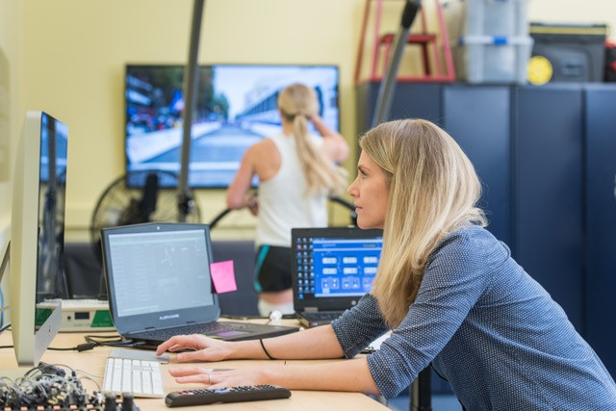
$100,000 Foundation
for Physical Therapy Research Grants available annually
Magistro Family Foundation Research Grant
Paris Patla Physical Therapy Research Grant
Paris Patla Manual Therapy Research Grant
*Letter of Intent (LOI) required early June;
Grant deadline for applications early August
Pictured: Past Magistro Grant recipient Cristine Agresta studies ACLR recovery

Slide 19
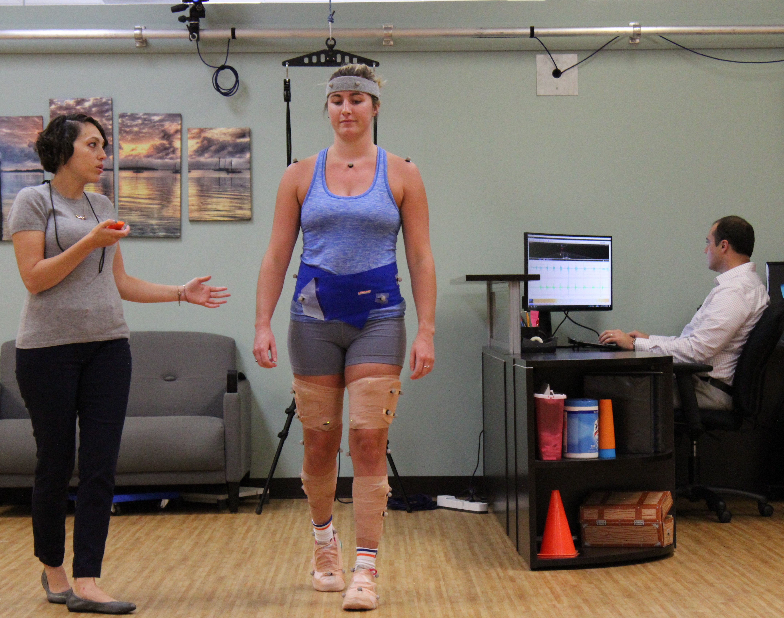
Promotion of Doctoral Studies (PODS) Scholarships*
PODS I ($7,500)
PODS II ($15,000)
*Applications open in the early October with early January deadline
learn more at foundation4pt.org
Pictured: Past scholarship recipient Katie Butera, PT, DPT, PhD

Slide 20
2024
Education-Focused Scholarship
Funding

Slide 21
Predoctoral Scholarship Funding
Promotion of Doctoral Studies (PODS) scholarships focused on education research training,
supported by the APTA Academy of Education Fund.
Bella May Fund supports applicants seeking to become teaching faculty and supports education research activities with the emphasis on creativity in educational approaches.
The Mildred Wood Endowment supports applicants seeking to become academic researchers.

Slide 22
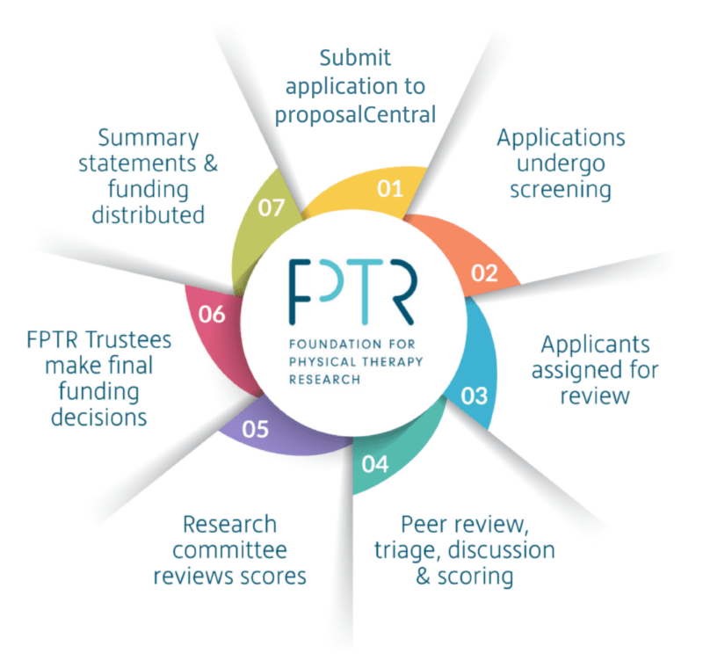
Our peer review process is modeled after the NIH and sets us apart in the field of physical therapy research funding.

Slide 23
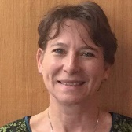
RESOURCES AVAILABLE AT:
Foundation4pt.org
Guidelines and instructions
Sample applications of past successful applications
Archived webinars and videos
Scientific Program Staff
LIZ JACKSON
Senior Specialist, Research & Grants Program

Slide 24
“I hope that my recently published paper on the effects of educational policy on racial and ethnic diversity in physical therapy programs creates an opportunity for a productive discussion on diversity, equity, and inclusion, which has recently been brought forth as a priority from the American Physical Therapy Association (APTA),” said Dickson.
Tara Dickson, PT, DPT, PhD
Tufts University
“As a profession, we have embraced evidence-based practice for patient care,” said Haladay. “It is now time for us to continue to embrace and support evidence through educational research in physical therapy programs. There is such a need and opportunity to challenge our traditions and improve our outcomes through research in physical therapy education.”
Douglas Haladay, PT, DPT, PhD
University of Florida

Slide 25
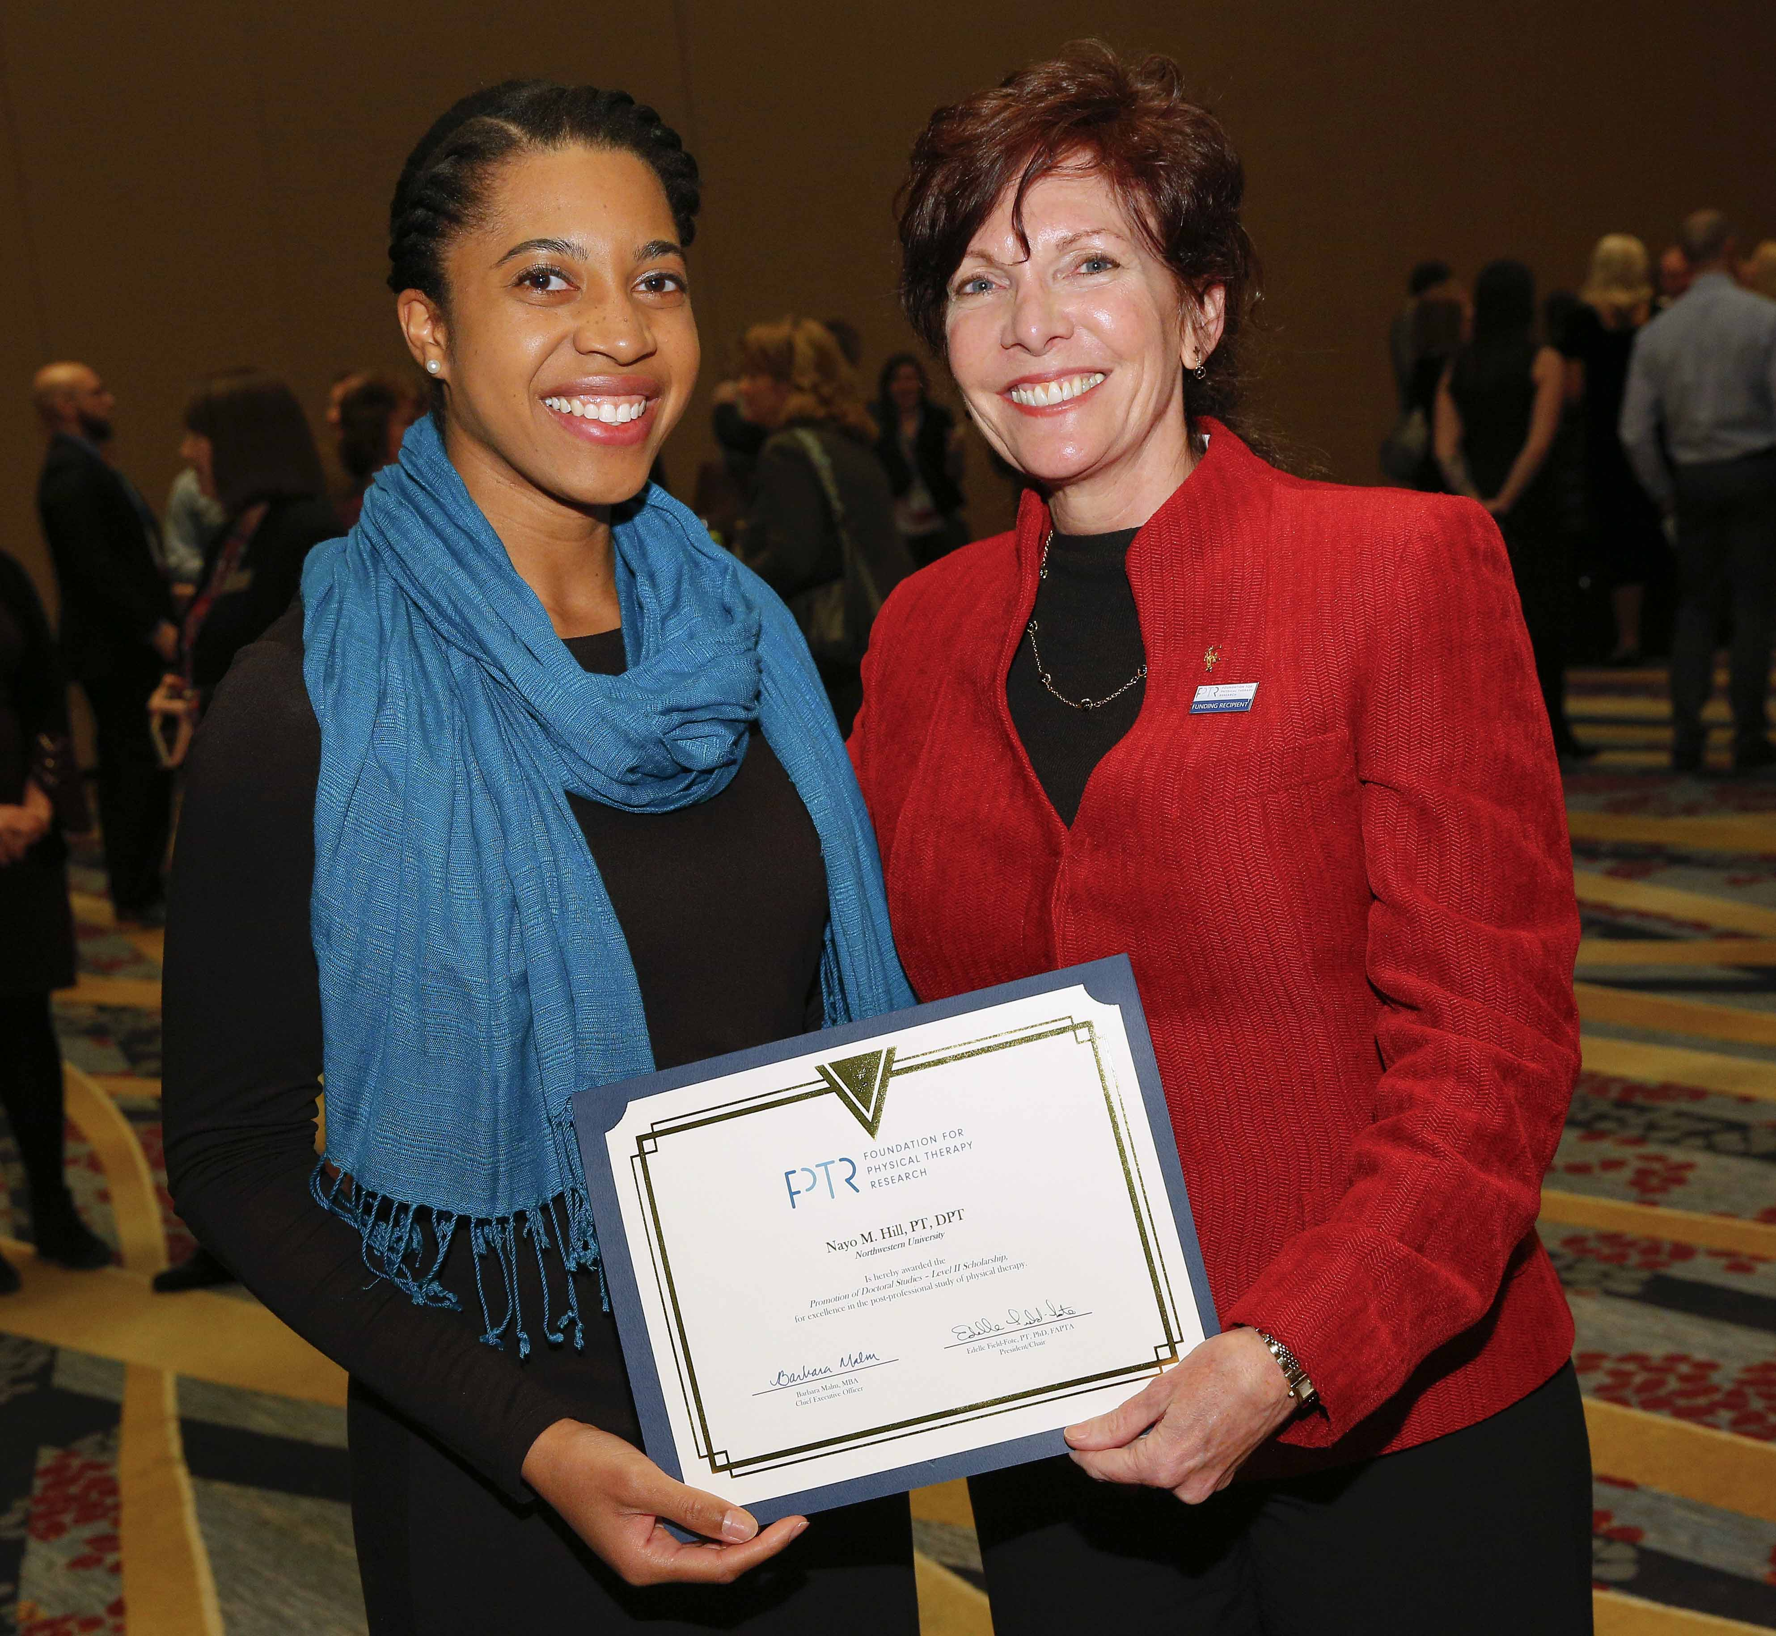
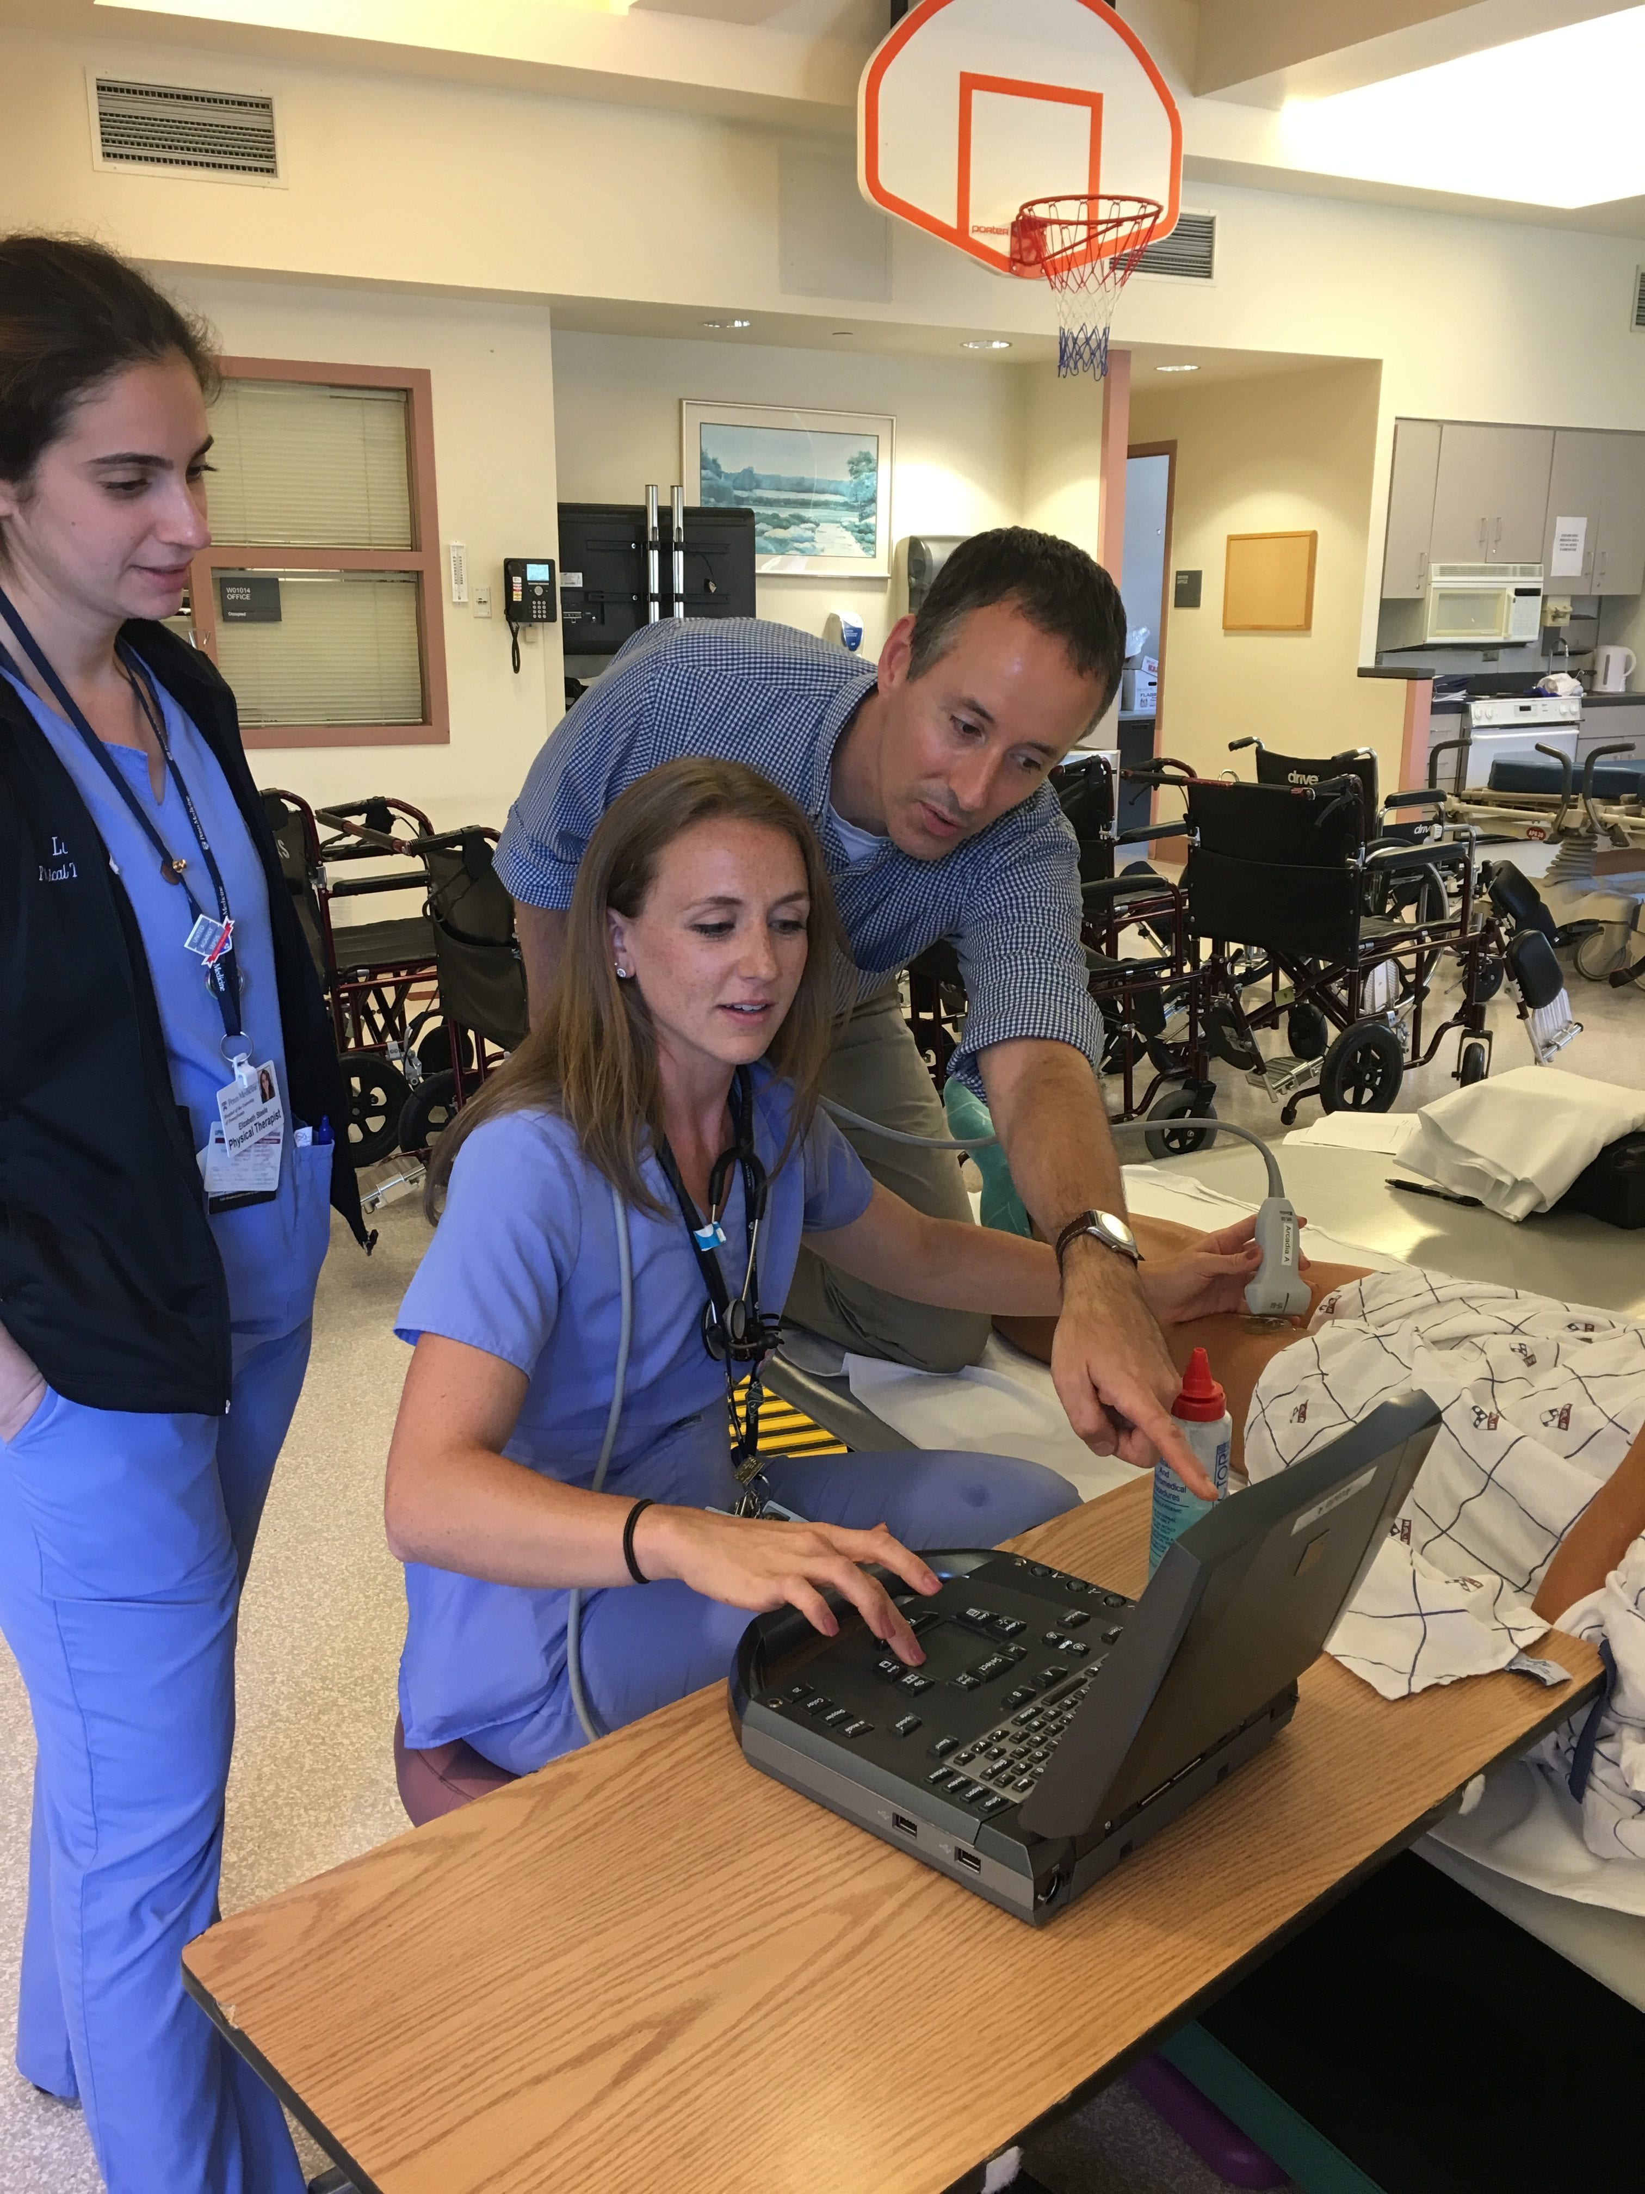
SOWING THE SEEDS FOR RESEARCH
FPTR AWARDS FUNDS
MORE RESEARCH TIME
FOLLOW ON FUNDING
Builds confidence and provides peer-review feedback
Allows researchers to spend more time developing research skills
Provides data and confidence for follow-on funding

Slide 26


Slide 27

Thank you!
Visit Foundation4PT.org to learn more
Or email info@Foundation4PT.org

Slide 28
Qualitative Research SIG

Slide 29


Qualitative and Mixed Methods Research SIG
Leadership
Subcommittees
Chair: Melissa Moran Tovin, PT, PhD
Vice Chair: Michelle Wormley, PT, PhD
Secretary: Laura Hagan PT, DPT, PhD
Treasurer: Laura Baehr, PT, DPT, PhD
Social Media & Website
Marketing and Programming
Student Engagement
Toolkit

Slide 30
Qualitative and Mixed Methods Research SIG
Promote and develop the pursuit of qualitative and mixed methods research methods in order to advance physical therapy practice.
Promote the role of qualitative and mixed methods research in the physical therapy profession.
Provide service to the Academy and the Association as a resource on qualitative and mixed methods research
Serve as a network resource for researchers and clinicians with an interest in qualitative and/or mixed methods research

Slide 31
Qualitative and Mixed Methods Research SIG
Programming: Past, present, and future…
  Qualitative and Mixed Methods
    Qualitative data analysis
    Manuscript preparation
    Standardized tool for reporting mixed methods research
    Pre-conference CSM 2023: Advancing Mixed Methods in Physical Therapy Research
  ELC 2023 – Tomorrow, 9:30am
    A Toolkit for Integrating Qualitative and Mixed Methods in DPT Curricula: Finding Balance in EBP (Tovin, Wormley, Cook, Hagan, Kaplan, Jensen)
  CSM 2024
    Preconference course: Writing Qualitative and Mixed Methods Grant Proposals. (Hamilton, Wormley, Tovin)
    The 8th Annual Kay Shepard Symposium

Slide 32
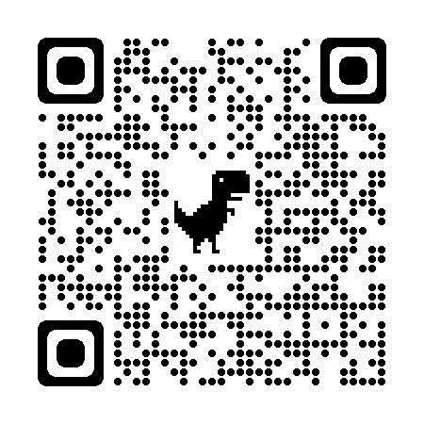
Qualitative and Mixed Methods Research SIG
Future Planning
  Development and sustainability of the Toolkit website
  Soliciting sponsorships
    Student scholarships/travel
    Future programming
    Website funding
  Increasing membership and engagement – join us!
    Step 1) Become a member of the Academy of Research
    Step 2) Join the Qual and MMR SIG

Slide 33
Scholarship of Education SIG
Business

Slide 34
SIG Open Positions for 2024 Slate
Qualifications to be eligible for election to any SIG office
  1. Be a member of the Academy as provided for in the Association bylaws and a member of the SIG for a period of at least one year immediately preceding the nomination deadline.
  2. Candidates for Chair or Co/Vice Chair must have been continuous members in good standing of the Academy for a period of at least two years immediately preceding the nomination deadline.
  3. Have consented to serve
Vice-Chair
Nominating Committee member
  Each position will be for a 3-year term

Slide 35

Vice-Chair
Assume assignments as delegated by Chair
Communicate with SIG committees/task forces and report activities to Chair
Communicate with SIG representatives to the Academy’s Conference Program Committee
Assume responsibilities of the Chair should the Chair be unavailable
  Chair responsibilities include:
    Develop SIG meeting agenda
    Serve as a member of and communicate with Academy Board of Directors
    Create task forces/special committees needed to meet SIG functions
    Submit annual report of SIG activities to the Academy

Slide 36

Nominating Committee Member
Consists of two members of the SIG.
The senior member of the Committee shall serve as Chairman.
Duties
Present a slate of two or more qualified candidates, if possible, for the open offices annually

Slide 37
Academy of Education Election Timeline
Nominations are due by November 1st
  You can self-nominate! Use form link here
  To nominate another member, please email Vicki LaFay at chair-nominations@aptaeducation.org
2024 Election Slate will be finalized after CSM (max of 3 nominees for each position)
Elections will begin in the Spring of 2024
Newly-elected officers will begin term on July 1st, 2024

Slide 38
Grant Writing Tips and Ideas
The SIG leaders have compiled tips from our experience… please share from yours as we explore these

Slide 39
Where to apply for grants

Slide 40
Grant Funding…
Help us add to this list
Foundation for PT Research (PhD in process folks and one education grant)
Academy of Education (every year, Oct 1 deadline)
In house funding (many universities have grant programs that can act as seed grants)
State level PT association (CA PT has a research grant each year)

Slide 41
New to Grant Writing

Slide 42
Getting Started
Make sure you clearly address all section
Make sure you have logical connections to all components of your abstract (background/ theory leads to methods etc)
Draw connections to prior research, especially where gaps or needs have been identified
Can also link to calls from APTA or component sections
For PODS applications: link how your advisor/ committee has connections to key researchers in the field (or are key researchers), or how their expertise relates to a significant gap in the field

Slide 43

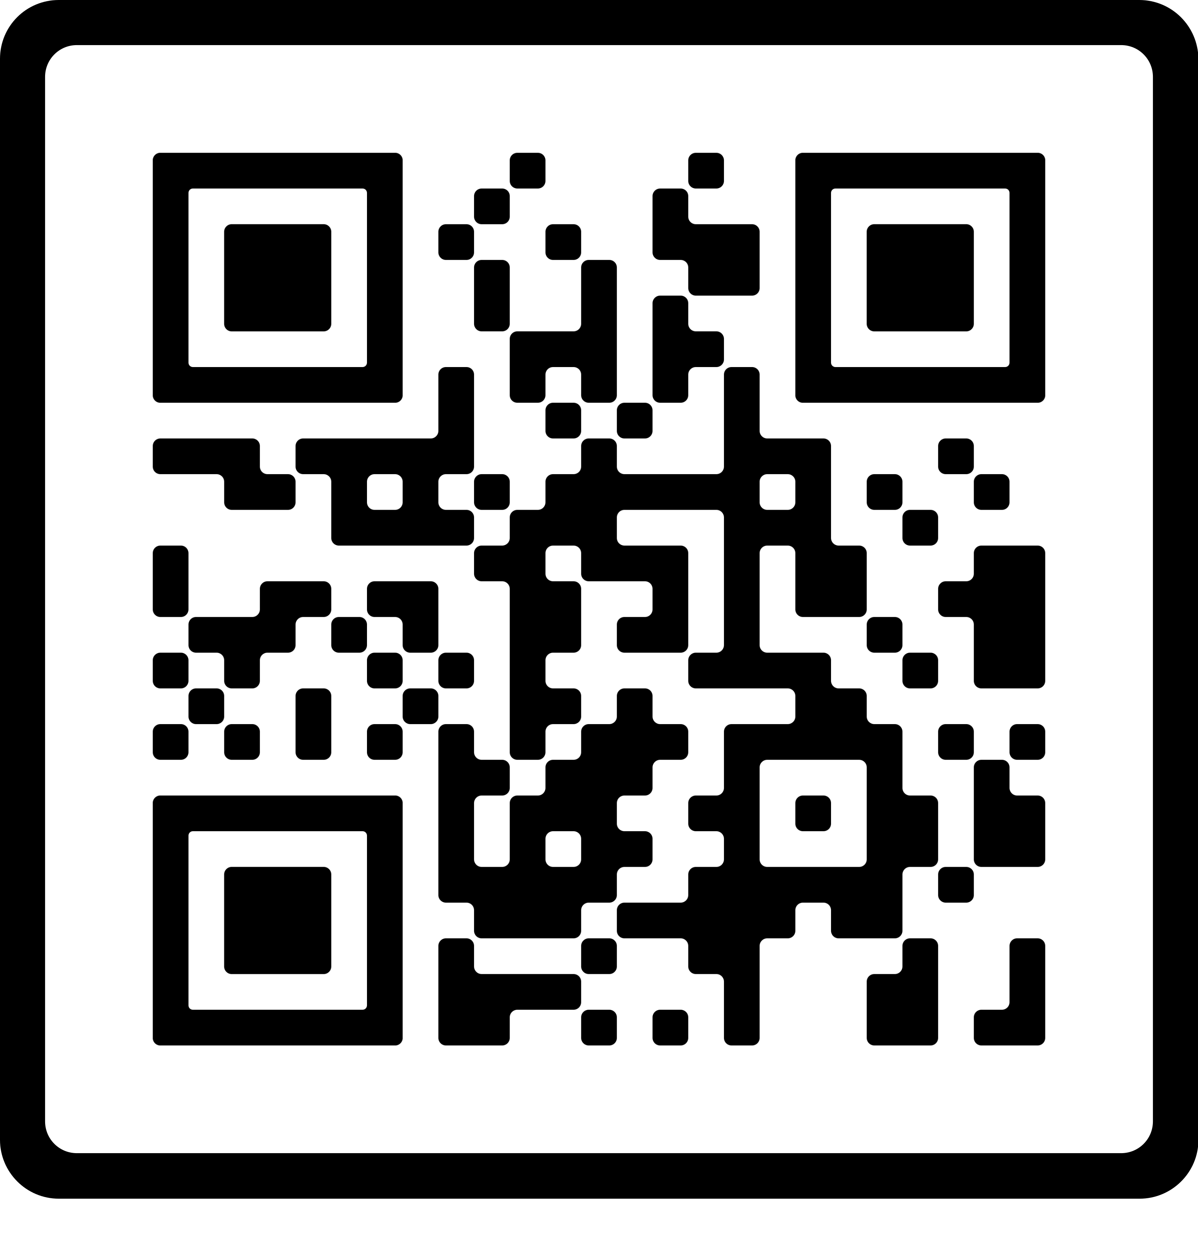
Two Sessions that may be helpful
At ELC
Foundation for Physical Therapy Research Pathways for PhDs (Webinar)
  Thursday October 19 1-2pm EST

Slide 44
Grant Writing with Experience

Slide 45
Tips for creating a competitive application
Make strong connections to current calls for research or well identified gaps in the literature
Justify your methods based on theory, research design, and prior studies in related areas
Clearly support each aspect of your methods (and data collection tools should be referenced as to how it was developed or its source)
Be very up to date on the literature (but also include “classics” in your field)

Slide 46
Tips for creating a competitive application
Make sure to “sell” your work to those who don’t understand education and educational research
If possible, ask for examples of past successful applications
Organize your time. Make sure to work well ahead of the deadline so you have time to step away and then re-read when you are fresh
If possible, have someone who does not understand your research area read your application
Stay true to your aims (sometimes feedback can be conflicting)

Slide 47
Questions, Discussion, Ideas?

Slide 48
Thank you for joining the Scholarship of Education SIG

