Slide 1
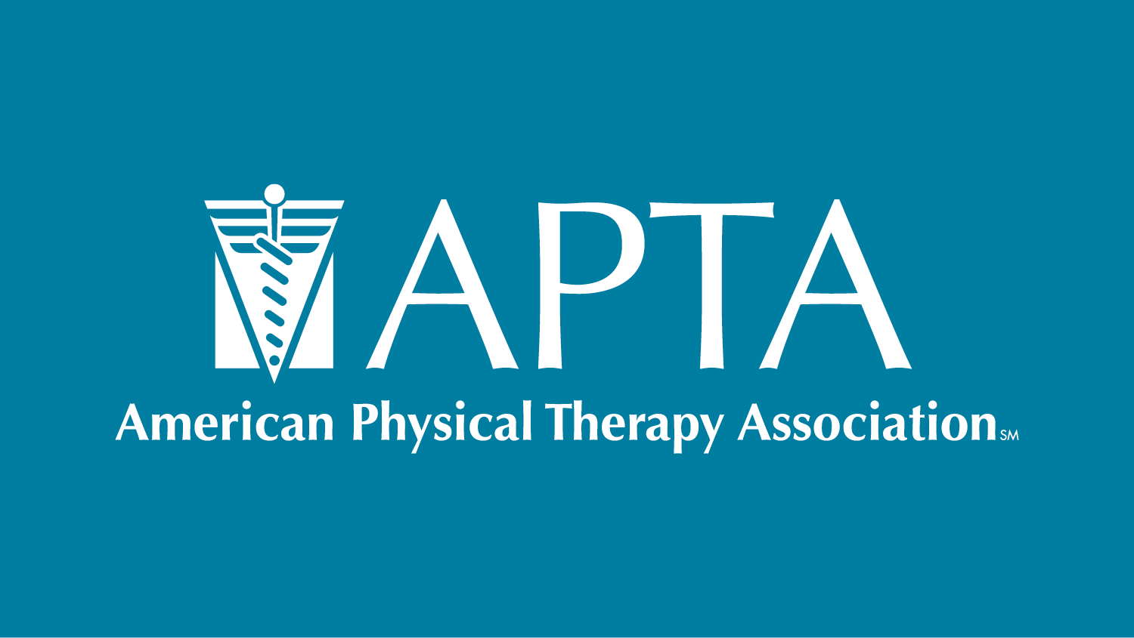

Slide 2
Anatomy From The Inside Out: A 3D Kinesthetic Learning Method
Beth Moody Jones, PT, DPT, EdD
Stephanie Muth, PT, PhD

Slide 3
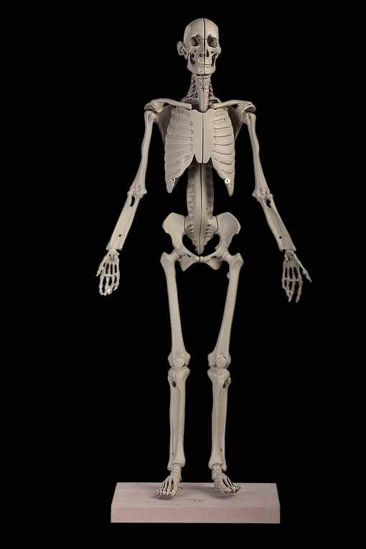
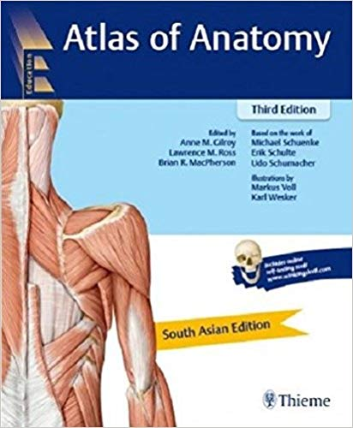
Disclosure
No relevant financial relationships
We would like to thank Anatomy in Clay© and Thieme for their support of this program

Slide 4
Learning Objectives
Compare and contrast dissection vs clay modeling to promote anatomy knowledge
Discuss pedagogical advantages of clay modeling
Discuss the use of clay modeling to facilitate palpation skill
Apply unique active learning technique to improve students’ understanding of anatomy

Slide 5
Introduction
The purpose of this program is to examine an active learning method as a supplement to PT gross anatomy dissection.
Participants will use plastic models and clay to create joints from the skeletal system outward to experience this kinesthetic learning method

Slide 6
Why Active Learning?
Increased content knowledge, critical thinking and problem-solving abilities compared to traditional lecture-based delivery
Increased enthusiasm for learning in both students and instructors
Improved development of critical and creative thinking, problem-solving, adaptability, communication and interpersonal skills
Anderson et al, 2005
Thaman et al., 2013

Slide 7
The Flipped Classroom
Curated assigned readings prior to class
Short on-line lectures
Class time spent discussing and applying material

Slide 8
The Flipped Anatomy Classroom
Key Findings:
Students spent similar amount of time with on-line materials as was previous spent in class prepping for lab
The 3D anatomy videos and key atlas figures were rated the most helpful resources
No change in average grades on the first and second laboratory examinations
Scores significantly higher on the final semi-cumulative laboratory exam post flipped classroom implementation
Take home message:
flipped classroom pedagogy can be effectively implemented in the gross anatomy laboratory
3D anatomy visualizations in a dissection-based course are deemed valuable
Fleagle et al., 2017

Slide 10
The Flipped Anatomy Classroom in a DPT Program
Key findings:
Students in the flipped anatomy classroom had an increase in semester average grades (p = 0.01) and better performance on higher-level analytical questions (p < 0.001).
Students from the flipped classroom demonstrated better long-term retention and knowledge transfer as assessed in subsequent semester's kinesiology course (P < 0.05)
When previously lower performing students were in a flipped anatomy class, they out performed their traditional anatomy class counterparts
Take home message: The flipped classroom is effective in improving long term knowledge retention and transfer, and may benefit lower performing student's knowledge acquisition and transfer to a greater degree than higher performing students
Day, L 2018

Slide 11
Alternatives and Adjuncts to Dissection
Prosections
Pros: 3D realistic structures, time (students), re-usable, space required; student preferences (dissection over prosection)
Cons: tissue layers, relationships between regions; time (faculty), less "exploration" and variety for students than dissection
Models/plastination
Pros: convenience, re-usable, can be semi-3D
Cons: not always true representation, lack variation, altered texture
Digital media
Pros: convenient, accessible, efficient, requires less space, seldom conflicts with religious concerns, cost?
Cons: not true 3D, lacks variability and realism, can’t assess tissue integrity; cost?
Living Anatomy
Pros: closely reflects PT clinical skills
Cons: probably not enough by itself

Slide 12
Meta-analysis of the Literature Comparing Various Instructional Methods
No effect on short-term outcome gains when comparing traditional dissection to other modes of instruction (prosection, digital media, models, hybrid)
Wilson AB et al., 2018

Slide 13
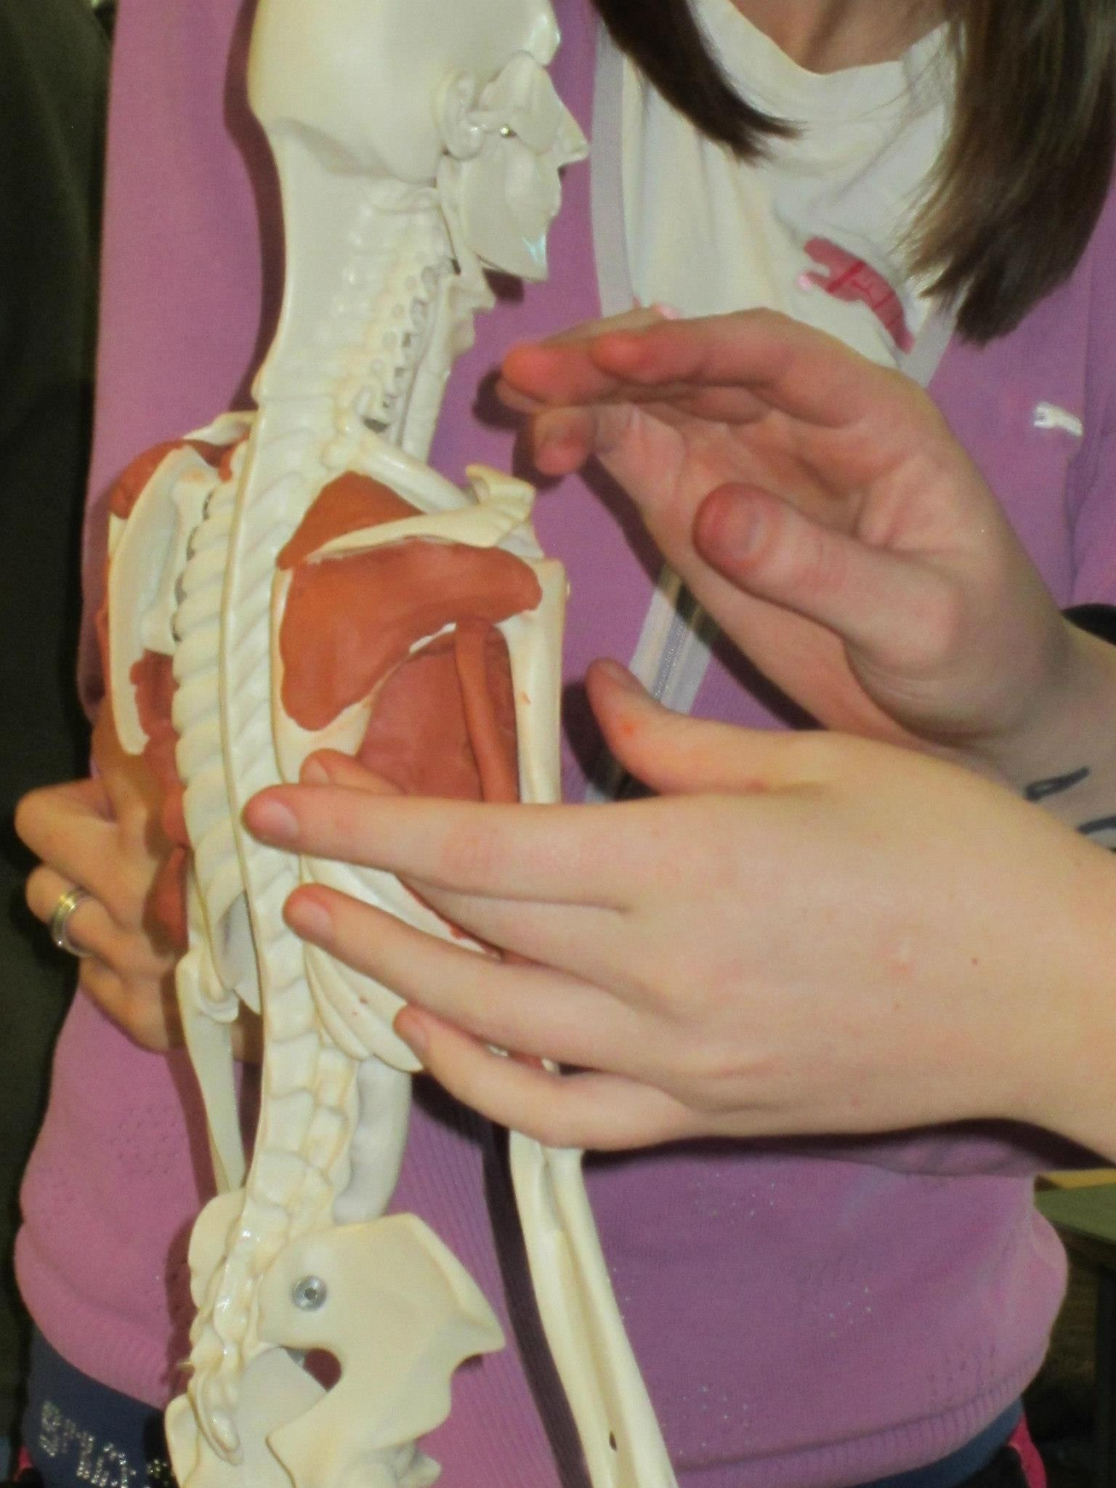
Why Clay Modeling?
Kinethestic
3D
Cooperative

Slide 14
Physical Models vs Digital Models and Text Books
Primary aim: Assess use of 3D physical model in demonstrating the complex spatial relationships of the equine foot compared to textbooks and 3D computer model
Key findings:
Mean MRI assessment scores significantly higher in physical model group (86.39%) compared to textbooks (62.61%) and 3D computer model (63.68%) (P < 0.001)
no significant difference between the textbook and 3D computer model groups (P = 0.685)
Student feedback was more positive in the physical model group compared to other groups
Take home message: physical models may enhance visuospatial and 3D understanding of complex anatomical architecture compared to text books and 3D computer models
Preece et al., 2013

Slide 15
Physical Models vs Digital Models
Primary Aim: Assess efficacy of clay modeling versus cat dissection in human anatomy course
Key Findings:
Clay modeling group scored higher scores on low level questions related to peripheral nerves
Both groups scored similarly on higher order questions related to peripheral nerves and all questions related to muscles and blood vessels
Students perceived clay modeling more favorably than cat dissection
Take Home Message: Clay modeling may be an adequate substitute for dissection in undergraduate education
De Hoff ME et al., 2011

Slide 16
Clay Modeling vs Written Modules
Primary Aim: Assess the effectiveness of clay modeling versus written modules about 3D anatomical relationships among students with different learning preferences
Key Findings
Change in post test scores for clay and module groups were each significantly higher than controls (21.46 +/- 8.2 vs. 15.70 +/- 7.5, P <= 0.05; and 21.31 +/- 6.9 vs. 15.70 +/- 7.5, P <=0.05, respectively)
Change in retention scores for clay and module groups approached but did not achieve significance over controls
Students of some learning styles tended to perform better when engaging in certain modalities
Take home message: Multiple teaching modalities may accommodate learning preferences and improve understanding of anatomy.
Bareither et. al., 2013

Slide 17
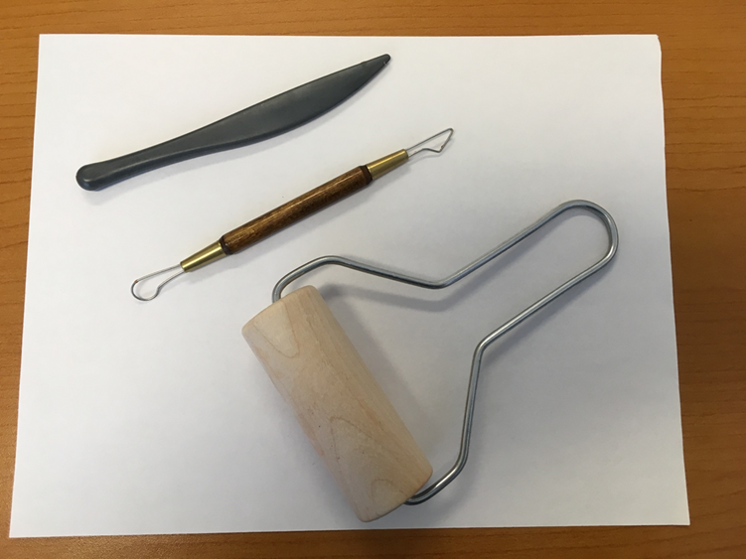
Modeling tools and techniques
Clay extruder:
Good for arteries, nerves, ligaments
Good for shaping, sculpting and contouring muscle

Slide 18
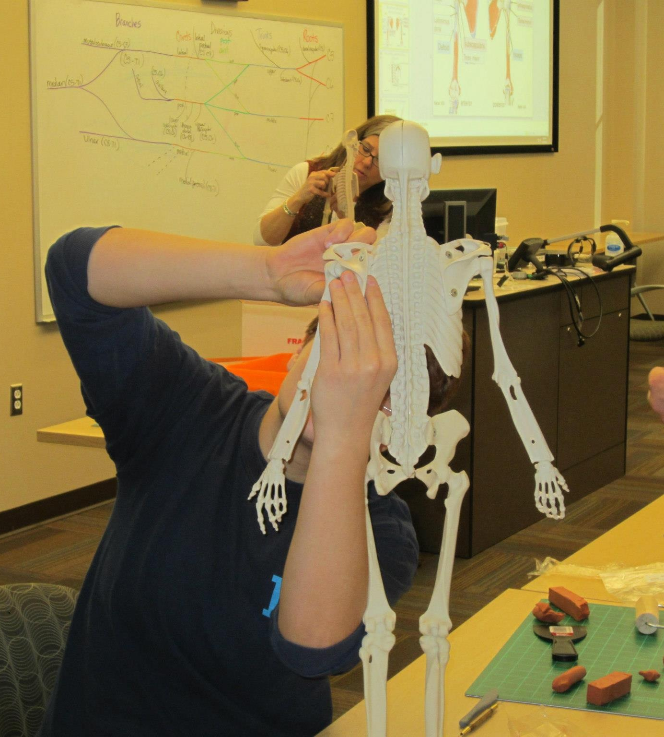
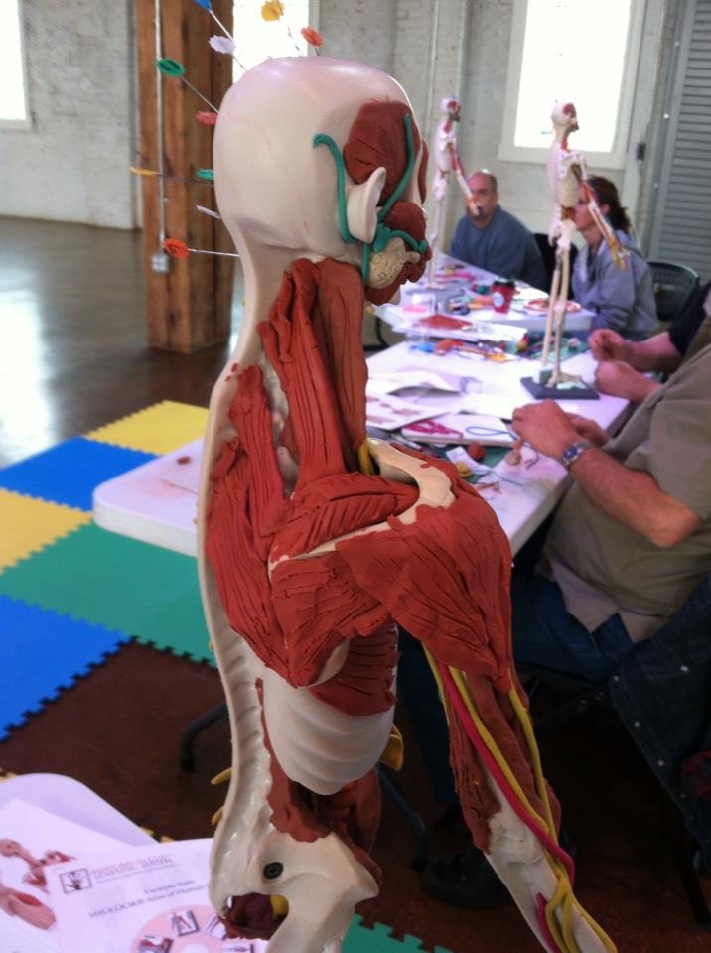
The Work in Progress

Slide 19
Lab activity
Share a model with a partner
Use the step by step directions for either the shoulder or pelvic girdle (please do not take those with you)
Choose one area and try building the model as outlined
You will be tempted to jump ahead but this must be completed systematically or you will find yourself removing muscles to create the necessary layering and relationships

Slide 20
How to begin
There are volunteer students on hand to assist you if needed
There are extruders up front you can use to create ligaments and nerves
Start with a cone shaped triangle of red clay
HAVE FUN!

Slide 21
Reference List
Anderson WL, Mitchell SM, Osgood MP. 2006. Comparison of student performance in cooperative learning and traditional lecture‐based biochemistry classes. Biochemistry and Molecular Biology Education 6: 387-393.
Bareither MJ, Arbe V. Growe M Muszczynski E, Rudd A and Marone JR. 2013. Clay Modeling versus Written Modules as Effective Interventions IN Understanding Human Anatomy. Anat Sci Educ 6:170-176
Day, L. 2018. A Gross Anatomy Flipped classroom Effects Performance, Retentions, and Higher-Level Thinking Lower Performing Students. Anat Sci Educ
Fleagle TR, Borcherding NC, Harris J and Hoffman DS. 2017. Application of Flipped Classroom Pedagogy to the Human Gorss Anatomy Laboratory: Student Preferences and Learning Outcomes. Anat Sci Educ
Preece D, Williams, SB, Lam R and Weller R. 2013. “Lets Get Physical”. Advantages of a Physical Model Over 3D Computer Models and Textbooks in Learning Imaging Anatomy. Anat Sci Educ 6: 216-224.
Thamen R, Dhillon S, Saggar S, Gupta M, Kaur H. 2013. Promotin Active Learning in Respiratory Physiologoy-Positive Student Perception and Improved Outcomes. National Journal of Physiology, Pharmacy & Pharmacology 1: 27-34.
Wilson AB, Miller CH, Klein BA, Taylor MA, Goodwin M Boyle EK, Brown K, Hoppe C and Lazarus M 2017. A Meta-Analysis of Anatomy Laboratory Pedagogies. Clinical Anatomy 31: 122-133.

