Slide 1



Welcome to UWC 211 HHS

Slide 2


United Way of Connecticut
United Way of CT is accredited by the American Association of Suicidology and the Alliance of Information and Referral Systems.
The 211 Contact Center follows American Association of Suicidology and Substance Abuse and Mental Health Services (SAMSHA) approved crisis intervention protocols for non-clinical risk assessment and intervention, referral, safety planning and follow-up.
About Us

Slide 3
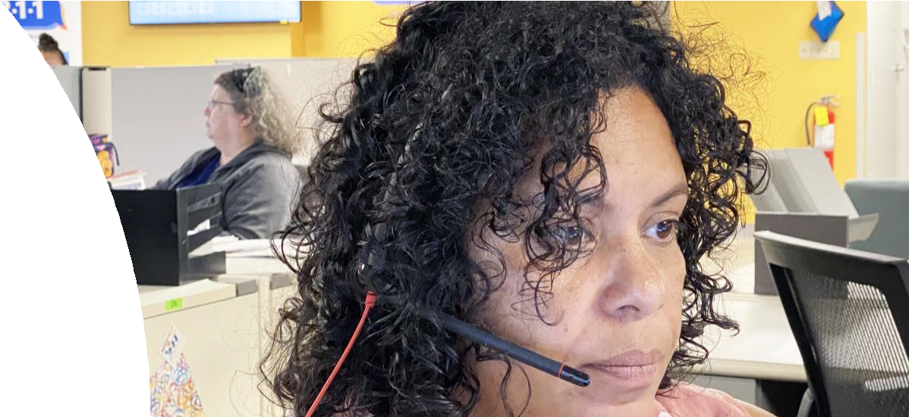

United Way of Connecticut
211 Contact Specialists are at minimum Bachelor level professionals who either have or are working towards a Certification by the Information and Referral System and Certification by the American Association of Suicidology.
All 211 Contact Specialists complete six to eight weeks of intensive training and mentoring before becoming responsible for working with callers in distress. Staff meetings and individual supervision occur regularly with on-going coaching and support. Trainings and refreshers are provided as needed and as regular requirements to maintain accreditation status.
In Fiscal Year 2023, United Way of Connecticut, 211 handled 321,865 contacts of which 52% (168,657) crisis-related calls.

Slide 4
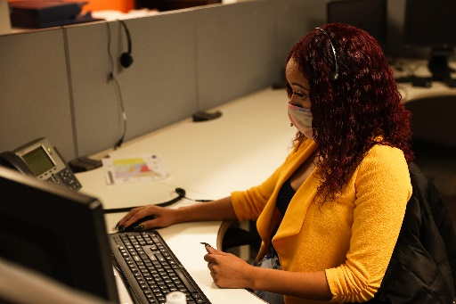
Training Methodologies
211 HHS Training Program
The 211 HHS training program is an intensive three-four -week hybrid program which delivers curriculum developed to meet AAS standards to introduce trainees to crisis call management using the least invasive approach and best practices for telephonic support and non-clinical assessment of needs and safety. Training sessions include:
  Live/Virtual Classroom Trainings
  Interactive Group Discussion
  Relias online training
  Using the ‘Teams’ platform for virtual training which allows for group collaboration and discussion with ability to have break-up sessions.
  Simulation sessions (Live/online)
  Role plays
  Call review of documentation and audio recordings
  Contact Specialist Observation

Slide 5
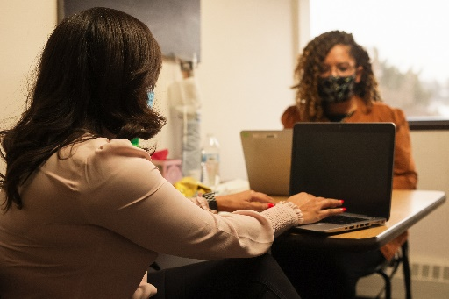
Individualized Training
211 HHS Training Program
After classroom training and Contact Specialist observation sessions, an 8-hour individualized training session is provided to trainees to reinforce practiced skills, which includes:
  Call simulation
  Side by Side call management coaching
  Side by Side documentation coaching
  Provide direct performance feedback
  Establish continued performance goals

Slide 6

211 HHS Training Program
After trainees have completed their individualized training and transition to hands on learning, they are paired with a seasoned contact specialist for mentoring 2-4 hours daily for continued guided call handling practice.
The mentor's role during these sessions include
  Demonstration of call management
  Demonstration of documentation completion
  Coaching trainees during call management
  Coaching trainees of documentation completion
  Provide direct feedback to trainees for growth
  Contribute feedback for trainee performance goals
Training Ambassadors

Slide 7
211 HHS Training Program
Training is offered in multiple sessions over the course of 4-8 weeks in preparation for independent call/chat/text handling. Training sessions are designed for trainees to gain effective skills in contact management that include
  Effective Engagement
  Assessment
  Collaborative Planning
  Resources, Referrals, and telephonic support
  Documentation
  Direct Referral to Programs and Services
  Collaboration with internal and external resources
Training Syllabus

Slide 8

Technology
Technology for Learning
Introductory training week is conducted in-office and includes instructions on accessing technological applications, communications, and completion of the Work From Home (WFH) approval process.
Trainees are issued company equipment for business use only which include:
Computer hardware
Computer software
VPN
Softphone Headset (if required)
HDMI cord to connect to internet router (connection req)
Other applicable equipment as deemed necessary

Slide 9
Workspace & Technology
Technological Requirements
211 HHS business is conducted remotely with some in office attendance based on schedule and team assignment. Eligibility for employees to train and work remotely in their home or designated location include the following:
Wired internet connection with bandwidth of 3MB or greater
Private workspace
  Free from distractions and access to materials by others
  Safe and hazard- free
  Meets ergonomic standards

Slide 10
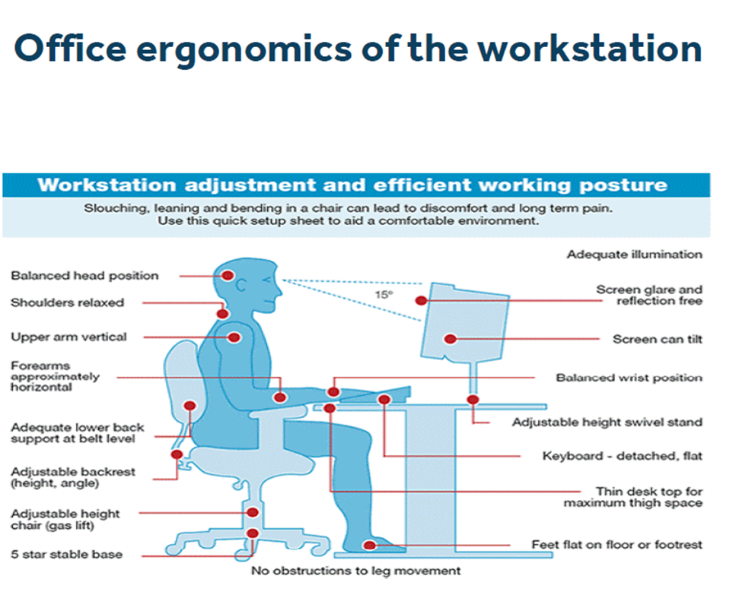
Safety & Comfort
Workstation Ergonomics

Slide 11

Approved!
Remote Approval Process
After equipment distribution, an employee requesting to WFH must complete a speed test and submit three (3) photos of the proposed WFH workspace to UWC management via request link (provided during orientation ). UWC management will review and determine if the proposed remote workspace is satisfactory for performing work and for the installation of equipment to be used while telecommuting.
Please note the approval process can take up to 2 weeks therefore preparation prior to orientation will give trainees a head start to the remote learning process.
If individual does not have a proper workspace at home, they are required to work in office.

