Slide 1

Build the Block
Notes:
Welcome to Build the Block! Thanks for joining us today eager to learn about what impacts design decisions when you’re creating a new school, hospital, or housing complex.
You’ll notice that there is one adult at each table. They are real-life architects!
This hands-on game demonstrates the impact architects and the field of architecture can make on communities – even yours – through real world design principles.
Before we begin, here’s a quick overview of the game you’ll be playing today…

Slide 2
Groups
This game is played in groups with architects leading each group.
Heavy on discussion—don’t be shy!
Scenario
There’s an empty lot in your community. Decide what to build on this lot—a school, hospital, or affordable housing units.
Goal
Fulfill all the needs in your community.
Notes:
As you can tell by the way you’re seated, this game is played in groups, with the architects leading each group. There is a lot of discussion in this game. Don’t be shy! Use your voice.
The premise of the game is that there is an empty, overgrown lot in a fictitious town. As a team, you must identify the best use of the lot and decide how to develop the site.
Your ultimate goal is to fulfill the needs of your community.

Slide 3
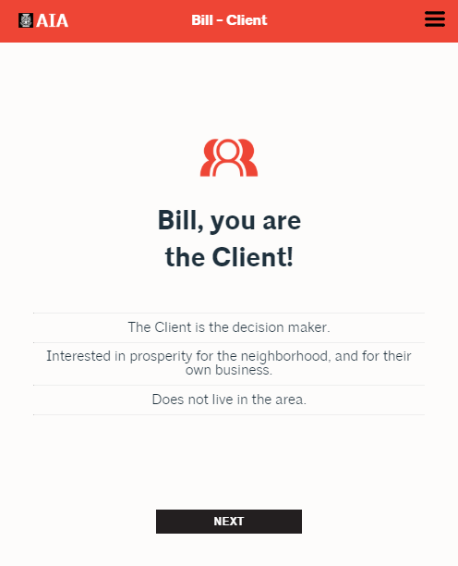
Your role
You play this role the entire game
Write down your role and characteristics
The Client
Every group has a Client
The Client makes the final decision on what to build
Notes:
Each player will be assigned a role in the game. Every group will have a Client as one role, but the rest of the roles are randomized, which means each team will have a different set of characters.
Each role has three characteristics. It’s your job to remember your role and characteristics – we recommend you write them down – and advocate for your role’s opinions and priorities throughout the game.
When it comes to making decisions, the Client has final say and can make any selection he or she wants, regardless of the group’s discussion. It’s your job to persuade the Client to make the decision YOU want!

Slide 4
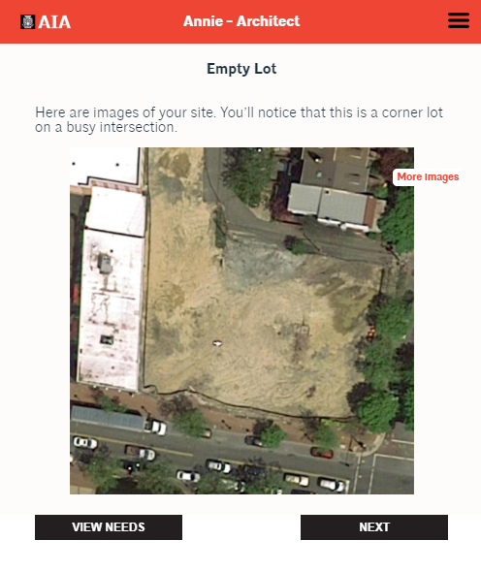
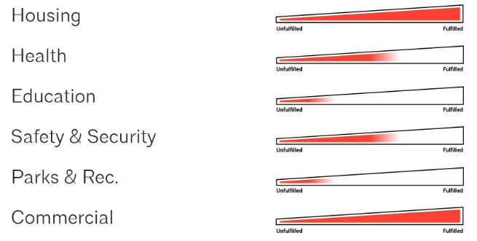
Your community and your lot
As a group, you’ll create your community
Then you’ll learn about and see your empty lot
This lot is where you’ll build your project
Then, you’ll discuss your community’s needs.
Notes:
Each team will be working in a different community because you get to create the community in which your lot is located. You can get as creative and detailed as you’d like.
Then, you’ll see a couple images of your lot – this is where you will build your project.
Here, you will also see your community’s needs. Every team will be measuring the same six factors – housing, health, education, safety, parks & rec, and commercial – but the values are different for everyone. Your goal is to fulfill as many community needs with your building as possible.

Slide 5
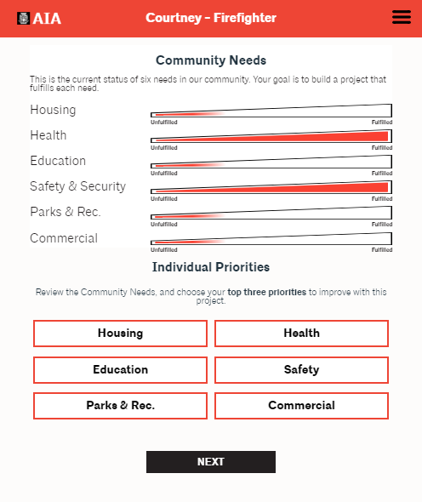
Tip: The role displayed at the top of the screen is who should be voting.
Vote for your Individual Priorities
Once you’ve discussed the community’s needs with the group, you’ll vote for your top three priorities, keeping your role’s characteristics in mind.
Notes:
Once you’ve seen the community’s needs, you get to vote for YOUR priorities. Remember, you’re each playing a role and get to vote for your individual priorities, regardless of the community’s needs.
Each person will have a turn to vote. Keep an eye on the top red bar to make sure you’re voting when your name appears!
After everyone has voted, you’ll see a tally of the results.

Slide 6
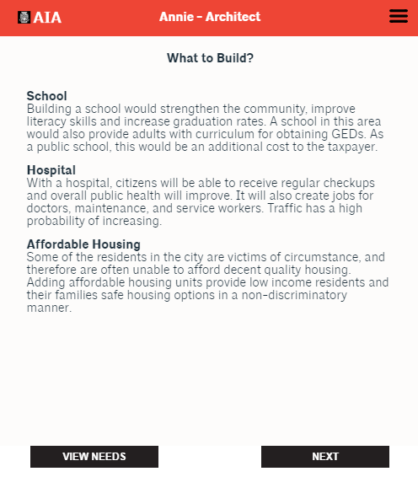
Deciding what to build
Discuss the building options as a group.
Voice your opinion on which building you should choose—remember your role’s characteristics and priorities.
Convince the Client to choose your building.
The Client makes the final decision.
Notes:
Then, you finally get to make a decisions on what to build! You’ll select either a school, hospital, or affordable housing.
This is your last chance to convince the Client to choose what YOU want to build, so use your voice. Then, the Client will make the final decision.
You’ll also be able to add a few enhancements to your project.

Slide 7
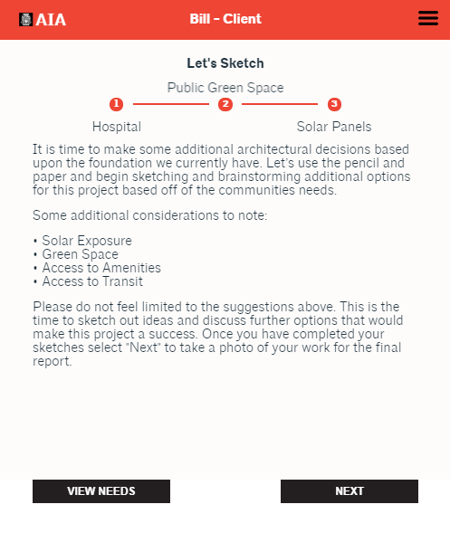
Sketch your building
After all your decisions have been made, you’ll design and sketch your building.
Use the materials provided for your sketch, then you can take up to six photos.
Materials:
  Empty lot picture
  Graph paper
  Tracing paper
  Pencils
  Colored markers
Notes:
After you’ve made your decision, you get to sketch your building! On your table, you have sketching materials, including a picture of your empty lot, graph paper, tracing paper, pencils, and colored markers.
The architect will give you further instructions on how to sketch. It’s okay if each group does this differently.
Then, you’ll upload up to six pictures of your sketch(es) into the game for the final presentation.

Slide 8
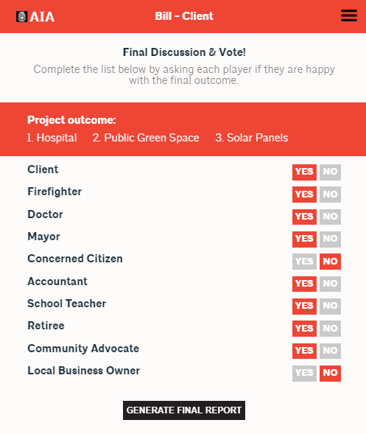
Final discussion & presentation
Discuss if you’re happy with the result and cast your vote
Present your group’s process and outcome
Notes:
Finally, everyone in the group gets to vote on the final outcome of the project. Did you like your selections? Are you happy with the sketches? Why or why not?
The architect will record your votes in the game.
When every group has finished, you’ll each come up to the front of the room and present your projects to the larger group.
Any questions?

