Slide 1
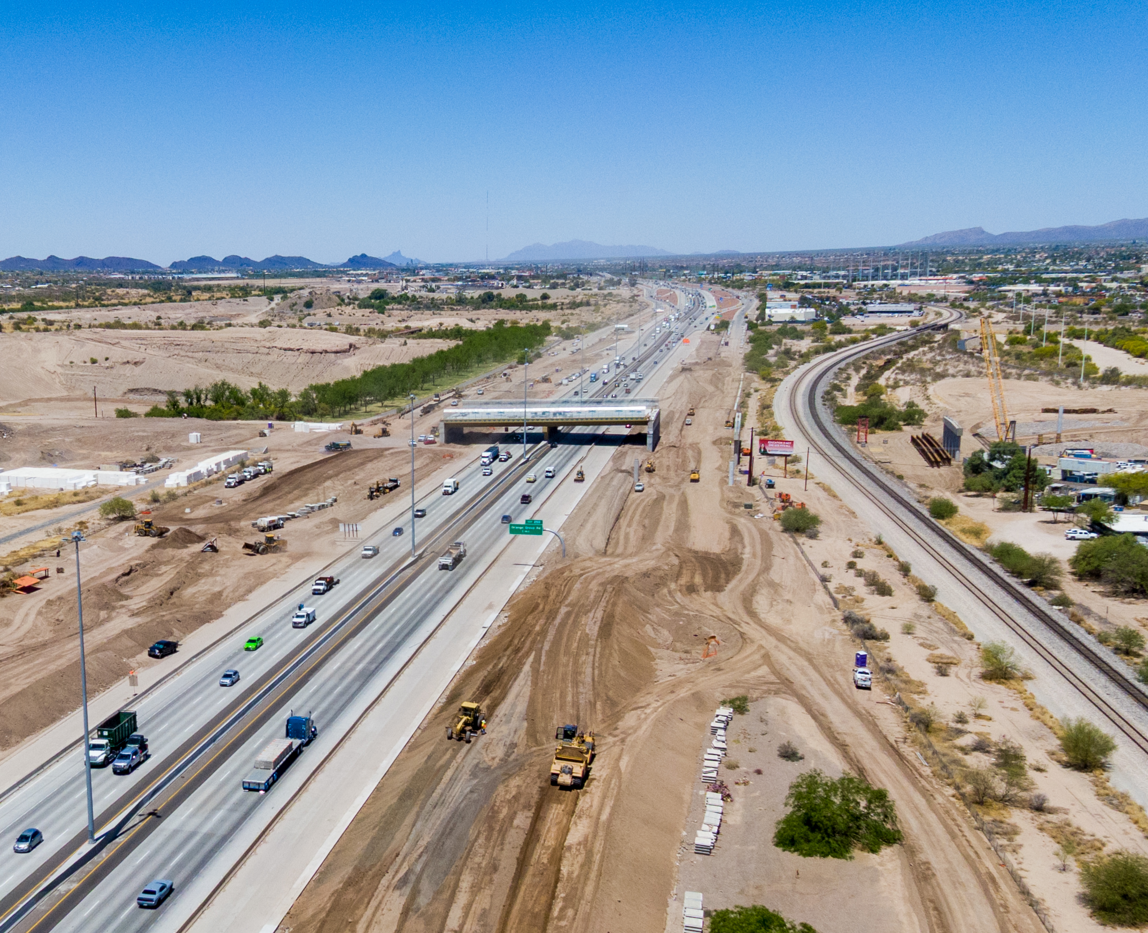
Delivering a new $2.67 billion regional transportation plan
Props 418 & 419
Election Outcome & Next Steps
Michael J. Ortega, P.E. | Executive Director

Slide 2
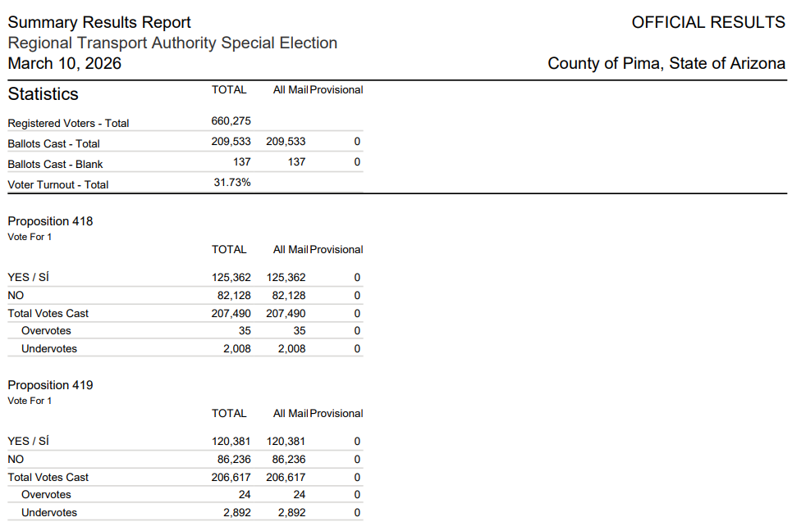
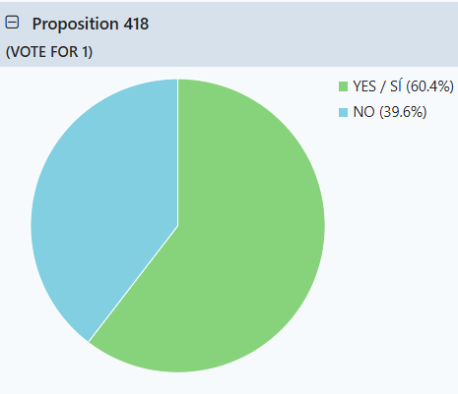
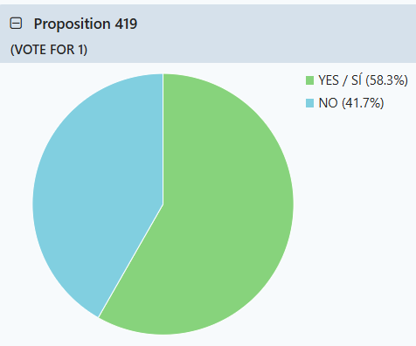
RTA Next election summary
Props 418 & 419 received >50% “Yes” votes in all jurisdictions
31.73% voter turnout
Prop 418 – 60.4% (Yes)
Prop 419 – 58.3% (Yes)
VOTER THANK YOU!

Slide 3

RTA Delivers: What to expect
New RTA revenue collections started April 1, 2026
Plan includes seven rescoped projects from 2006 RTA plan
Remaining 2006 RTA projects completed using RTA reserves and regional funds programmed through 2029
First period projects funded with new RTA funds + regional funds through 2031
Transit services continue; future expansion planning begins

Slide 4
Continued Accountability
RTA Board
CART Committee
Technical Management Committee
Quarterly analysis of project delivery and budget for ongoing accountability and openness to the public, committees and RTA Board
Audits
Annual independent financial audits
State-mandated performance audits every 5 years
RTA meetings open to the public; materials and information on the RTA website
Published RTA Annual Report

Slide 5

Thank you!
Community presentations available for ongoing public education
Stakeholders can continue to share RTA news and updates via their respective newsletters to others
You can stay informed
Visit RTAmobility.com
Sign up for news and notices online or via email at info@RTAmobility.com
Meetings open to the public; meetings streamed on YouTube
Quarterly tracking reports and project information available online
Tune in to RTA Delivers podcast
Follow us on Facebook, Instagram, LinkedIn and YouTube
Notes:
Note: QR Code allows you to sign up and receive a copy of our newsletter

