Slide 1
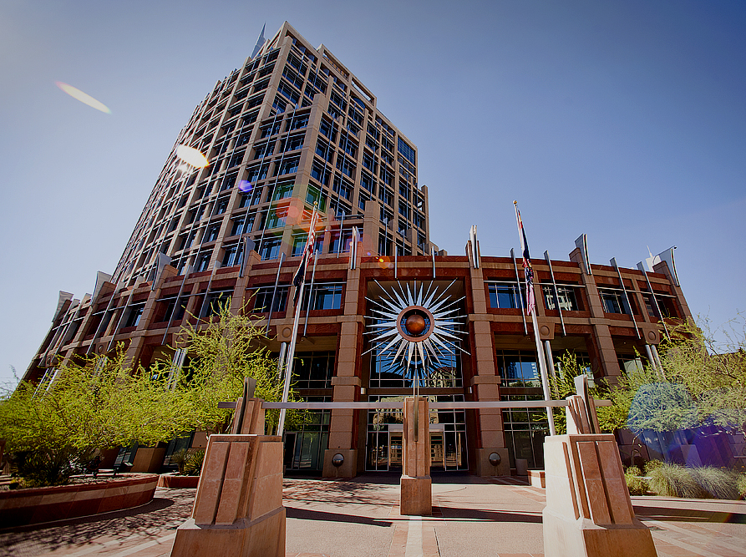
Bond Program
Fiscal Capacity Committee
August 25, 2026

Slide 2
Agenda
2023 GO Bond Program Status
Stages of Project Execution
Project Execution Challenges
Project Execution Resources
2023 Lessons Learned and 2028 Changes
GO Bond Programs Background

Slide 3
GO Bond Program Background
The City has a long history of issuing GO bonds
Phoenix voters have approved 13 bond programs since 1957, totaling $5.1 billion
2023 GO Bond Program approved for $500M
GO Bonds were issued in 2024 (1st Tranche); next issuance planned for fall 2026 (2nd Tranche)
GO Bonds are issued for major capital infrastructure with specific legal restrictions and financial considerations.

Slide 4
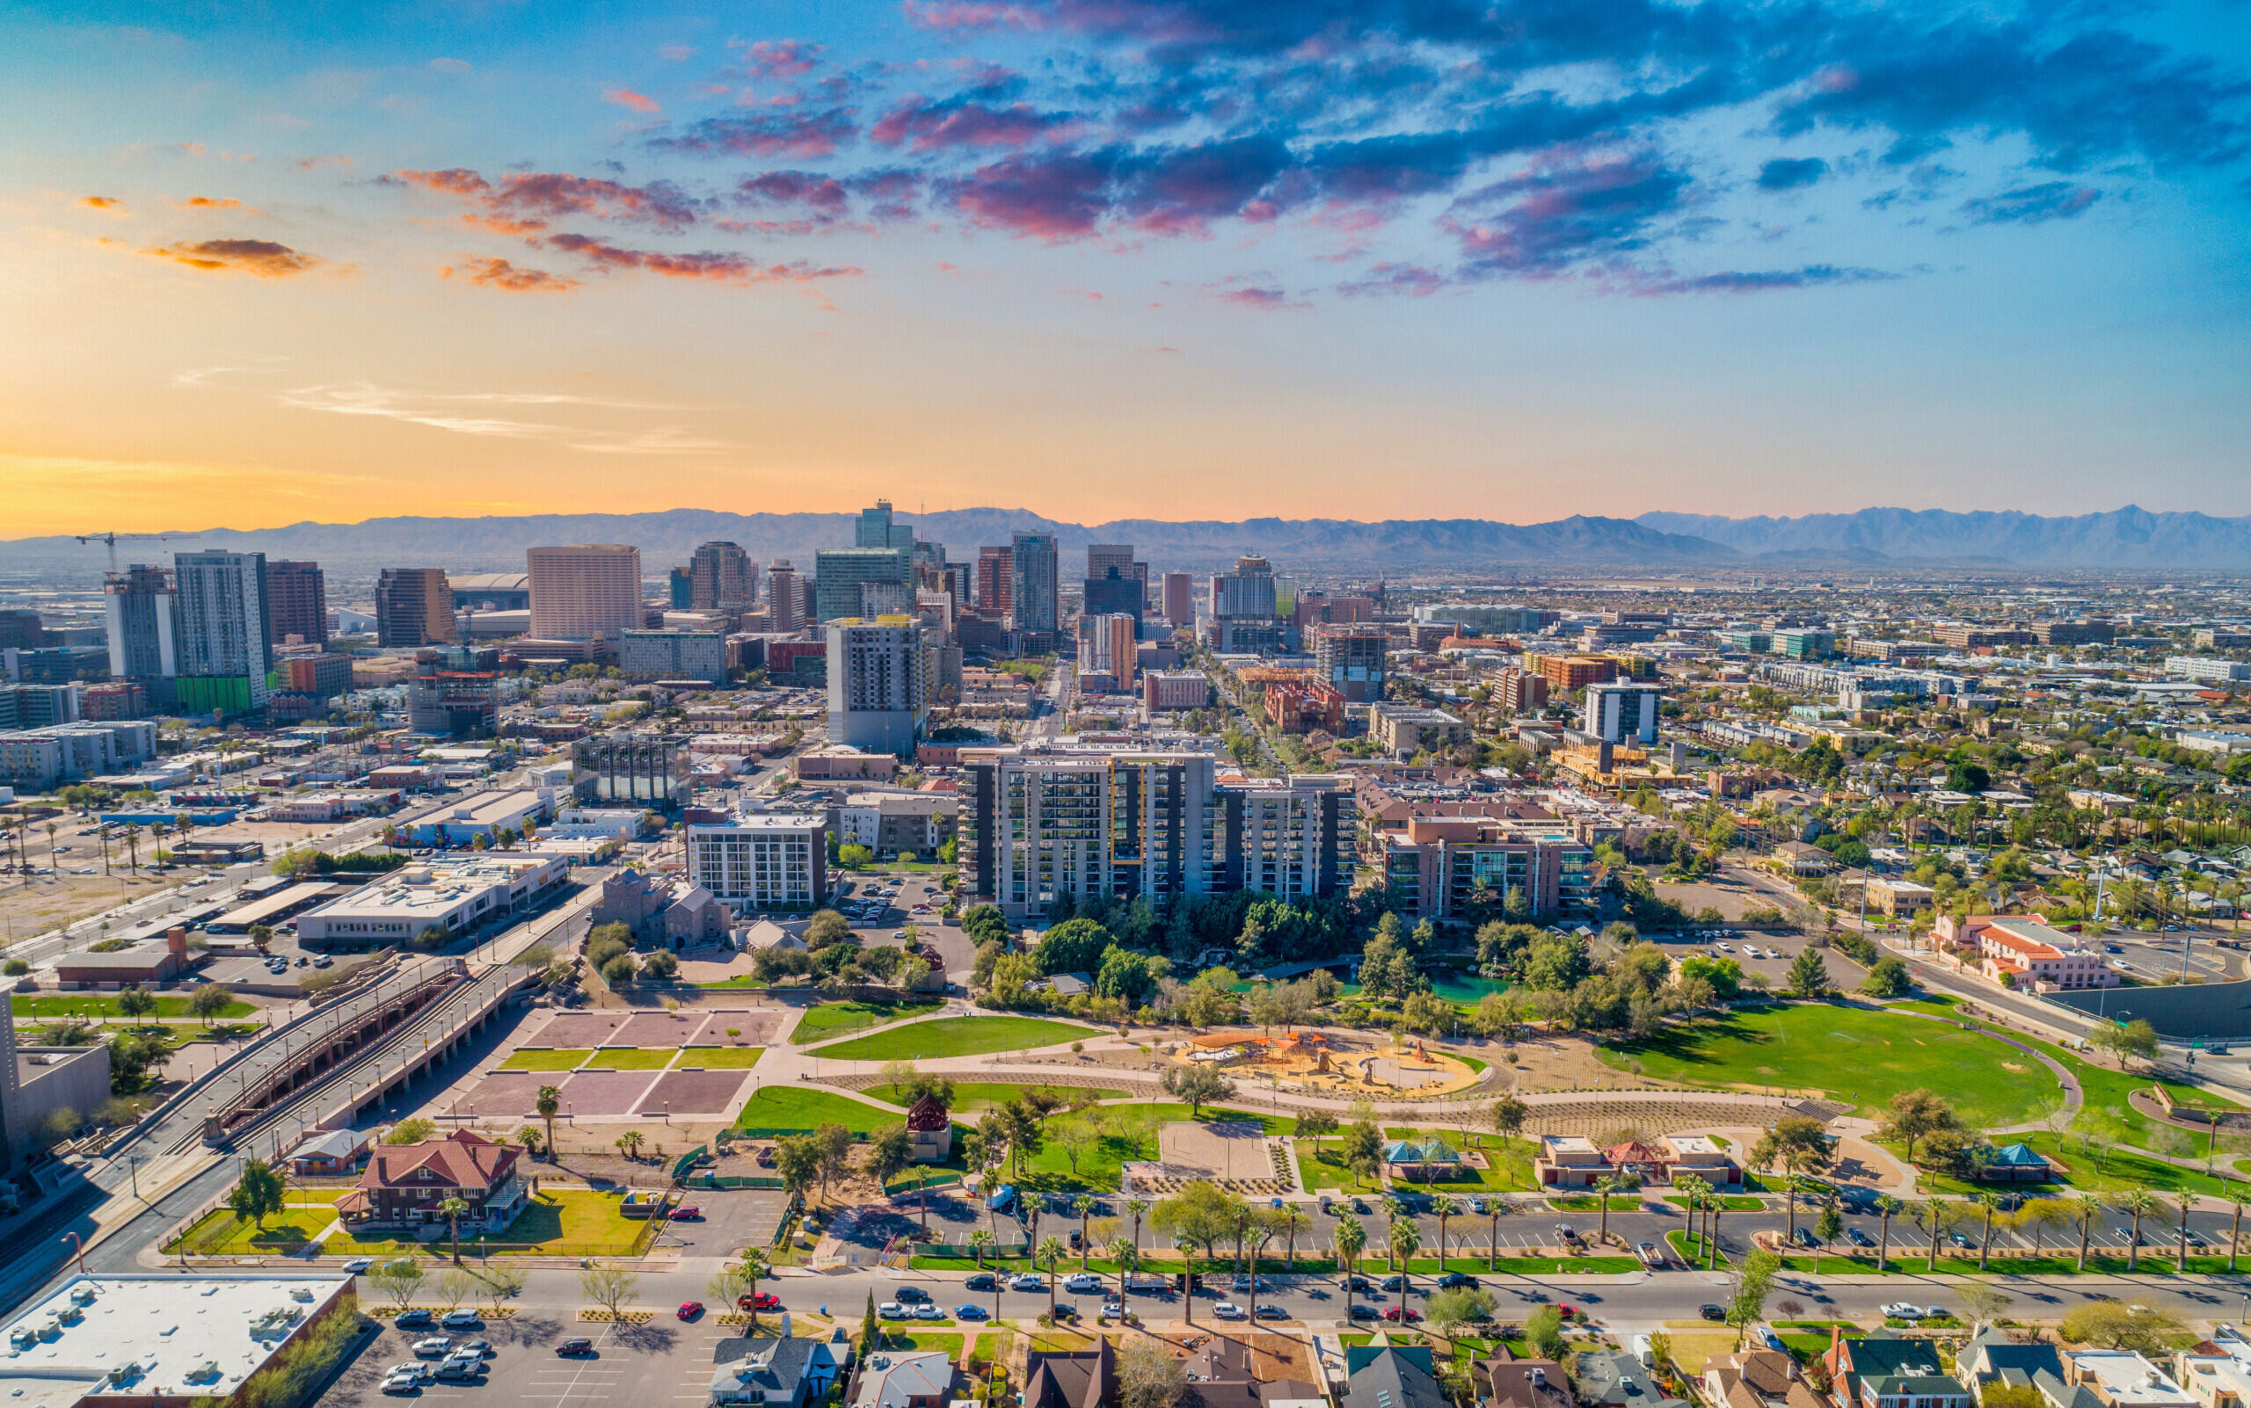
2023 GO Bond Program Status

Slide 5

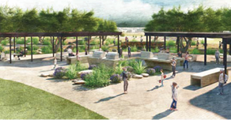
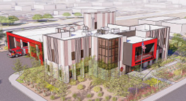

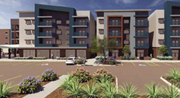
2023 GO Bond Program
$500M
Voter Approved Propositions:
$214M - Enhance Community Safety through Fire, Police, Roadway and Pedestrian Infrastructure
$109M - Improve Quality of Life in Phoenix Neighborhoods
$114M - Create a Modern, Sustainable Phoenix to Live and Work
$63M - Enhance, Preserve and Increase the Supply of Affordable Housing and Senior Centers

Slide 6
2023 GO Bond Program
$500M
14 Departments
Arts & Culture (7)
Community & Economic Dev (3)
Fire (4)
Floodplain (3)
Heat Resilience
Housing (5)
Human Services (2)
Library (3)
Environmental Programs
Parks (10)
Planning & Development (2)
Police (3)
Public Works (3)
Street Transportation (3)
Support Functions
City Engineer
Budget & Research
Finance
Law

Slide 7
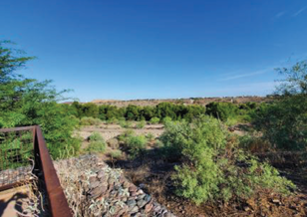
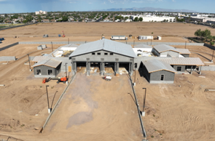
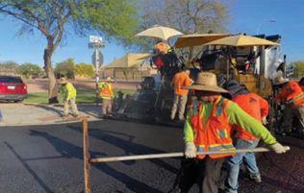
Projects Underway
Rio Reimagined Land Acquisition - $23M
Community and Economic Development will begin community engagement & concept plan development for the site.
Fire Station 15 (45th Ave and Camelback) - $21M
Opening Fall 2026
Pavement Maintenance/Storm Drain - $81M
58 projects completed or underway, and many more to come!
July-2026-GO-Bond-Status-Update.pdf

Slide 8
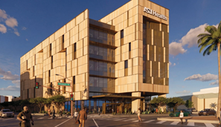
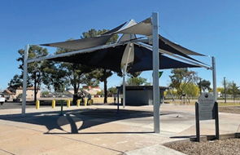
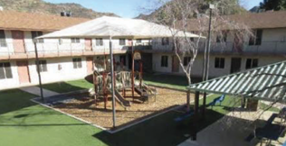
Projects Underway
Arizona State University Health Technology Center- $11.9M
April 2026 Groundbreaking
Opening Fall 2028
Heat Resilience - $7.6M
Tree planting, shade structures, reflective surfaces and green stormwater infrastructure at multiple sites throughout the City.
Affordable Housing Property Preservation - $32.8M
Four Projects under construction – Eight more planned.

Slide 9
2023 GO Bond Program Spending
85% Spend
1st Tranche (Est.)
85% Spend 2nd Tranche (Est.)
$108,784,898 (43.6%)
2nd 2023 Tranche Issuance

Slide 10
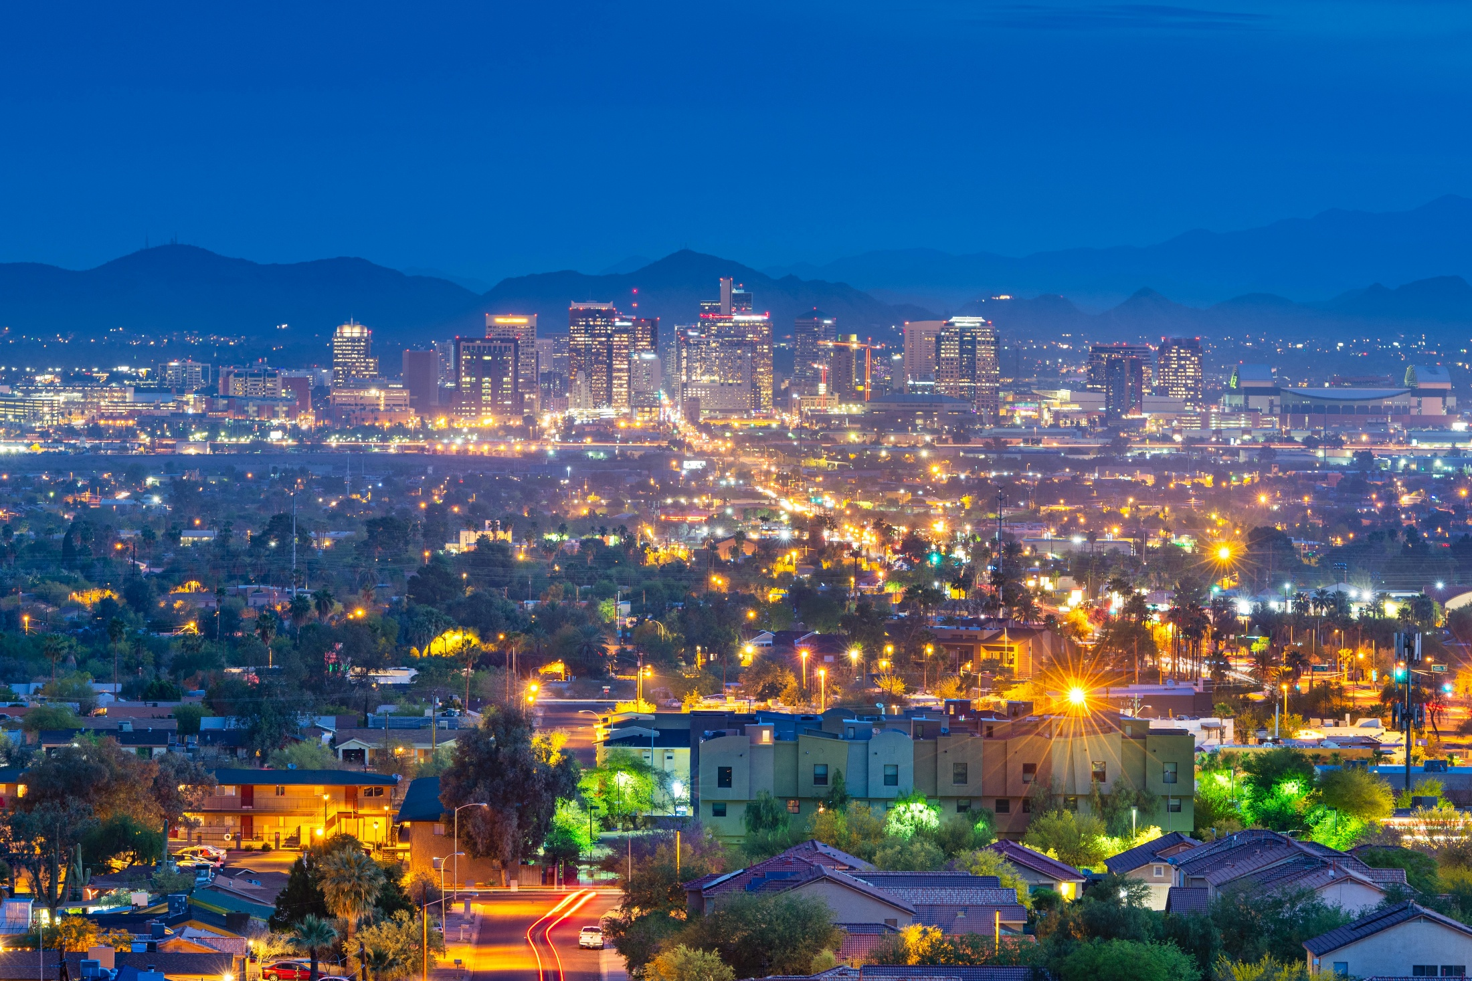
Stages of Project Execution

Slide 11
Stages of Project Execution
Planning
Design
Construction
Feasibility
Studies
Procurement
Delivery
Method
Selection
Procurement
Project Assessments
Sustainability
Efforts
Contract
Execution
Project
Initiation
Property Acquisition
Environmental
Construction
Document
(Design)
Construction
Project
Closeout
6-8 Months
12-18 Months
12-24 Months

Slide 12
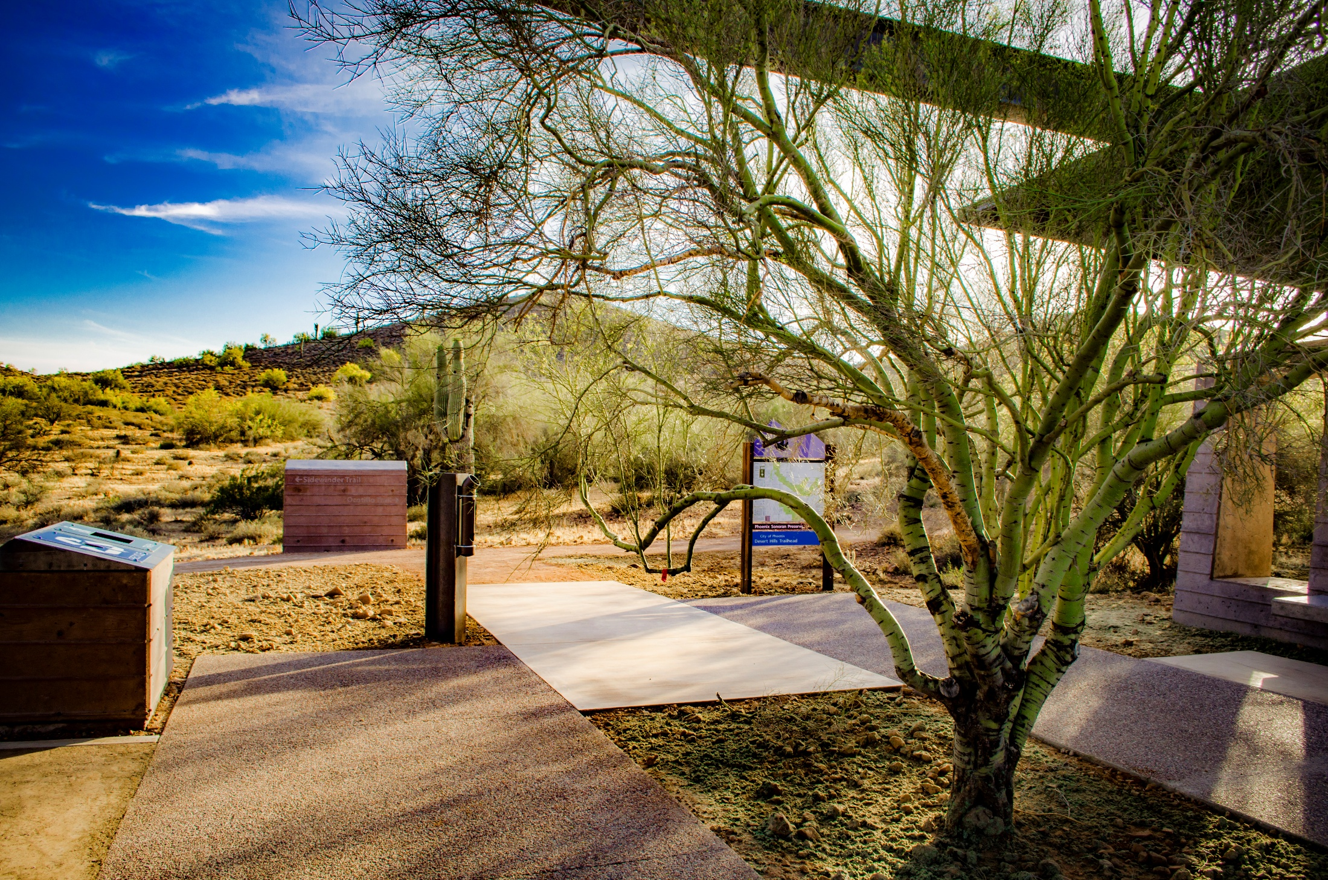
Project Execution Challenges

Slide 13
Project Execution Challenges
Existing $12B CIP
Limited Departmental Project Delivery Experience
Limited Comparative Costs
Limited Planning Efforts associated with 2023 GO Bond
Price escalations

Slide 14
Project Execution Challenges
Year | 2021 Inflation Factor | Actual/ Current Forecast
2022 | 7.7% | 11.5%
2023 | 2.7% | 5.2%
2024 | 2.2% | 2.2%
2025 | 2.0% | 1.2%
2026 | 1.8% | 2.8%
2027 | 2.1% | 2.6%
2028 | 2.1% | 2.4%
2029 | 2.1% | 2.2%

Slide 15
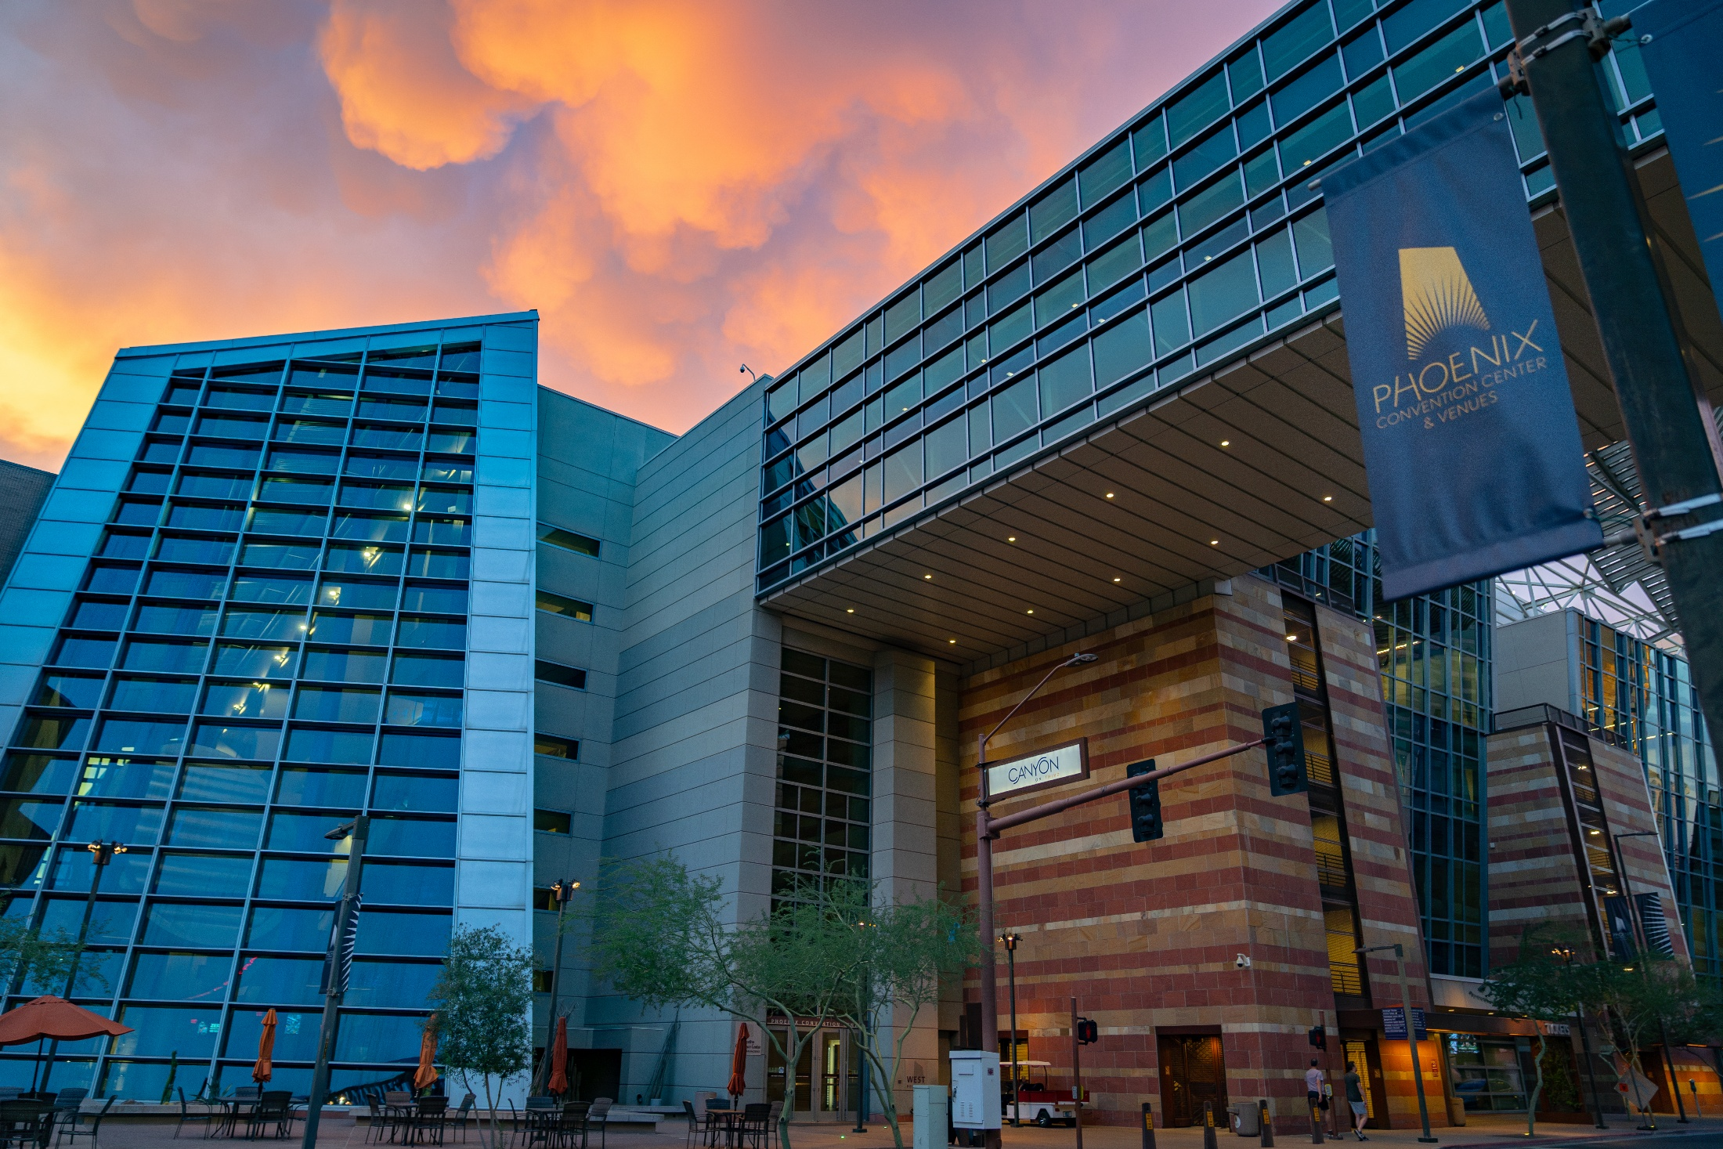
Project Execution Resources

Slide 16
Project Execution Resources
Monthly Meetings
Bi-Annual Meetings with CMO
Quarterly Reports (B&R)
https://www.phoenix.gov/administration/departments/budget/general-obligation-bond.html
City Managers Dashboard
https://cmpr-dashboard-phoenix.hub.arcgis.com/pages/1de04266616342a4bcd21e6f7f5dc351
Office of City Engineer (OCE)
  Procurement, Environmental, Project Management
Facility Review Committee (OCE/Public Works)
Notes:
Monthly Meeting
Monitor Progress
Share Lessons Learned
“Peer Pressure” towards success

Slide 17
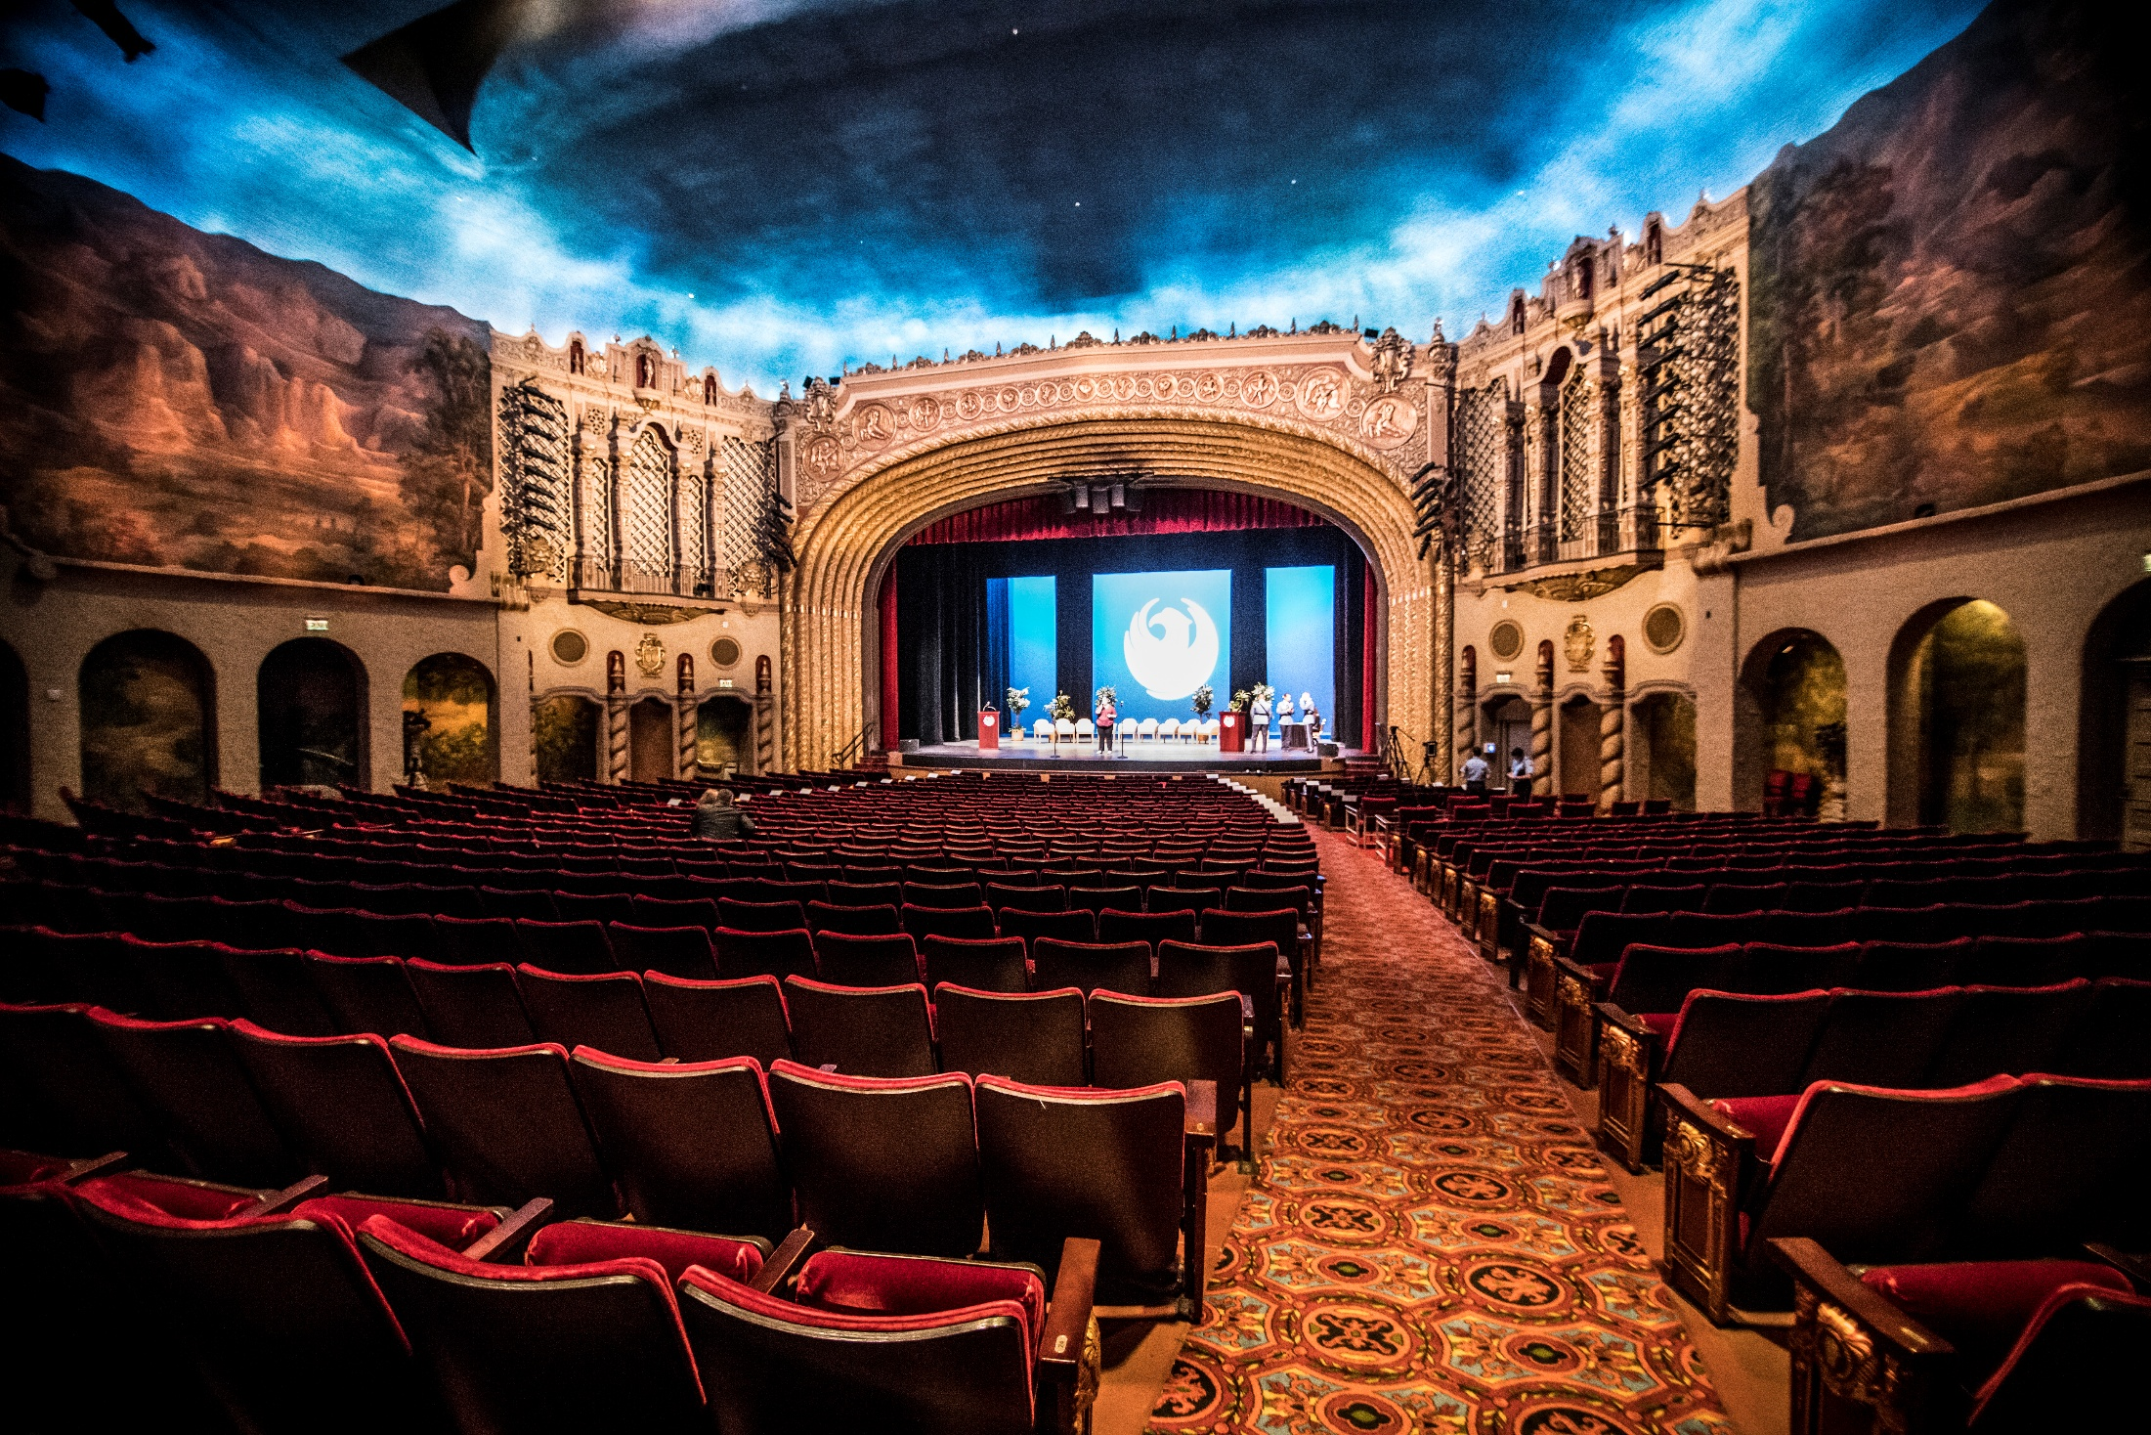
2023 Lessons Learned and 2028 Changes

Slide 18
2023 Lessons Learned and 2028 Changes
Careful Project Selection for Consideration
Balance between programs, projects, acquisitions
Earlier Procurement Initiation
Feasibility Study Emphasis
Advance Design Efforts
Greater support to Departments
Formalized Guidance to Non-Profit Partners
Dedicated department and OCE staff for execution
Notes:
Dedicated department and OCE staff for execution – SPA and Asst City Engineer

Slide 19
2023 Lessons Learned and 2028 Changes
Accelerate Design
Initiate Construction
More Consistent Delivery
Bond Issuance
Design/Feasibility
Procurement Underway or Complete

Slide 20
City Engineer’s Perspective
Project Needs are not lacking
2023 GO Bond will be delivered
Intent is all 2023 GO Bond projects will be complete or nearing completion prior to 2028 GO Bond
Confident in delivery of either option for 2028 GO Bond
Notes:
2023 Needs exceeded $1.2B

Slide 21
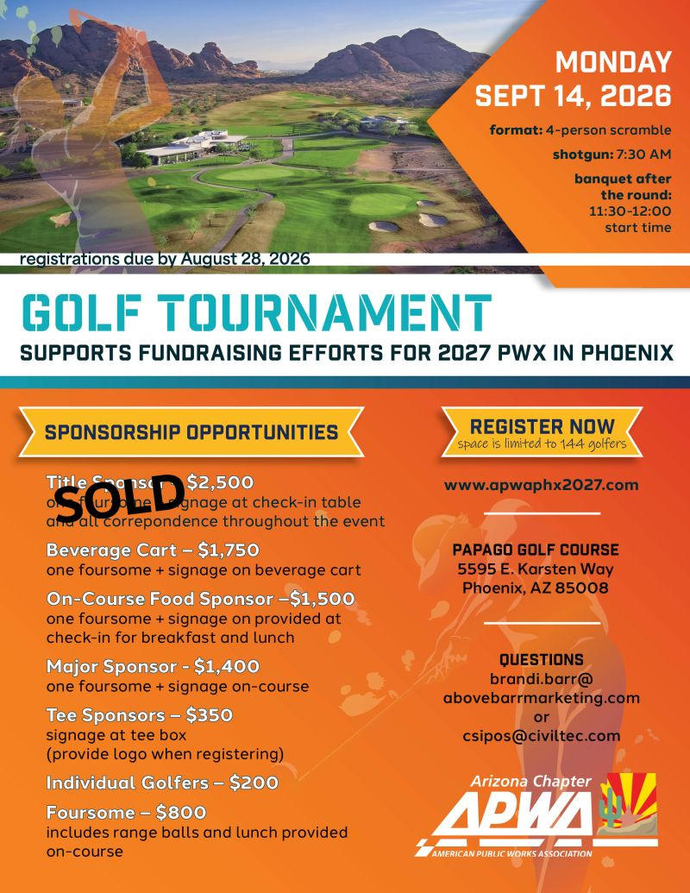

Notes:
2023 Needs exceeded $1.2B

Slide 22
Questions and Additional Discussion

