Slide 1
ADOT’s
Digital Delivery Program
2026 Update
March 4, 2026

Slide 2

Presentation Objective
ADOT’s
Digital Delivery Program
2026 Update
Update on Digital Delivery Initiative
Successes to Date
Today’s Efforts
Future Focus
2026 Goals and Strategies
Business Strategies
Deployment Strategies

Slide 3
01
Update on Digital Delivery Initiative

Slide 4
Digital Delivery Initiative
ADOT’s
Digital Delivery Program
2026 Update
Summary: Modernization of the project delivery process to develop and deliver high-quality, data-rich design models and data for use in design, construction and asset management - goal of no longer using traditional plan set formats.
Successes To Date
New Standards and Standard Work (ISO 19650, ProjectWise
Draft ADOT Modeling Standards
Draft Survey Specifications
ADCMS Grant Award
Peer Exchanges, DOT & FHWA Collaboration
Today’s Efforts
Piloting Common Data Environment
Establishing New Data/Design Quality Management Standards (NCHRP 10-113 & 1153)
Developing Deployment Strategies
Industry Collaboration (IHEEP, WASHTO, ACEC & AGC)
Future Focus
Model Progression Specification Standards (LOIN ISO 7817-1)
Workforce Development
Development of New Bridge, Drainage, & Utility Modeling Standards
Pilot Data Quality Mgmt.
Define ADOT’s Digital Data Lifecycle

Slide 5
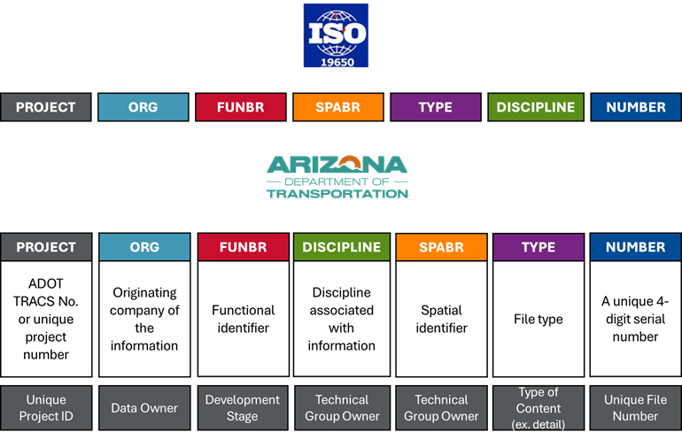
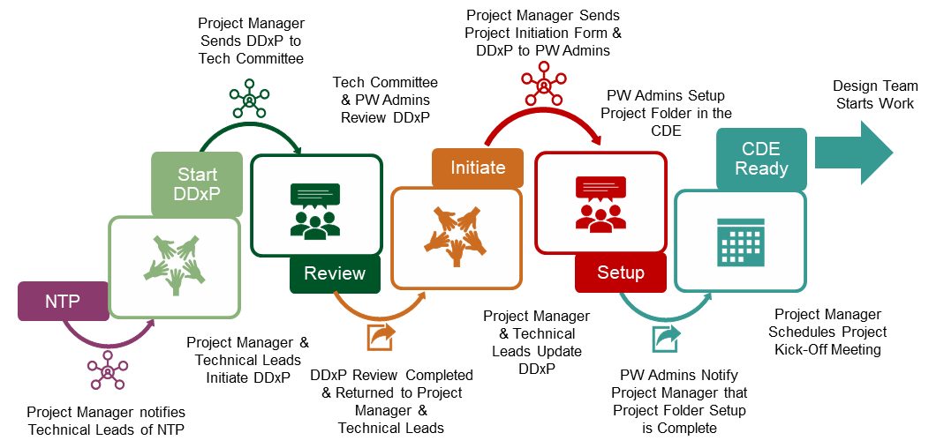
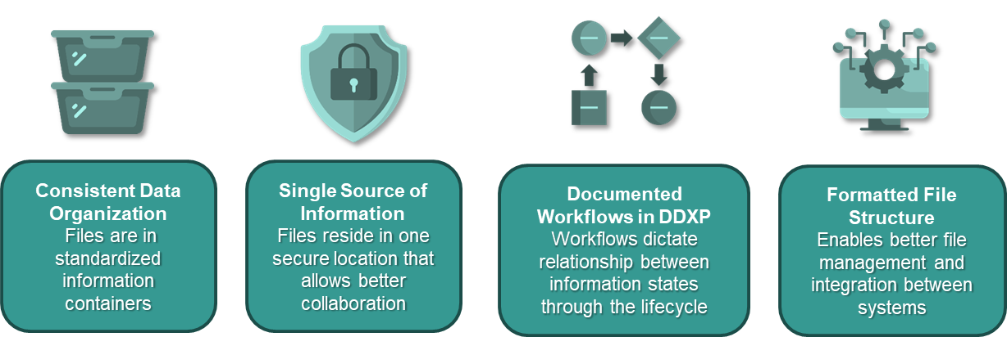
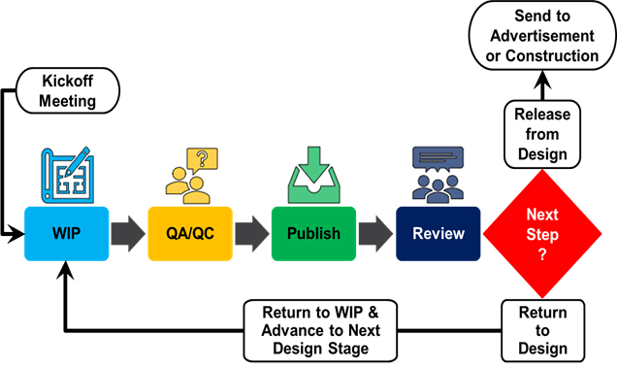
ADOT’s Approach with ISO 19650
ADOT’s
Digital Delivery Program
2026 Update
Standardized File Naming & Organization
Standardized Project Setup and Initiation Process
Geographic Location
Common Data Environment for Design
Standardized Design & Review Process

Slide 6
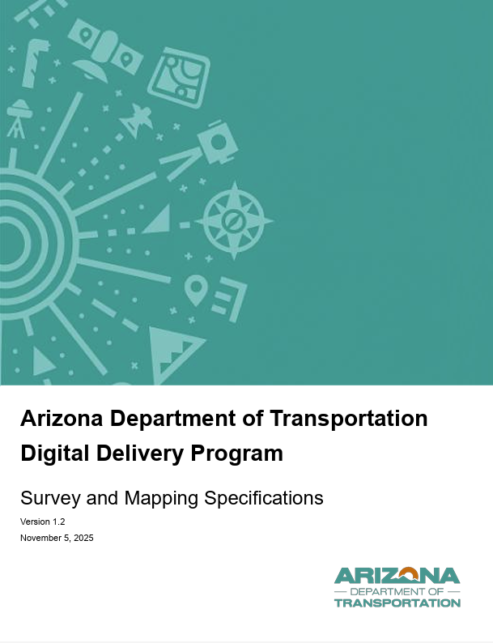
ADOT’s
Digital Delivery Program
2026 Update
Survey & Mapping Specifications
Digital Delivery Mapping Needs
Reference Frames
Epoch
Horizontal Reference Frame & Projection
Vertical Reference Frame & Geoid
Units & Scale Factors
Using Legacy Data
Survey Control Specifications & Accuracy Classes
Accuracy and Verification
Control Network
Metadata
QA Review
File Specific Data Guidelines
Deliverable Requirements
Workflows & Standard Work
Checklists & templates
Survey Codes
Survey QA

Slide 7
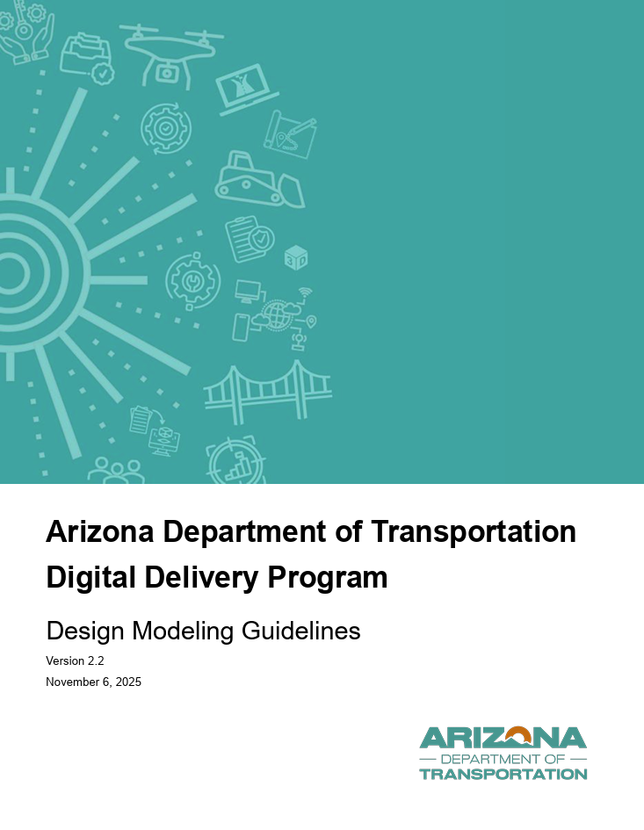
ADOT’s
Digital Delivery Program
2026 Update
Design Modeling Guidelines
Digital Delivery Program Overview
Digital Delivery Execution Plan (DDxP)
Project Initiation
Model Development & Review
Model Architecture & Discipline Based Models
Naming Conventions
Organization
Workflow and Dataflow
Model Progression and Level of Information Need
Quality Management
Model Validation
Review Checklists
Deliverables and Submittal Process
Model and Data Handoffs
Construction & As-Built Integration

Slide 8
03
2026 Goals and Strategies

Slide 9
Digital Delivery Initiative
ADOT’s
Digital Delivery Program
2026 Update
Business Strategies & Goals for 2026
ADOT Digital Delivery Leadership Focus
Digital Delivery - Program Manager
Advancing Use of Digital Technologies, Data Generation and Workflows from Survey - Design - Construction
Digital Delivery - Common Data Environment Manager
Advancing and Standardizing CDE, Workflow, and Modeling/Design/Survey Standards
2. Industry Collaboration
State DOTs and FHWA
ACEC & AGC
Risk Register Management
BIM For Infrastructure Pooled Fund
3. Training & Communication
Training Modules - ADOT and Community Availability
Website Update - Communicatio, Standards, Documentation, Guidance
Educational Institutions and Other Agencies and Organizations
4. Bentley Versioning & PW Deployment
Bentley Versioning
New Projects: 2024
On-Going Projects
Prior to Stage 3: Upgrade to 2024
At Stage 4 or 5 may elect to remain at 10.12
**If consultant is working outside of ADOT PW Environment.
ProjectWise
New Projects (upon approval)

Slide 10
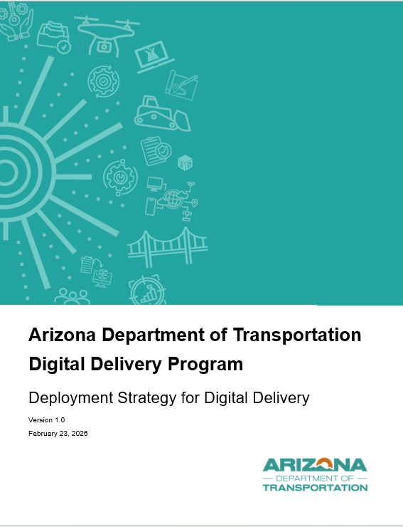
Digital Delivery Initiative
ADOT’s
Digital Delivery Program
2026 Update
Deployment Strategies for 2026
Testing End-to-End Workflow Threads
Pilot Standards
Validate Workflow
Evaluate Tools
FY27 Targeted Pilot Project (Types)
2 Pavement Preservation Projects
2 Pavement Rehabilitation Projects
2 Modernization Projects
1 Expansion Project
Survey
Modeling
Reporting & Quantities
Handoff
Key Elements for Success
Know our Constraints & Address
Defined Pilot Project Objectives & Measurements
Communication & Feedback

Slide 11
Digital Delivery Initiative
ADOT’s
Digital Delivery Program
2026 Update
Practice Constraints for 2026
Model as a Legal Document (MALD)
Current Workspace, including industry, is not fully ready for MALD. PDF and Sealed Documents will remain the official contract record.
Signing/Sealing Models (digital data/records) needs to be addressed in state regulations.
Business Constraints for 2026
State In-House Design and Consultant Designers Collaboration (same direction)
What one learns and applies, needs to be shared with others.
Different Project Delivery Methods, Roles & Responsibilities
Uncertainty of impact to project design schedule and cost.
Training and Communication for ALL stakeholders.

Slide 12
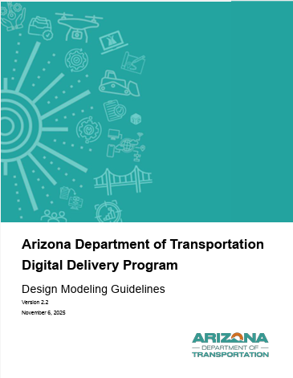
Digital Delivery Initiative - 2026 Goals
ADOT’s
Digital Delivery Program
2026 Update
Deployment Strategy - Survey to Design Focus
Utilize Survey Request Workflow, Form & Classification Tables
Capture Survey QA/QC Forms and Control Reports in CDE
Accuracy & Point Density Standards based on project type.
Survey Working Group Organization
Survey, Design, Construction, GIS
Opportunity Considerations
Capture Targeted As-Built Survey Data and update (as-built) Model Geometry and Attributes.

Slide 13
Digital Delivery Initiative - 2026 Goals
ADOT’s
Digital Delivery Program
2026 Update
Deployment Strategy - Modeling Focus
Validate DDxP Process and Documentation
Roles, Deliverables
Deliverables
Platforms
For Select Asset Categories (ex. Signs, Barriers), export model derived GIS data sets and evaluate alignment between platforms.
Validate Model Data and Workflow
Development: LOIN, Authoring, Federated Filing, Pay Codes, Feature Definitions
Quality Checks & Review
Quantity Reports
Handoff
Use Bentley Infrastructure Cloud as the primary model review environment for internal and external stakeholders
Modeling & Workspace Working Group Organization
Survey, Design, Construction, GIS
Opportunity Considerations
Model Review/Validation with Contracting Community

Slide 14
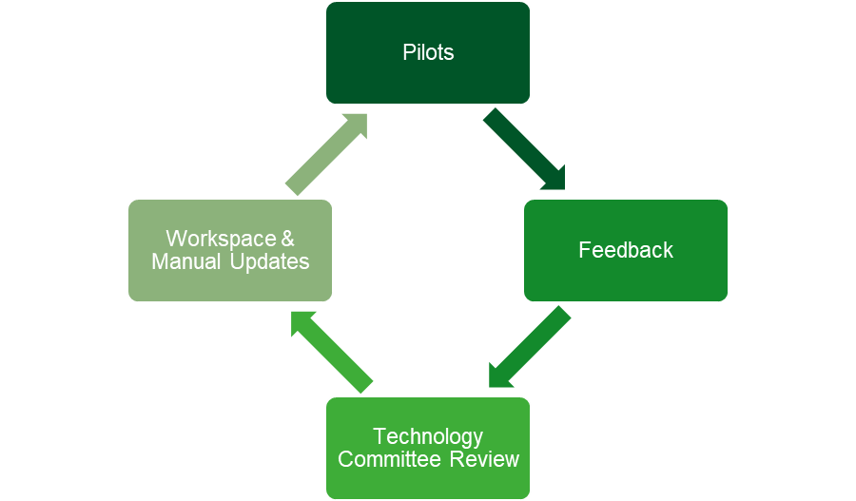
Digital Delivery Initiative - 2026 Goals
ADOT’s
Digital Delivery Program
2026 Update
Deployment Strategy - Feedback and Measurement
Post Workshop Survey and Readiness Scorecards
Project Level and Workspace Level Testing (ex. DDxP, PW Updates, etc.)
ProjectWise Working Groups
Survey
Modeling & Workspace
Project Level Testing
Workflow and Data Exchange
Risk Register Update & Planning
Opportunity Considerations
Future Digital Delivery Dashboard
Deployment Goals
Manual/Guidance Update
Pilot Metrics
Peer Exchange and Training Opportunities
Training Opportunities and Progress

Slide 15


